Slide 1
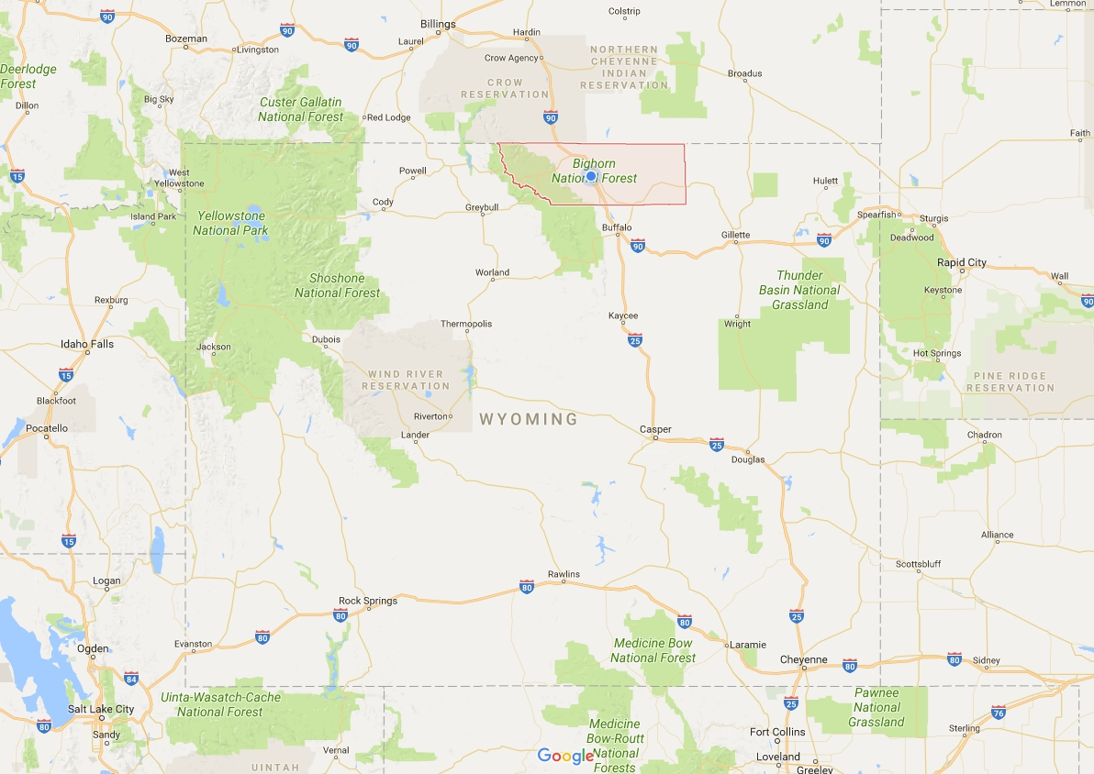

Slide 2
2016

Slide 3
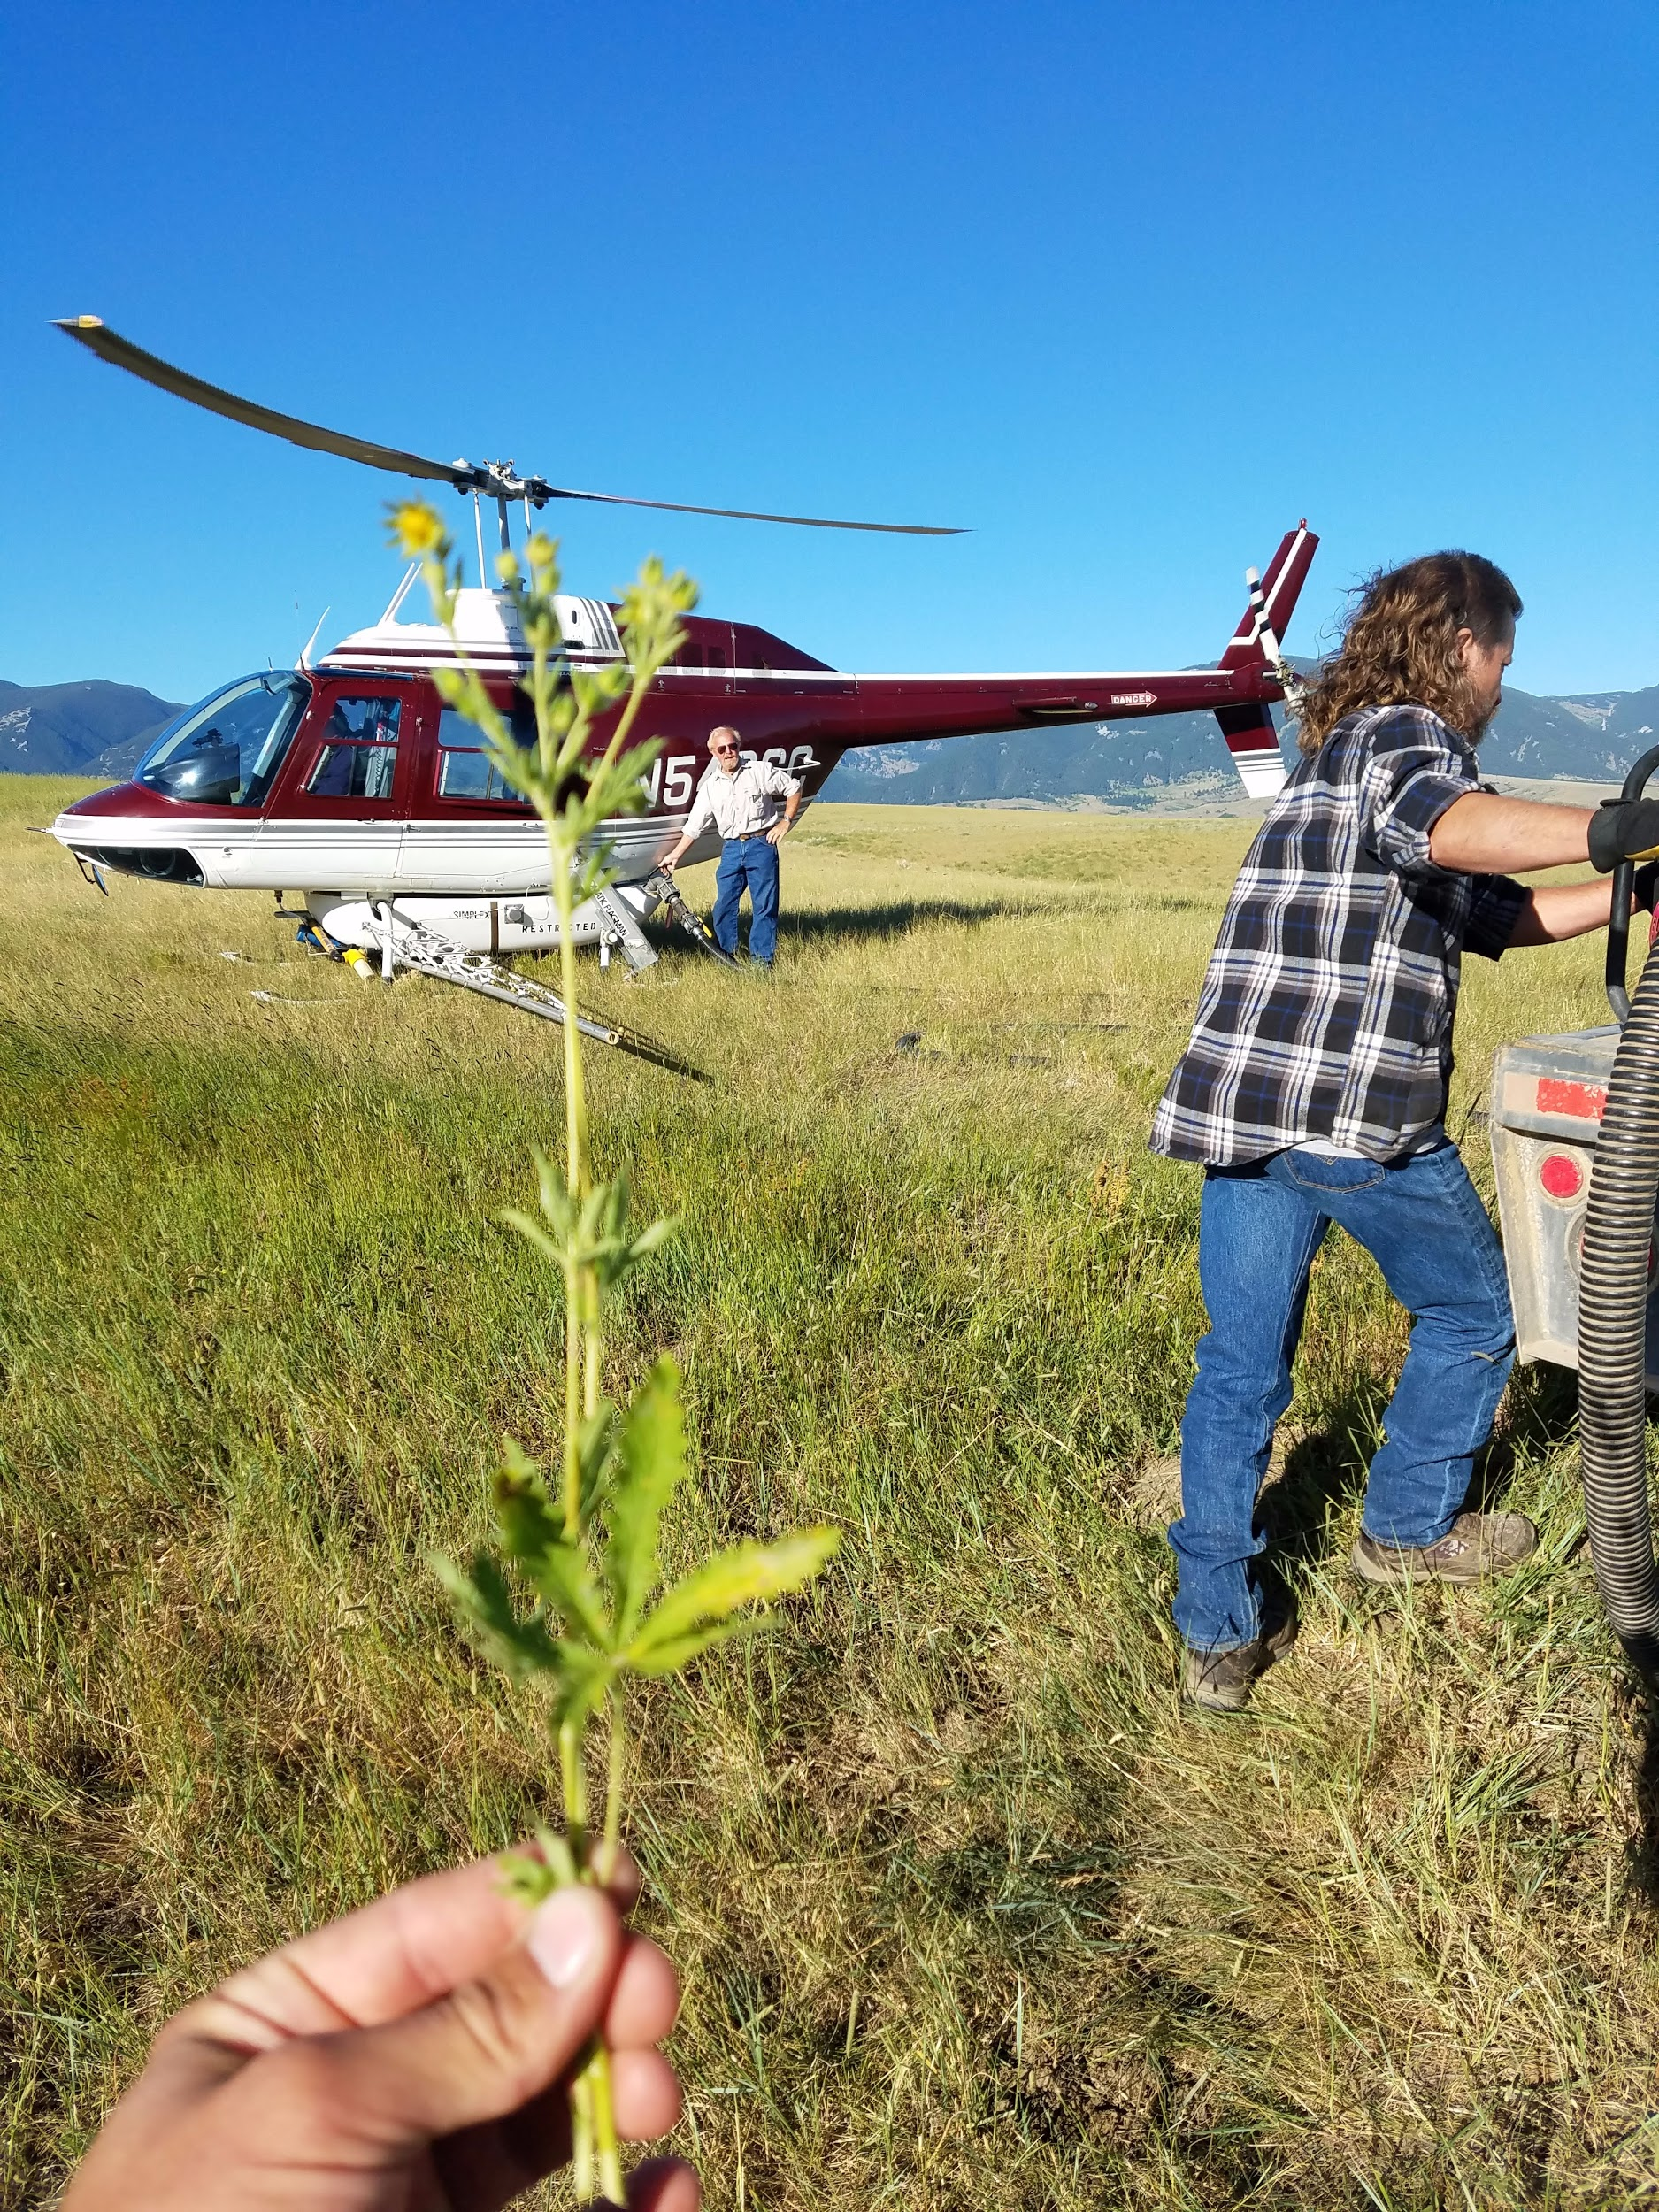
Sulphur cinquefoil (Potentilla recta)

Slide 4
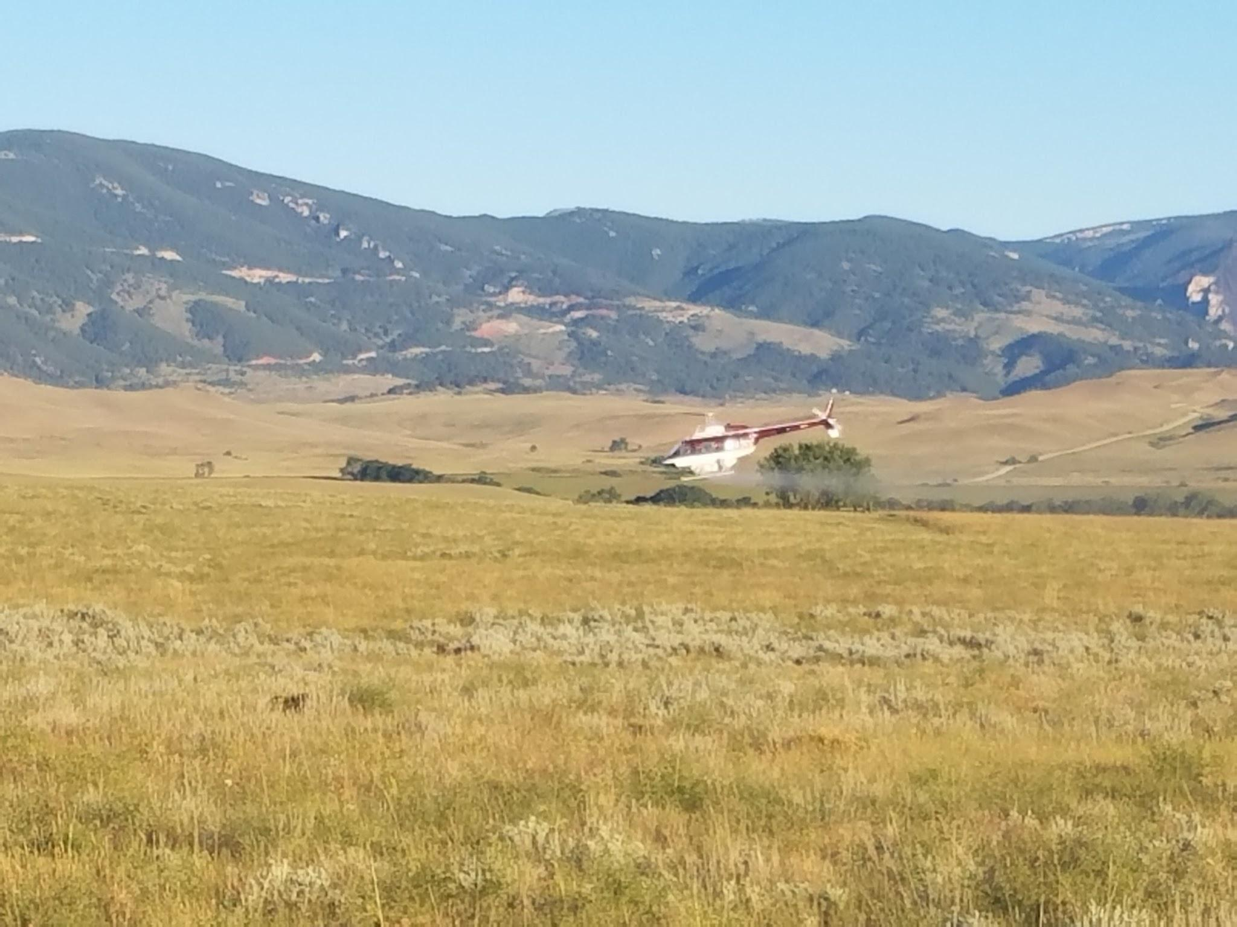

Slide 5
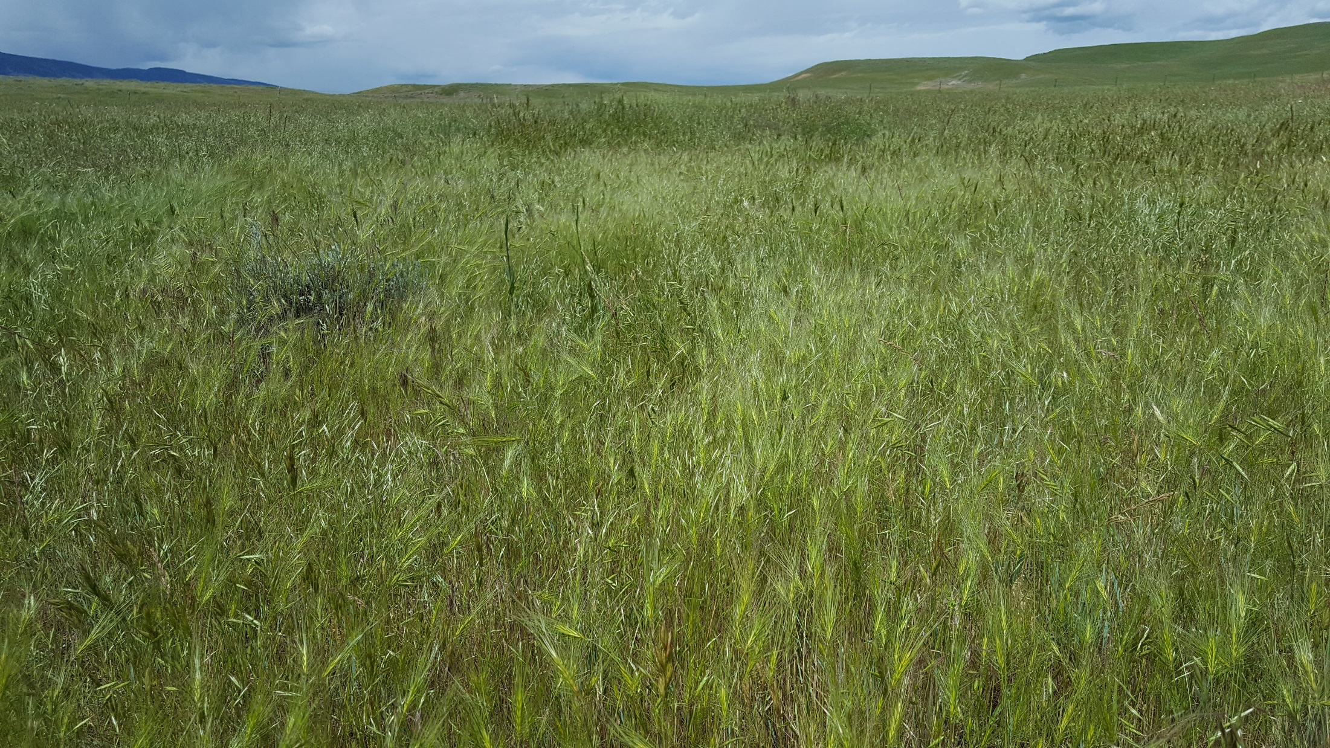

Slide 6
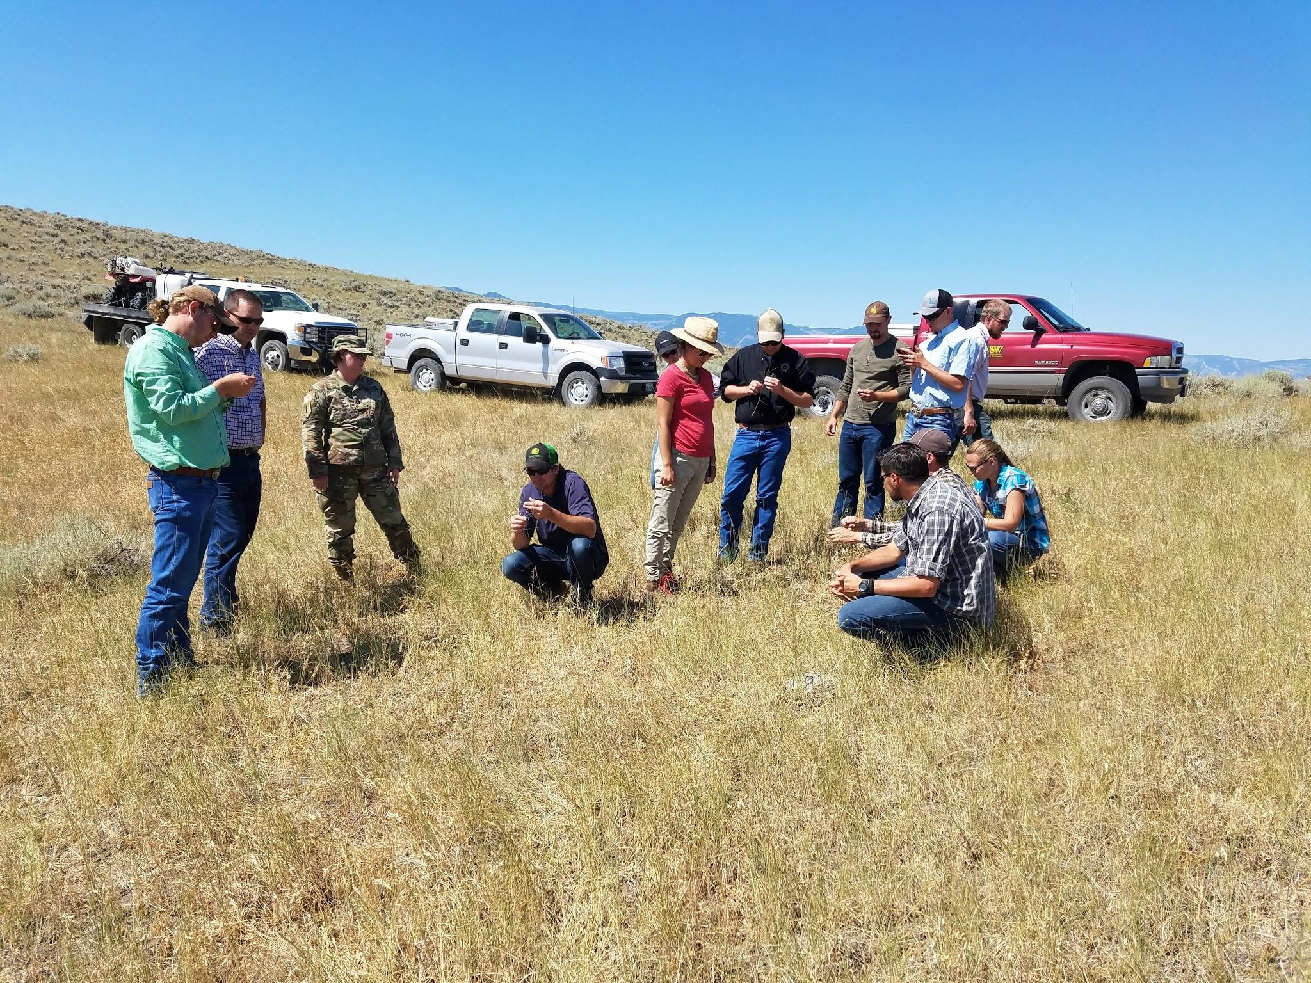
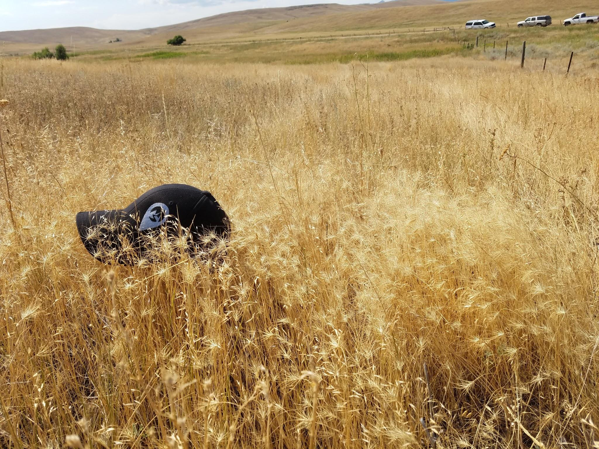
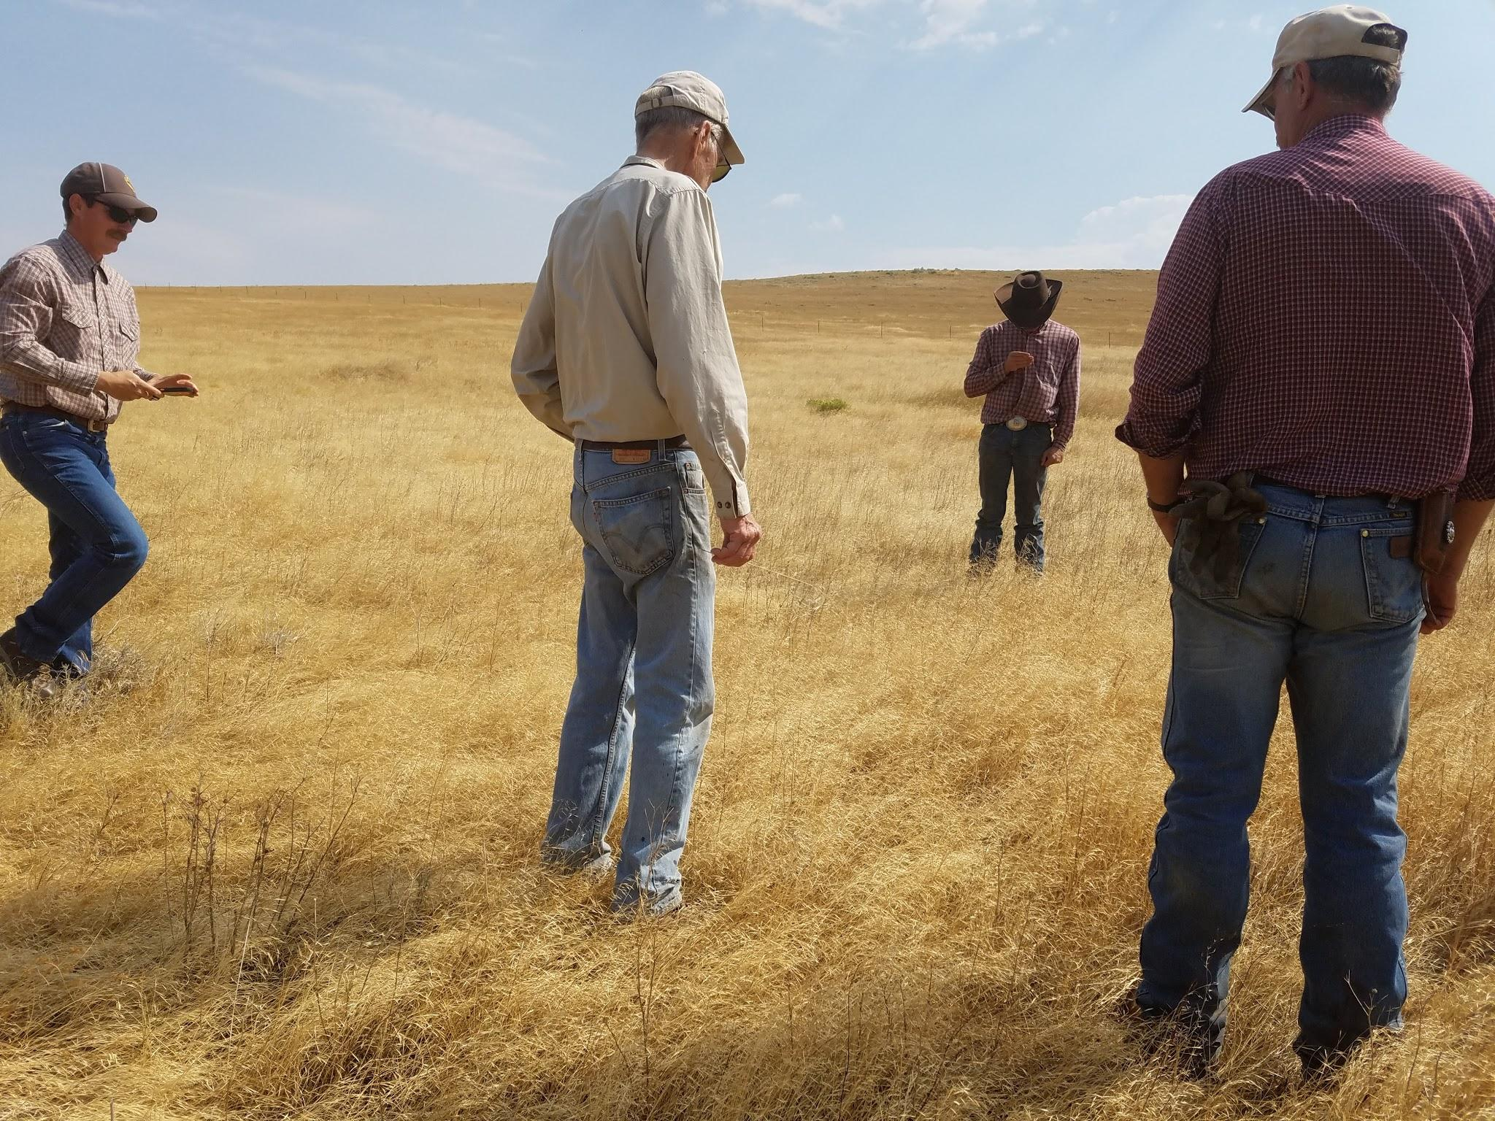
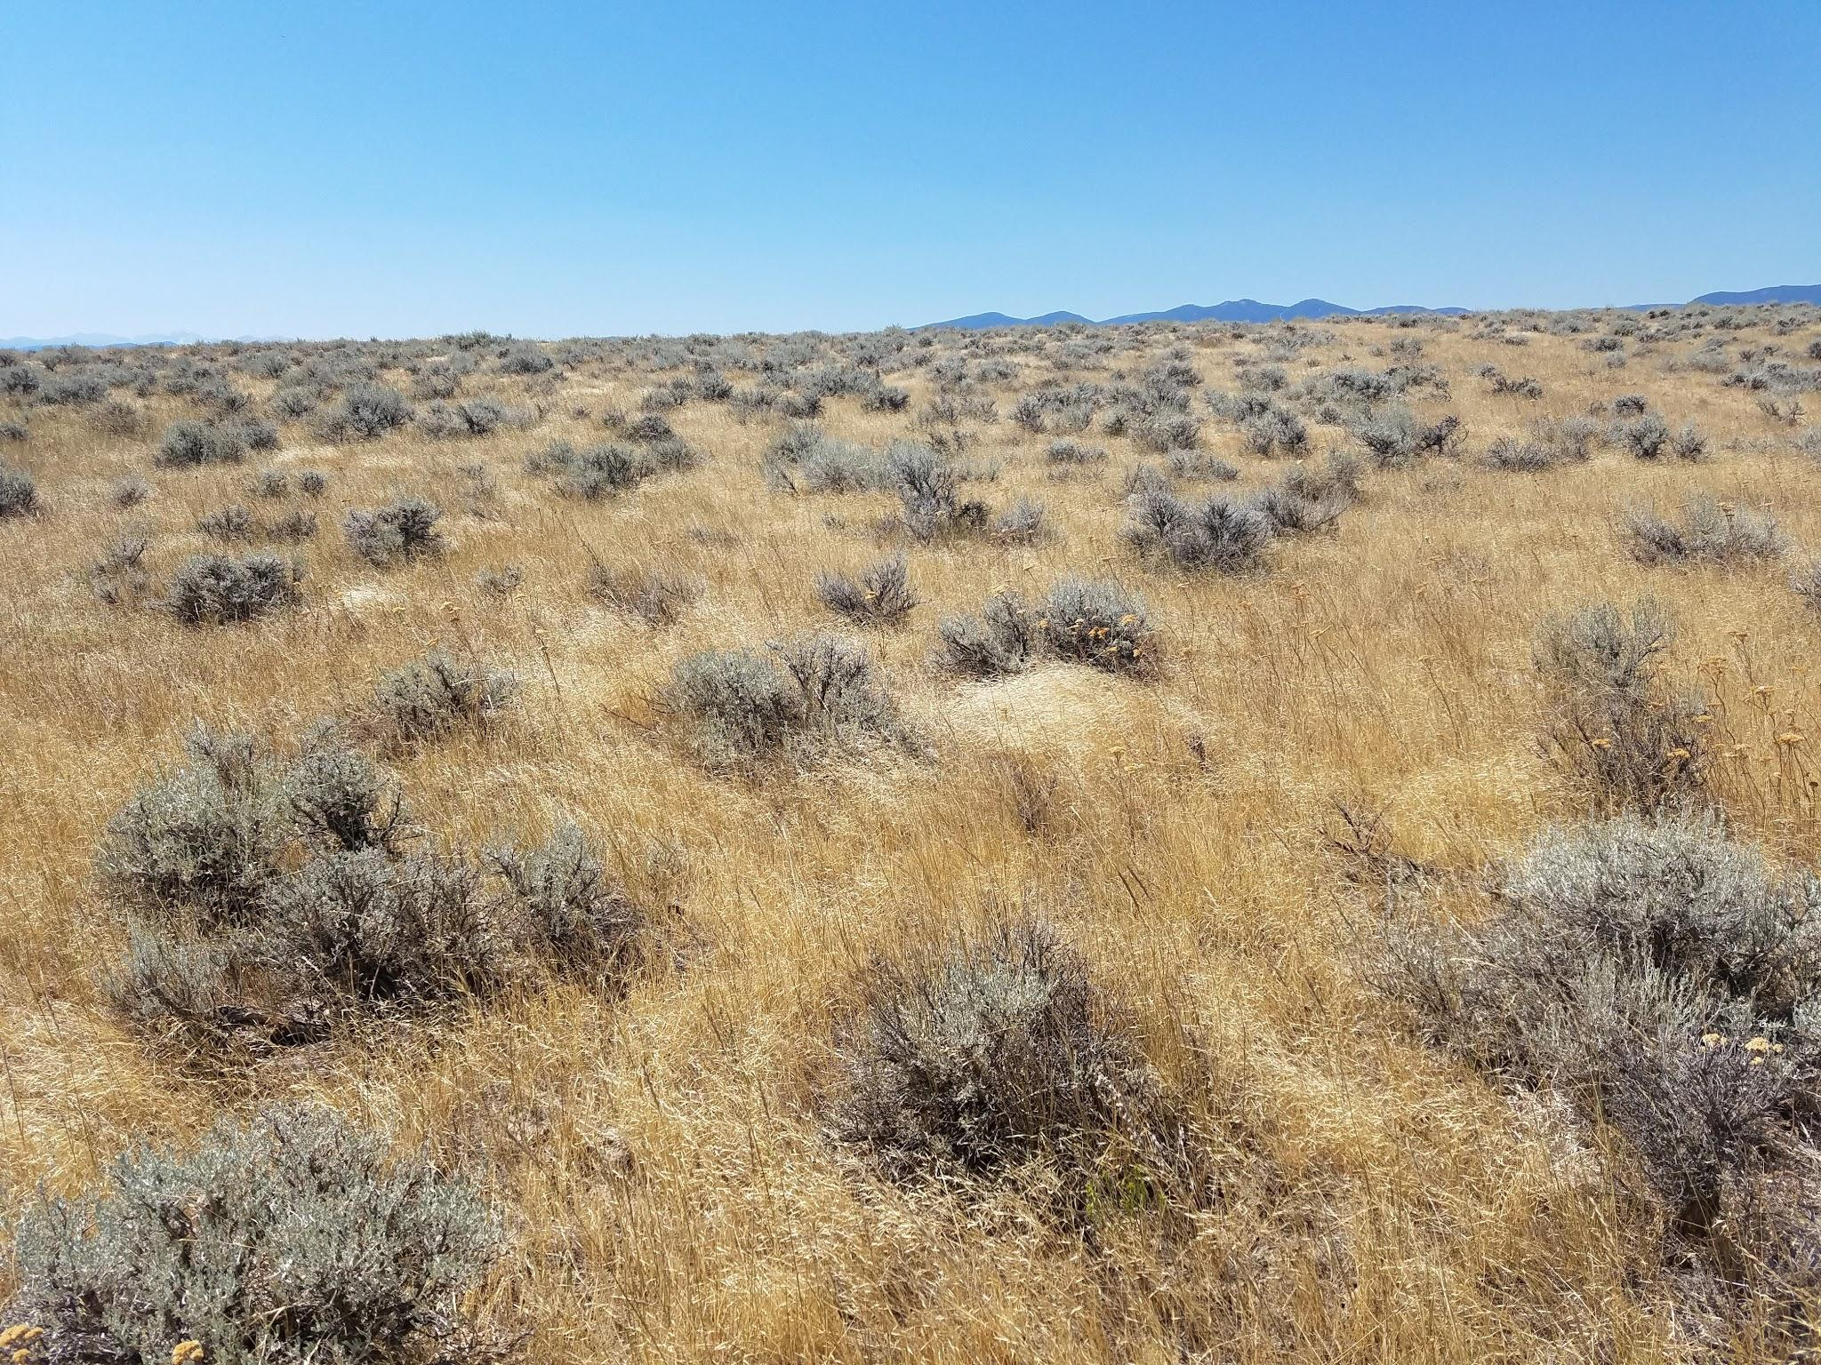

Slide 7
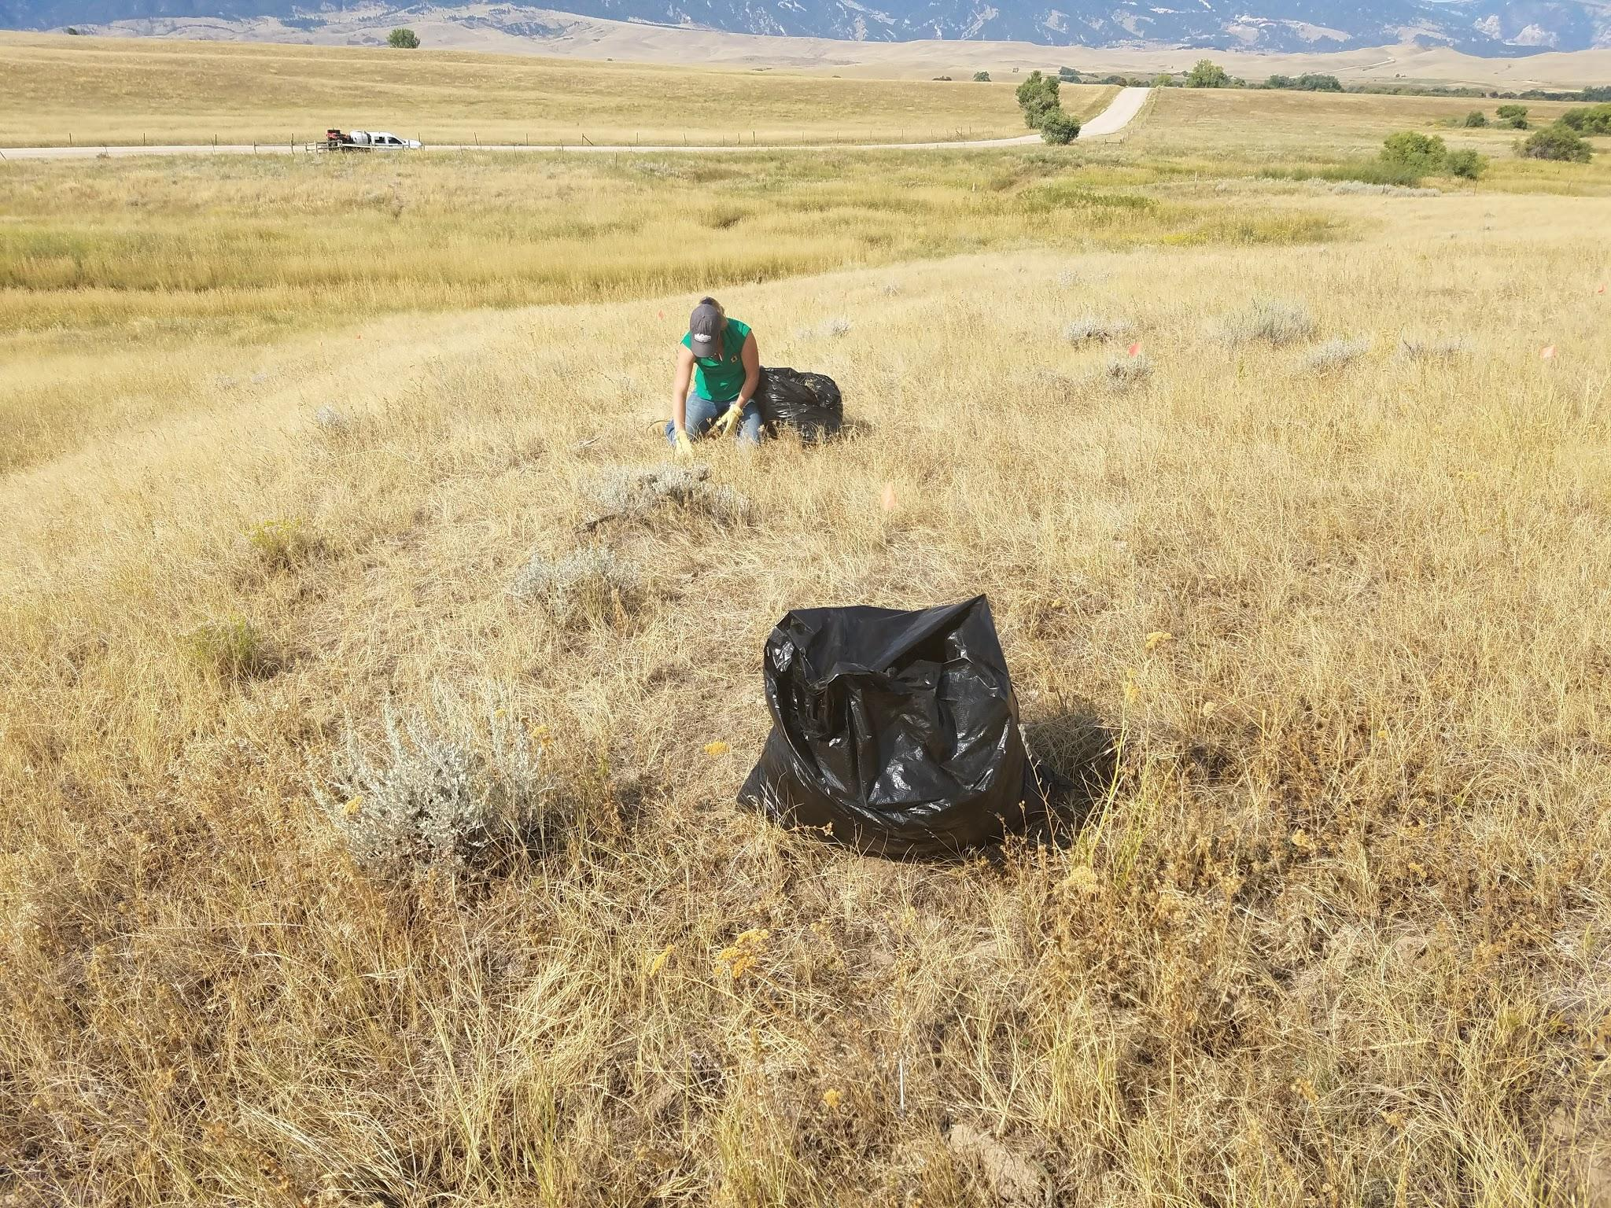

Slide 8
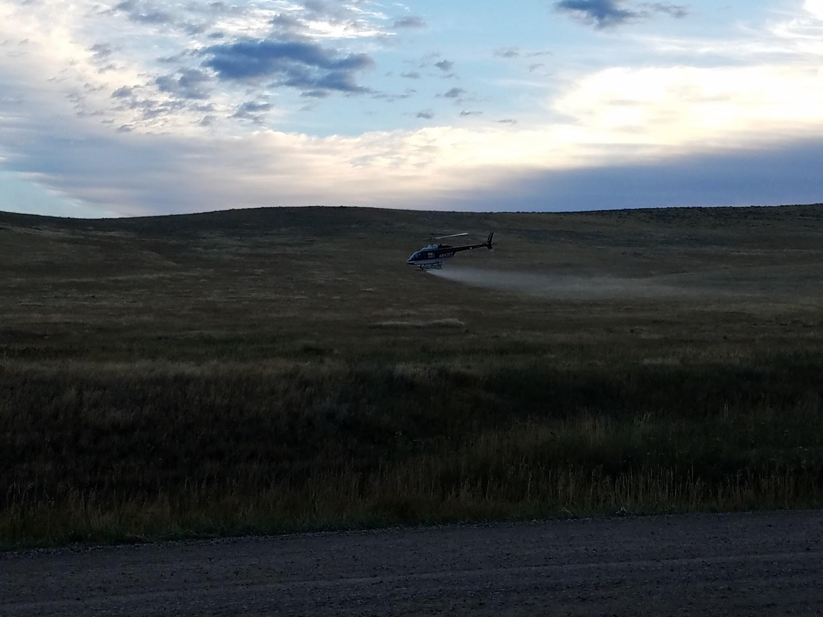
Aerial application of 7 ounces Plateau + 7 ounces Milestone applied September 2016

Slide 9
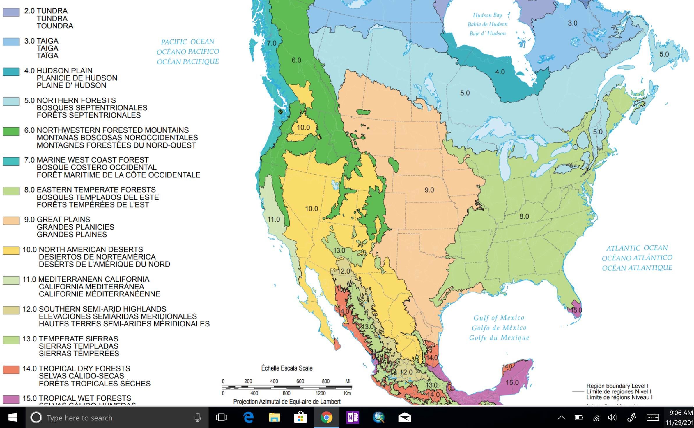

Slide 10
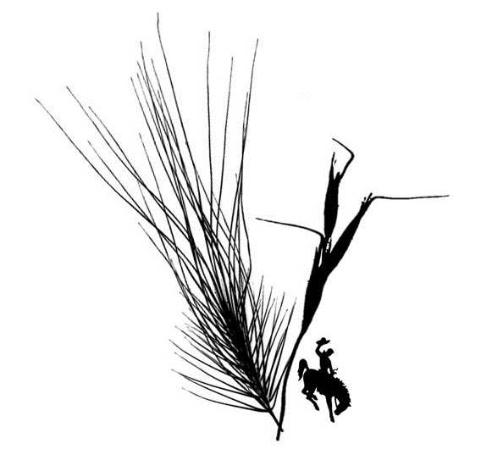
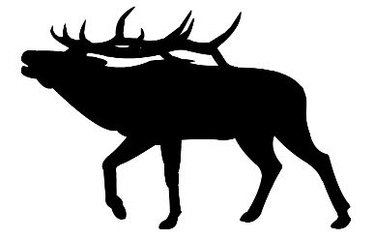

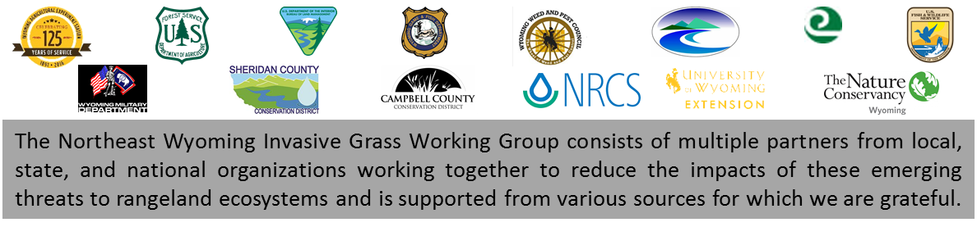
Northeast Wyoming Invasive Grass Working Group
NEWIGWG
Minimizing impacts to rangelands for wildlife and agriculture by reducing, containing, or eradicating medusahead and ventenata in northeast Wyoming

Slide 11

Primary objectives
Clearly understand distribution of target species
Identify potential for spread
DEVELOP & IMPLEMENT MANAGEMENT STRATEGIES
Treat and monitor known infestations
Increase awareness of land managers and communities
Facilitate data sharing to enhance management

Slide 12
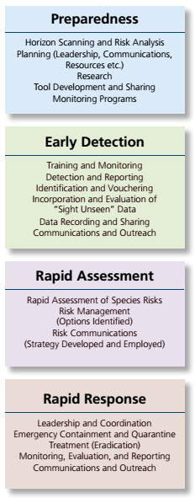
National EDRR Framework (USDI 2016)
Multi-jurisdictional partnership already in place
Management approaches under evaluation
Monitoring and research to develop suitability models
Sharing identification information far and wide
Verifying reported infestations
Targeted survey by multiple groups
Documentation and reporting avenues already in place
Both grasses known to be invasive in similar habitat
Assessments of management strategies higher priority
Have already proven ability for rapid response
Leadership and coordination already in place
Outreach and communications under way

Slide 13
Education and outreach
Boot brush signs at 8 locations
Written outreach fact sheets and identification guides included in all BLM and State Lands permitting correspondence in Spring/Fall 2017 ->2000 contacts
Developed and distributed Wyoming Invasive Grass Quick Reference Guide
Information included in multiple conservation district newsletters
Educational presentations including:
Wyoming Society for Range Management Wyoming Weed and Pest Fall Conference Northeast Wyoming Sage Grouse Local Working Group Powder River Restoration Initiative Habitat Workshop Bureau of Land Management Buffalo Field Office Sheridan County Small Acreage Workshop Wyoming Crop Improvement Association Sheridan County Chamber of Commerce Ag and Natural Resources Committee Wyoming Mining Natural Resources Foundation | Wyoming Weed Management Association Annual Meeting Montana Weed Control Association Southeast Regional Meeting 2017 Medusahead – Ventenata Field Tour 2017 Soil Health Workshop 2017 Nebraska Weed Management Association 2017 USDA-PPQ Seasonal Training 2017 Highland CWMA Meeting Media coverage on multiple fronts

Slide 14
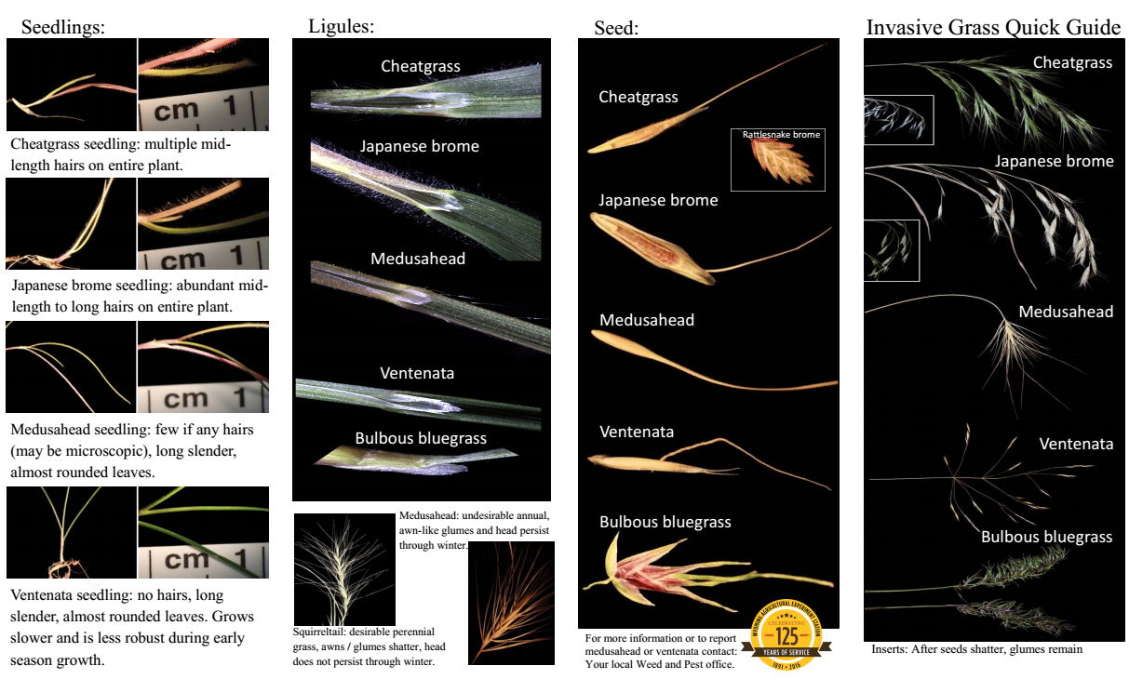

Slide 15
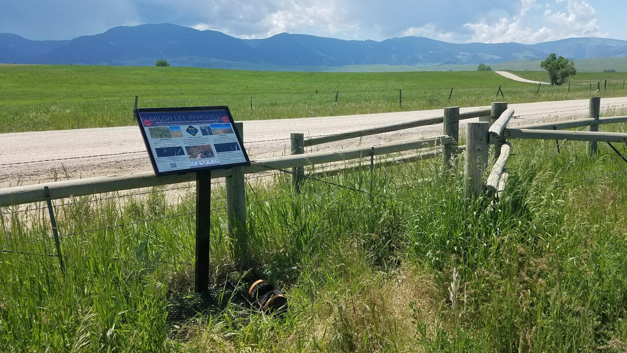

Slide 16
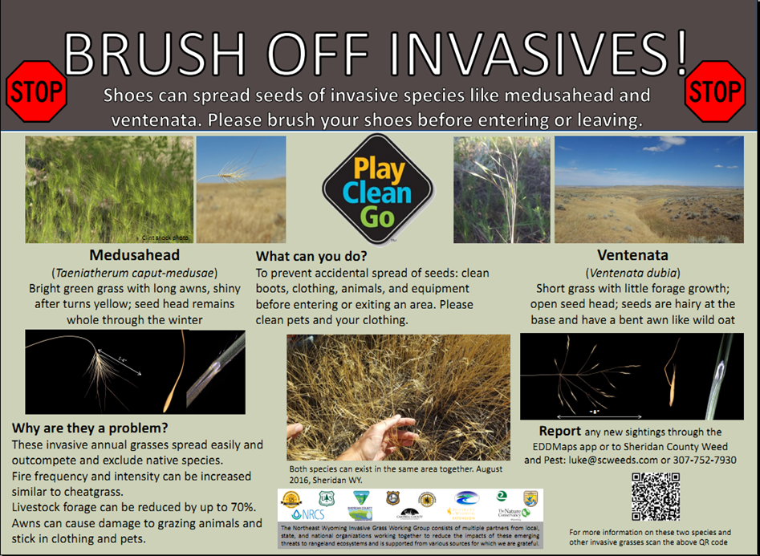

Slide 17
Management actions
Treated first known medusahead population within 1 month of reported occurrence
Developed and implemented tiered-priority survey
~20,000 acres of priority 1 area surveyed 2017
Treated all known medusahead acres with surrounding ventenata matrix in September 2017

Slide 18
2017

Slide 19
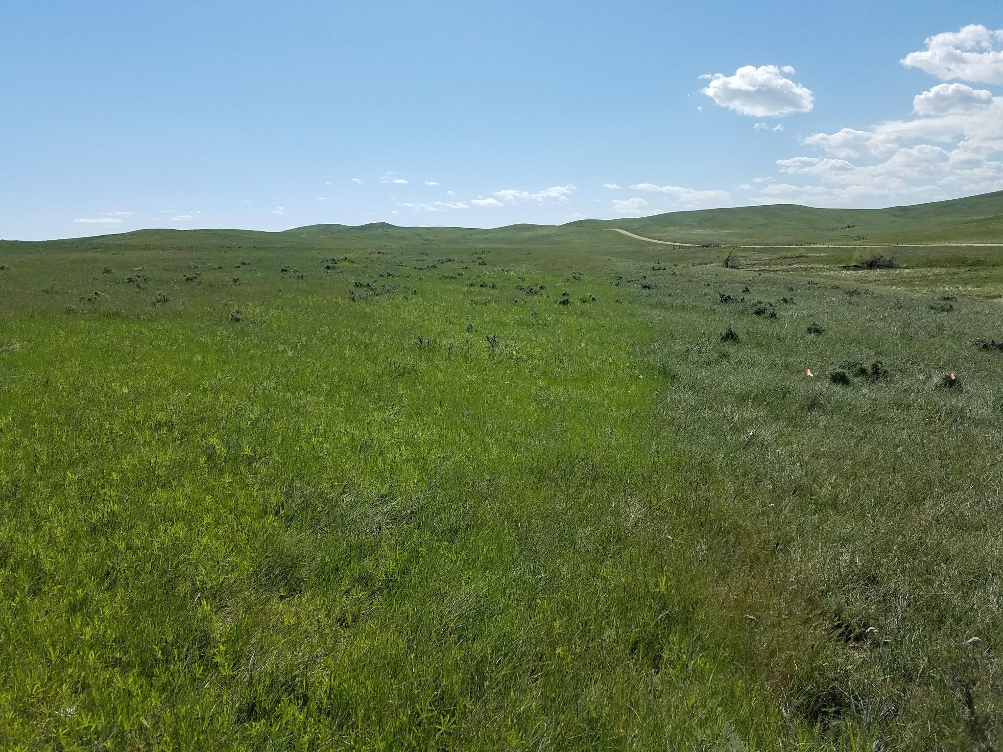

Slide 20
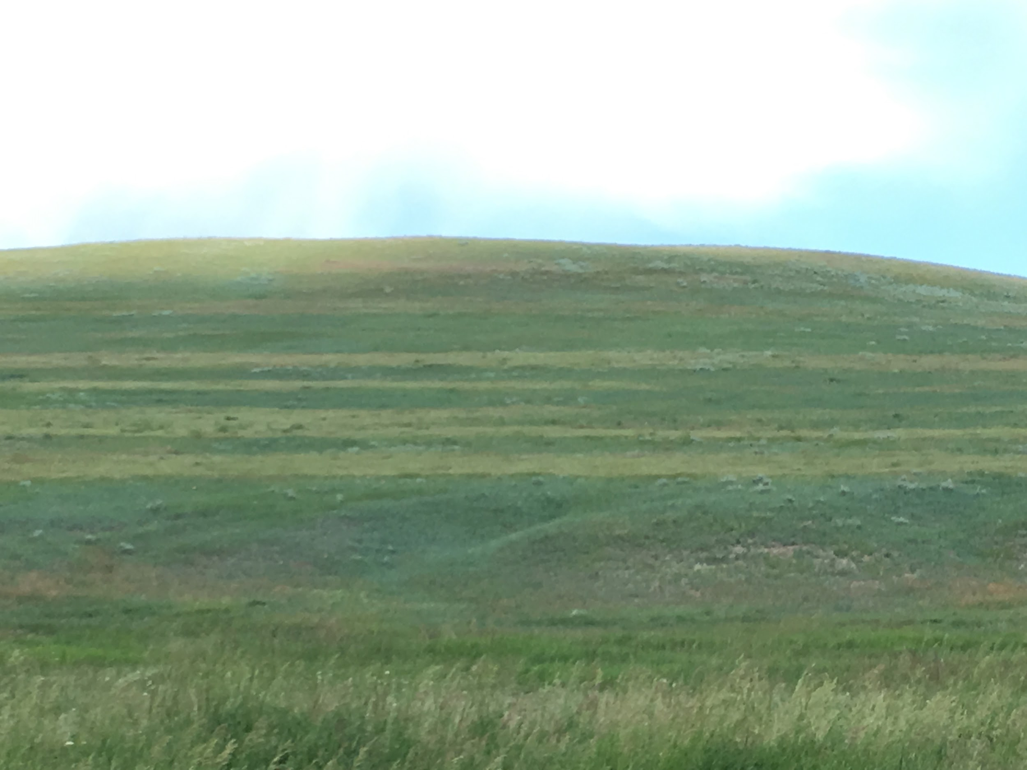

Slide 21
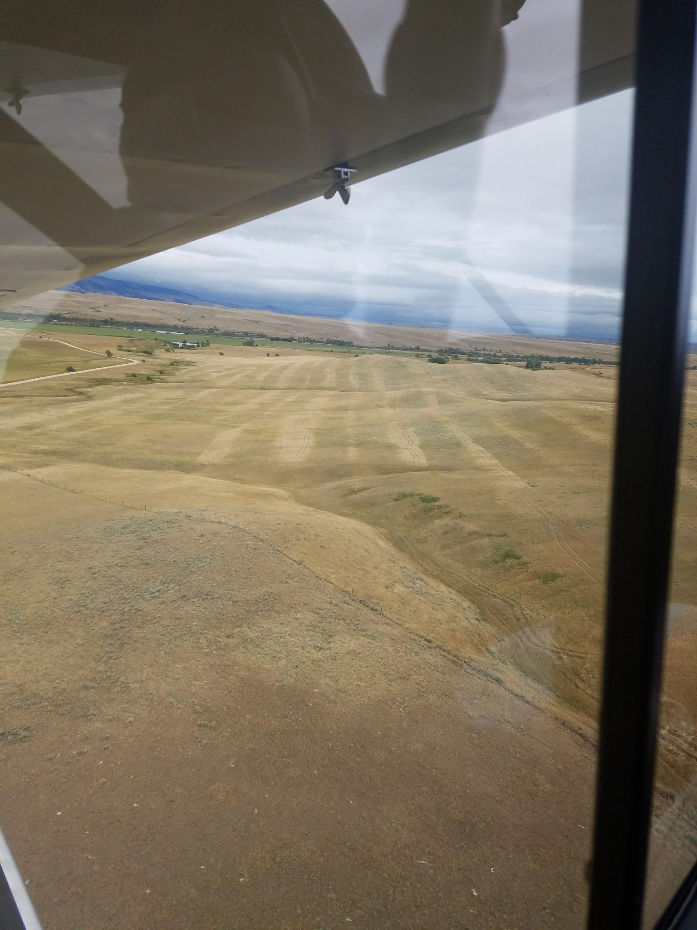

Slide 22
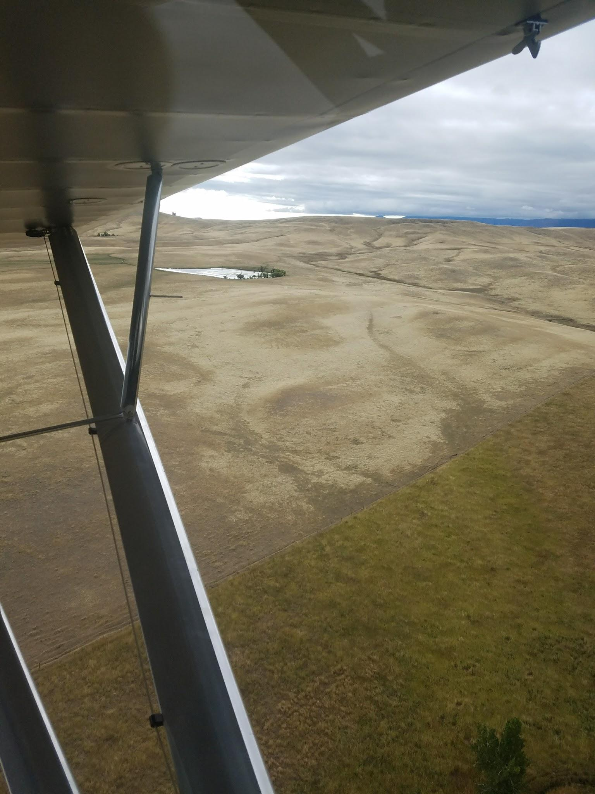

Slide 23
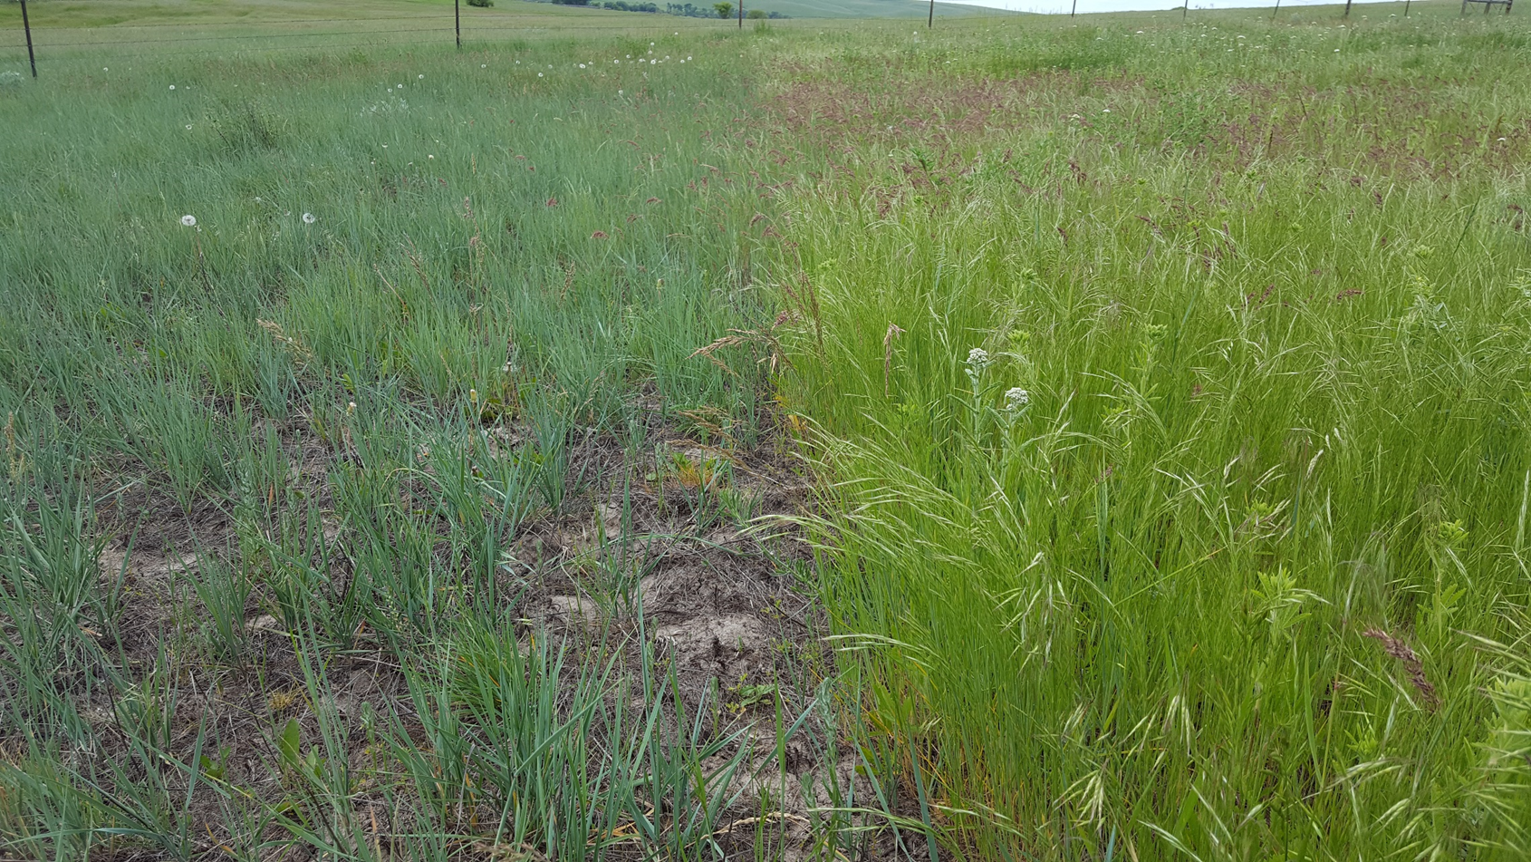
Aerial application of 7 ounces Plateau + 7 ounces Milestone applied September 2016 (left), nontreated strip (right) —photo taken June 2017.

Slide 24
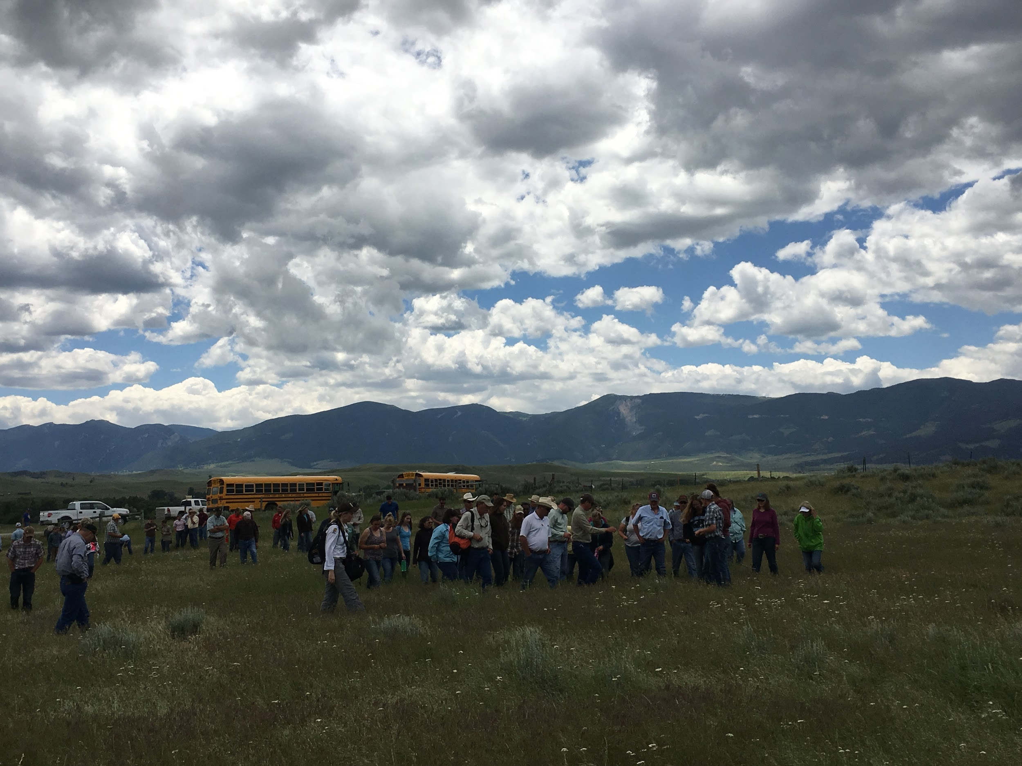

Slide 25
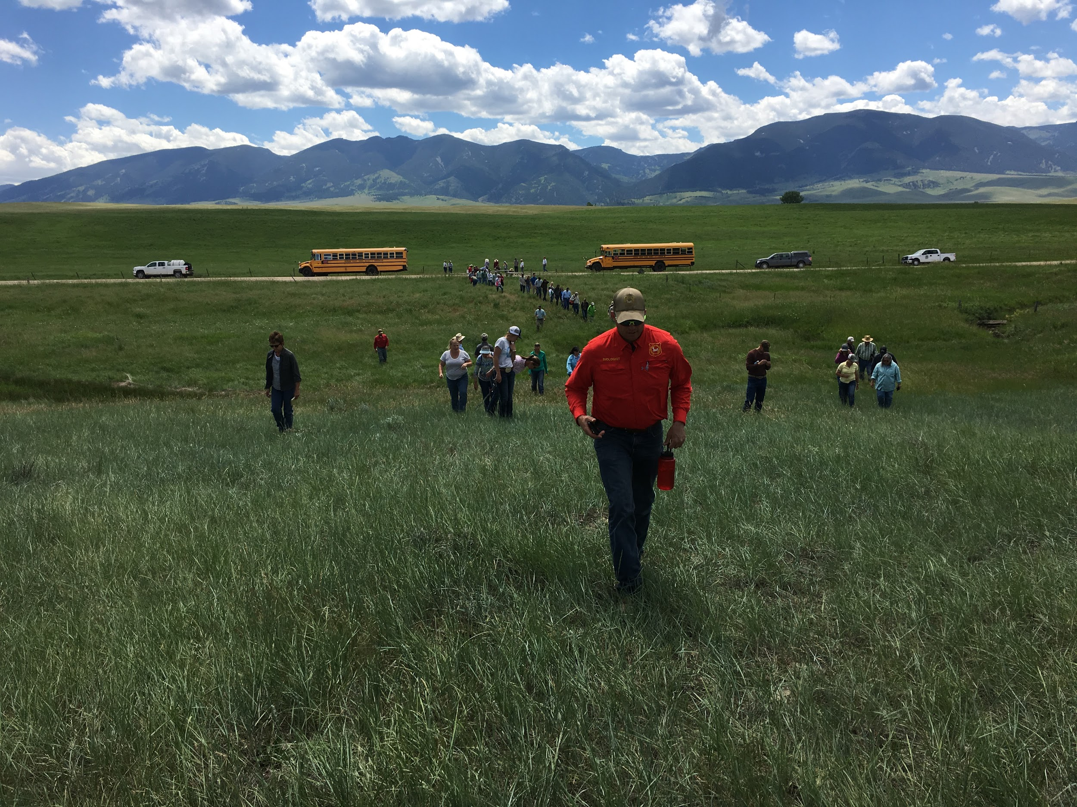

Slide 26
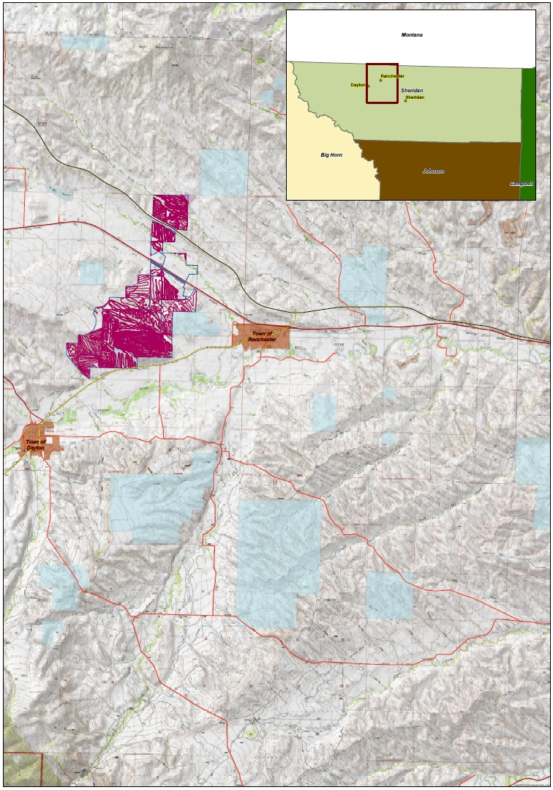

Slide 27
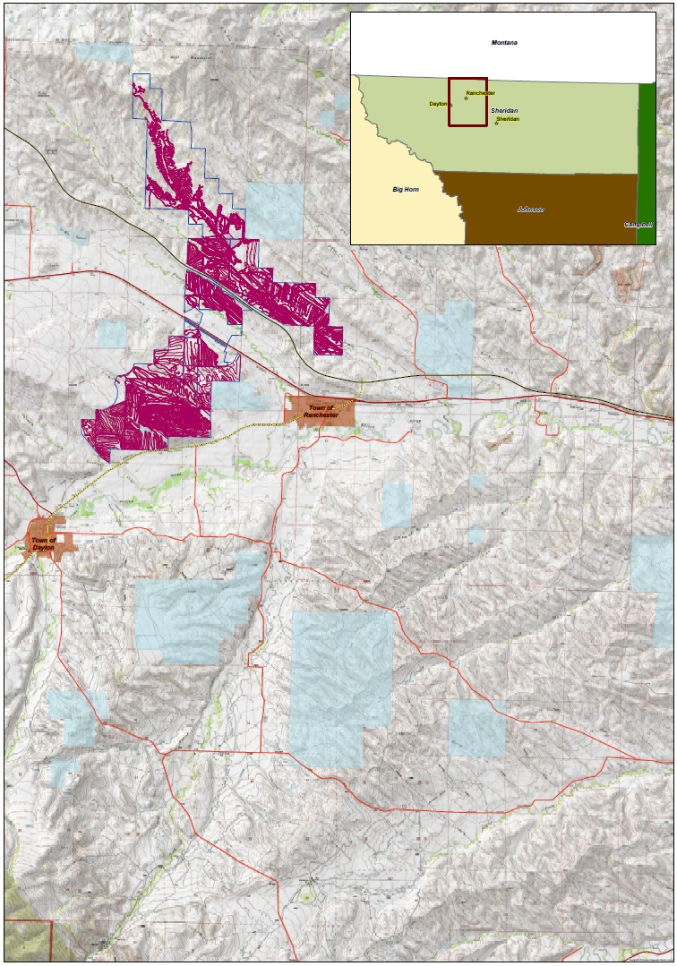

Slide 28
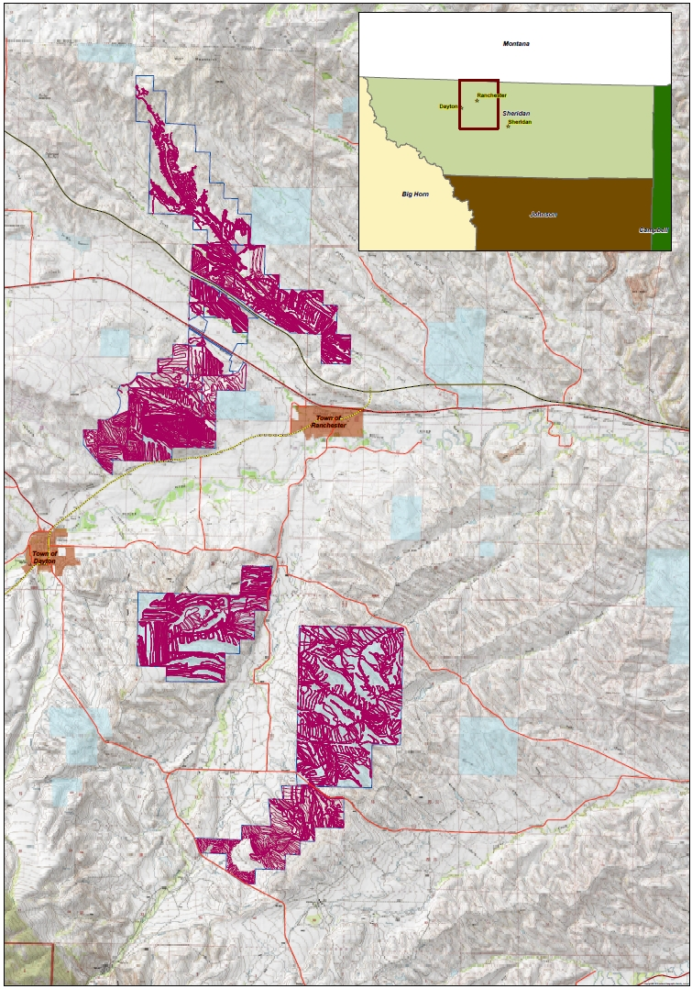

Slide 29
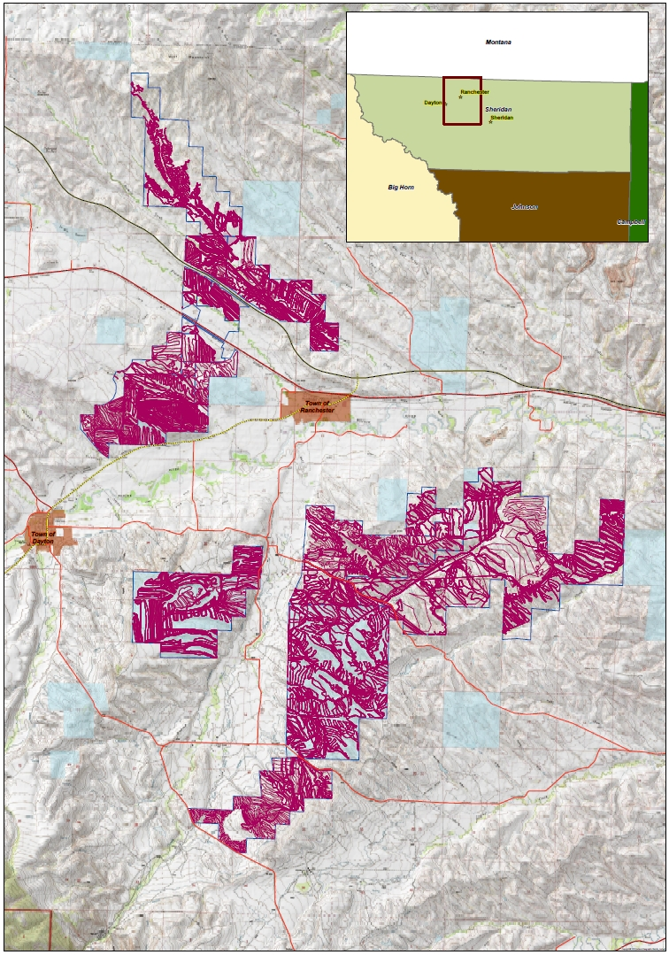

Slide 30
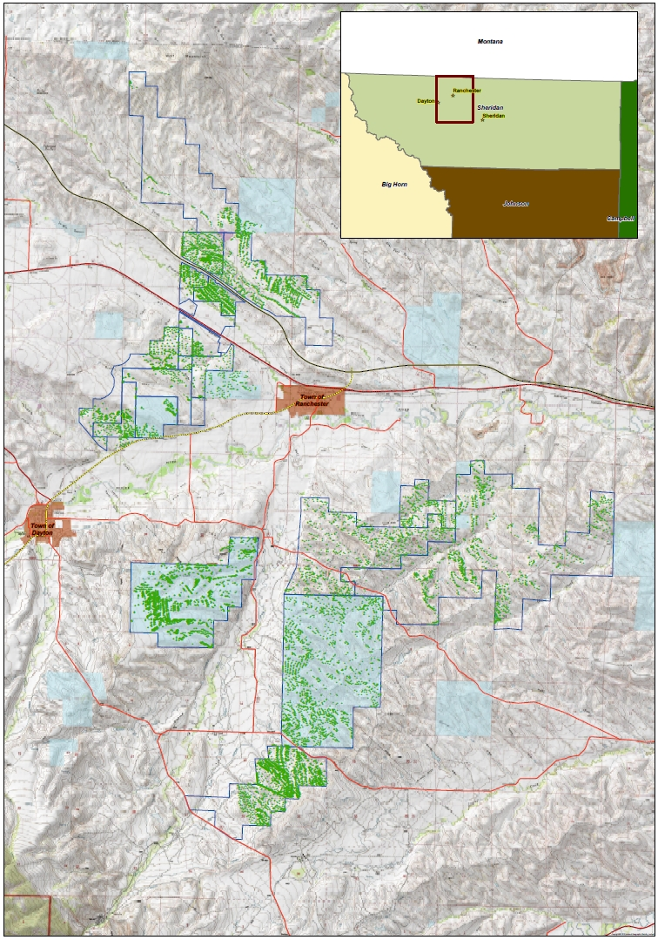

Slide 31
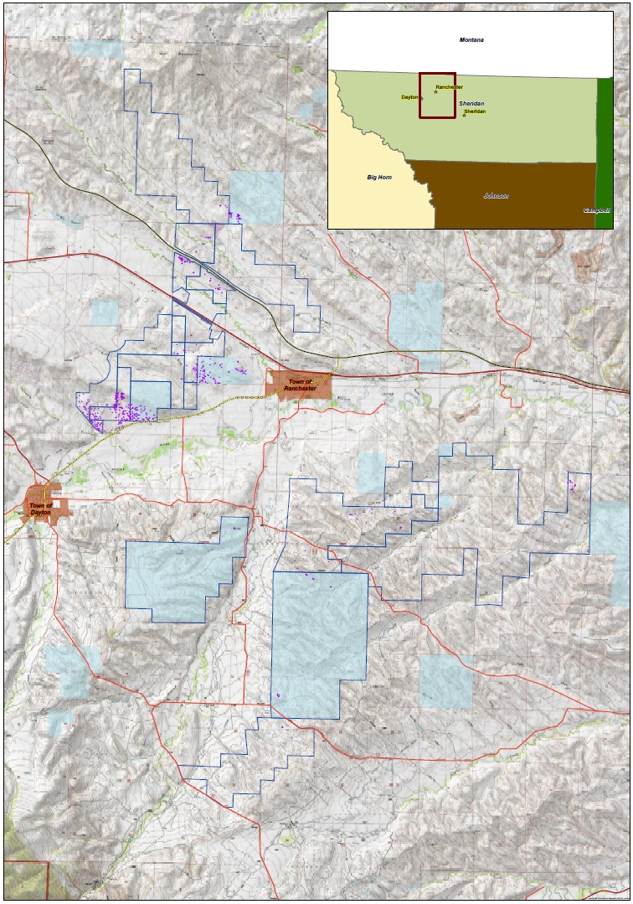

Slide 32
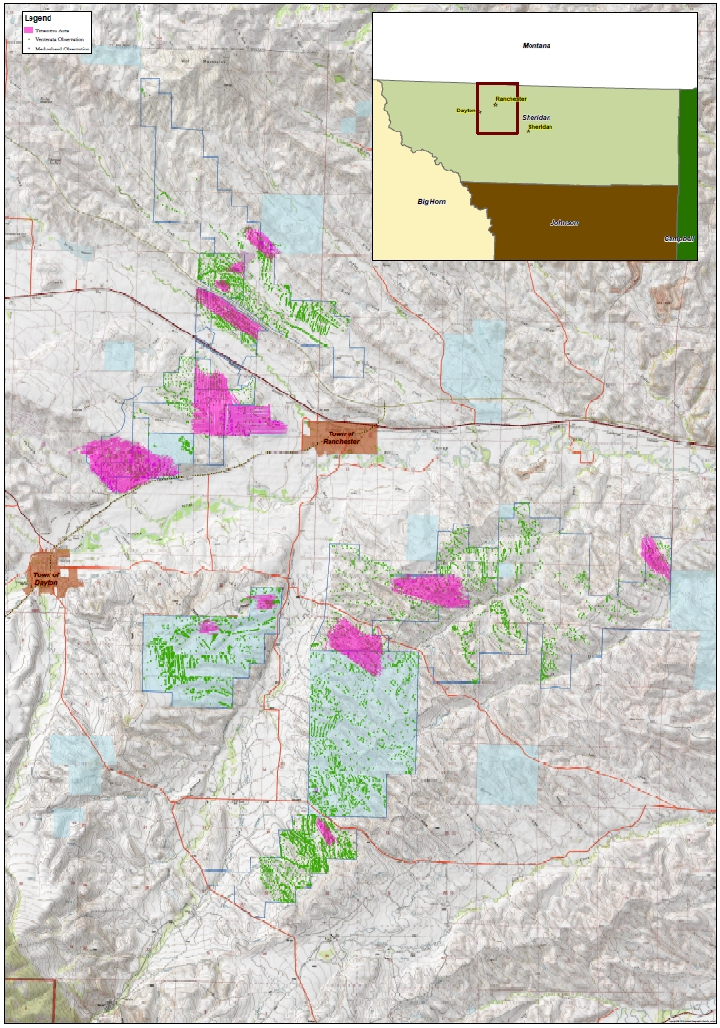

Slide 33
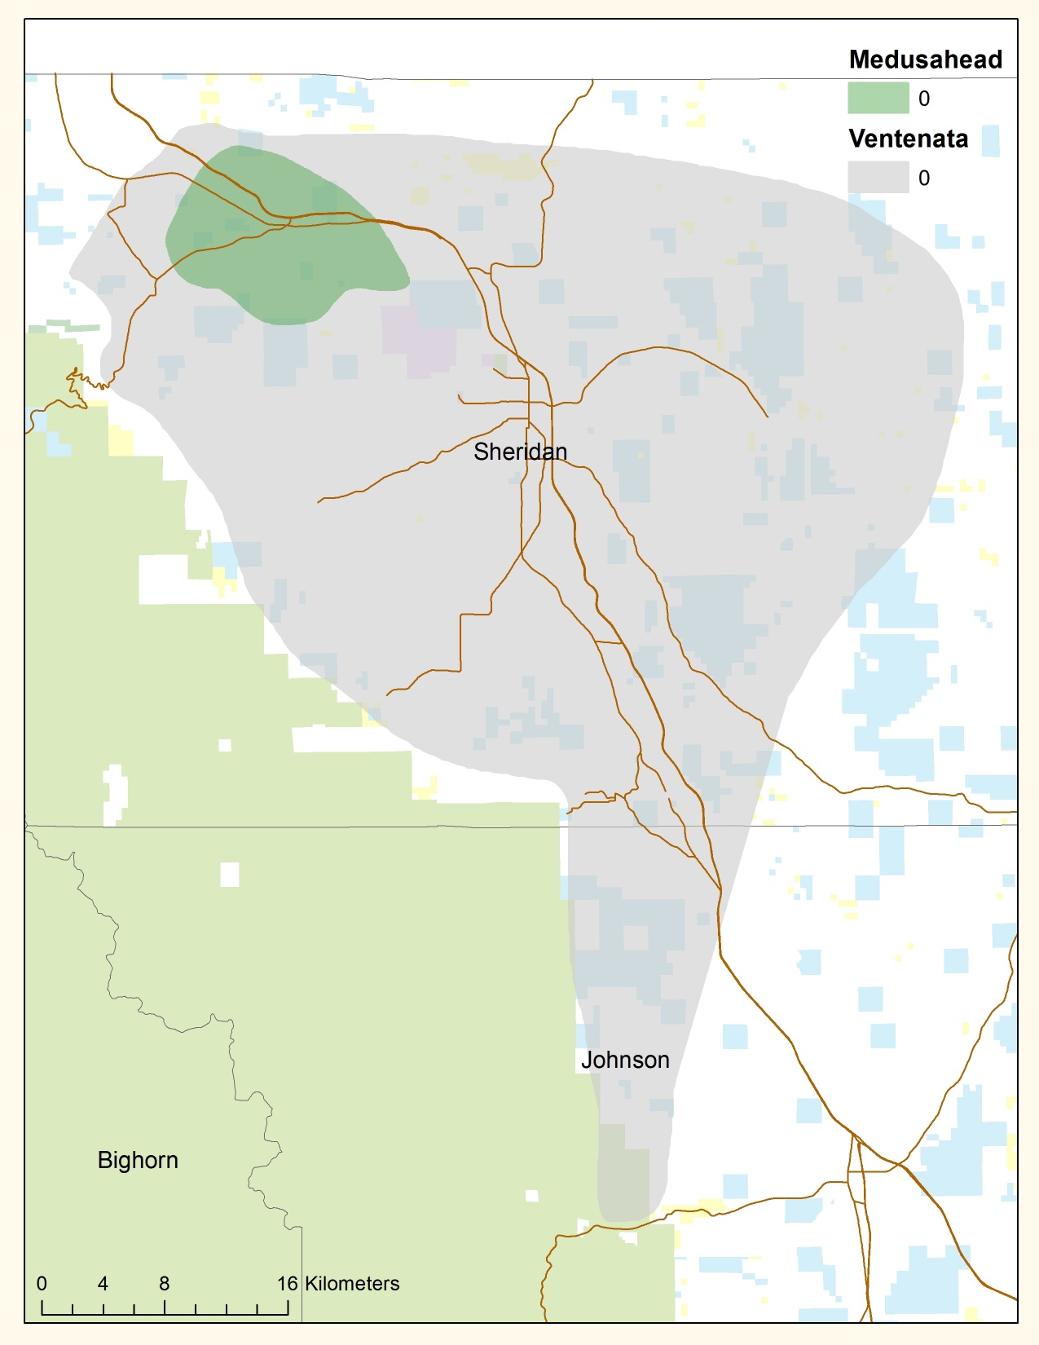
600,000 Acres

Slide 34
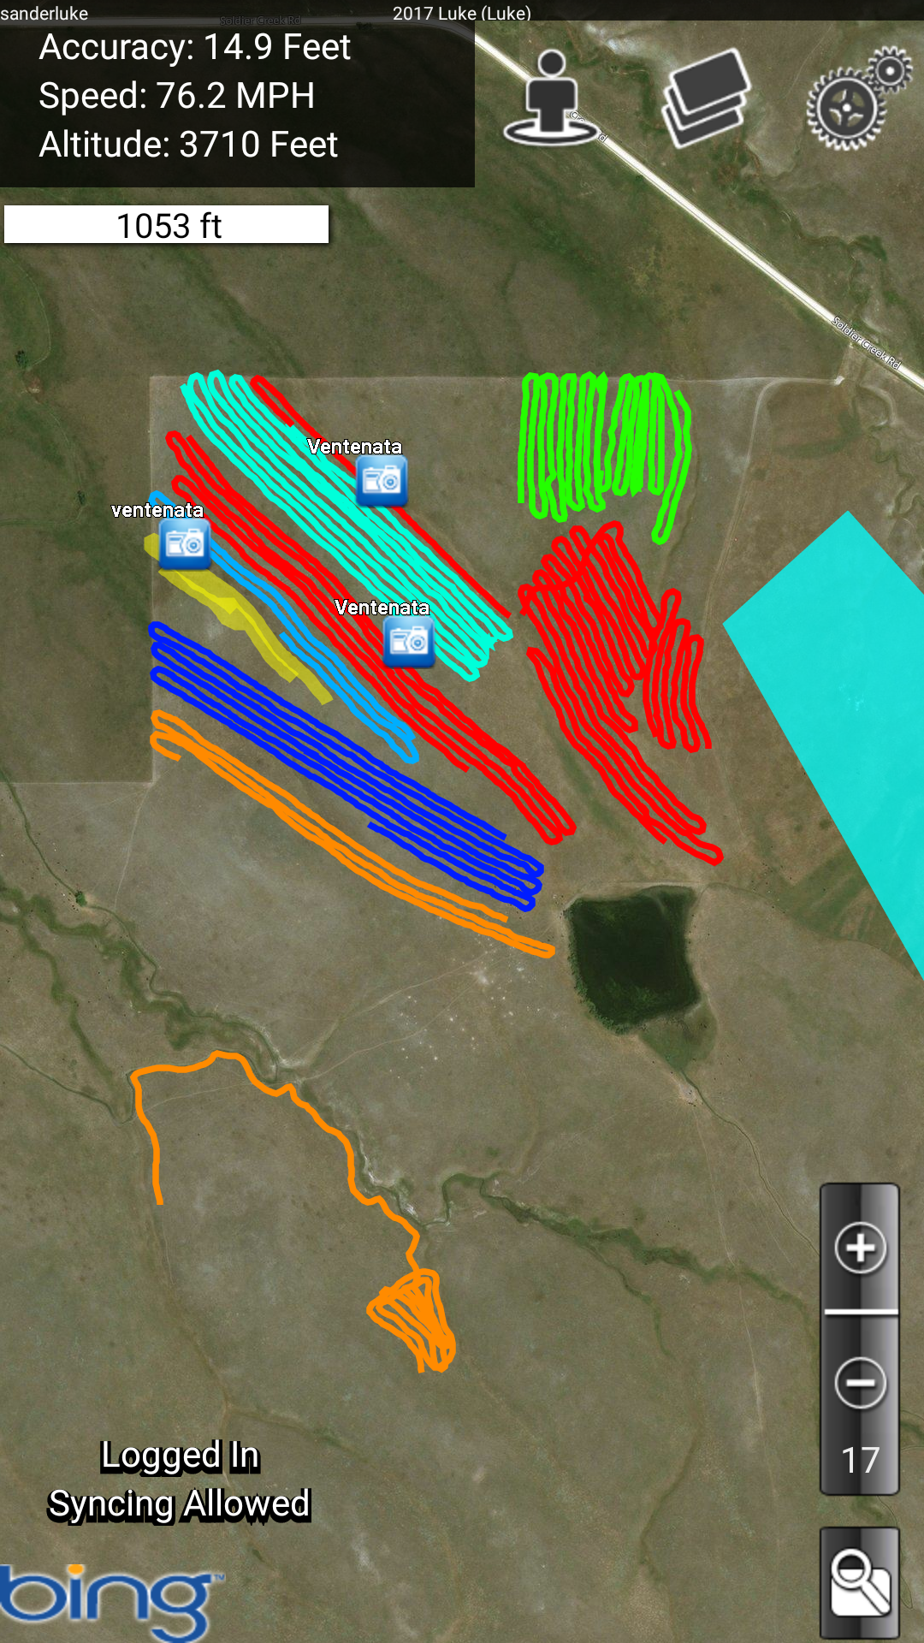

Slide 35

TIMELINE
Ventenata first reported in Sheridan
Ventenata first reported in Campbell
WY Cheatgrass Task Force “charge”
NEWIGWG drafts initial strategy:
- Eradicate medusa
- Find/contain ventenata
Ventenata “rediscovered”
NEWIGWG formation
New medusa reported outside survey area
Ventenata on USFS surface
Medusahead in Sheridan
Ventenata in Johnson
1997
6/16
8/16
9/16
12/16
1/17
5/17
7/17
8/17
9/17
10/17
11/17
First herbicides applied
Field survey starts
>20k acre survey completed
Public outreach started
Initial strategy developed
Treat >2k acres medusahead
WY Weed & Pest recommends both species for state-designation as noxious

Slide 36
Moving Forward?

Slide 37
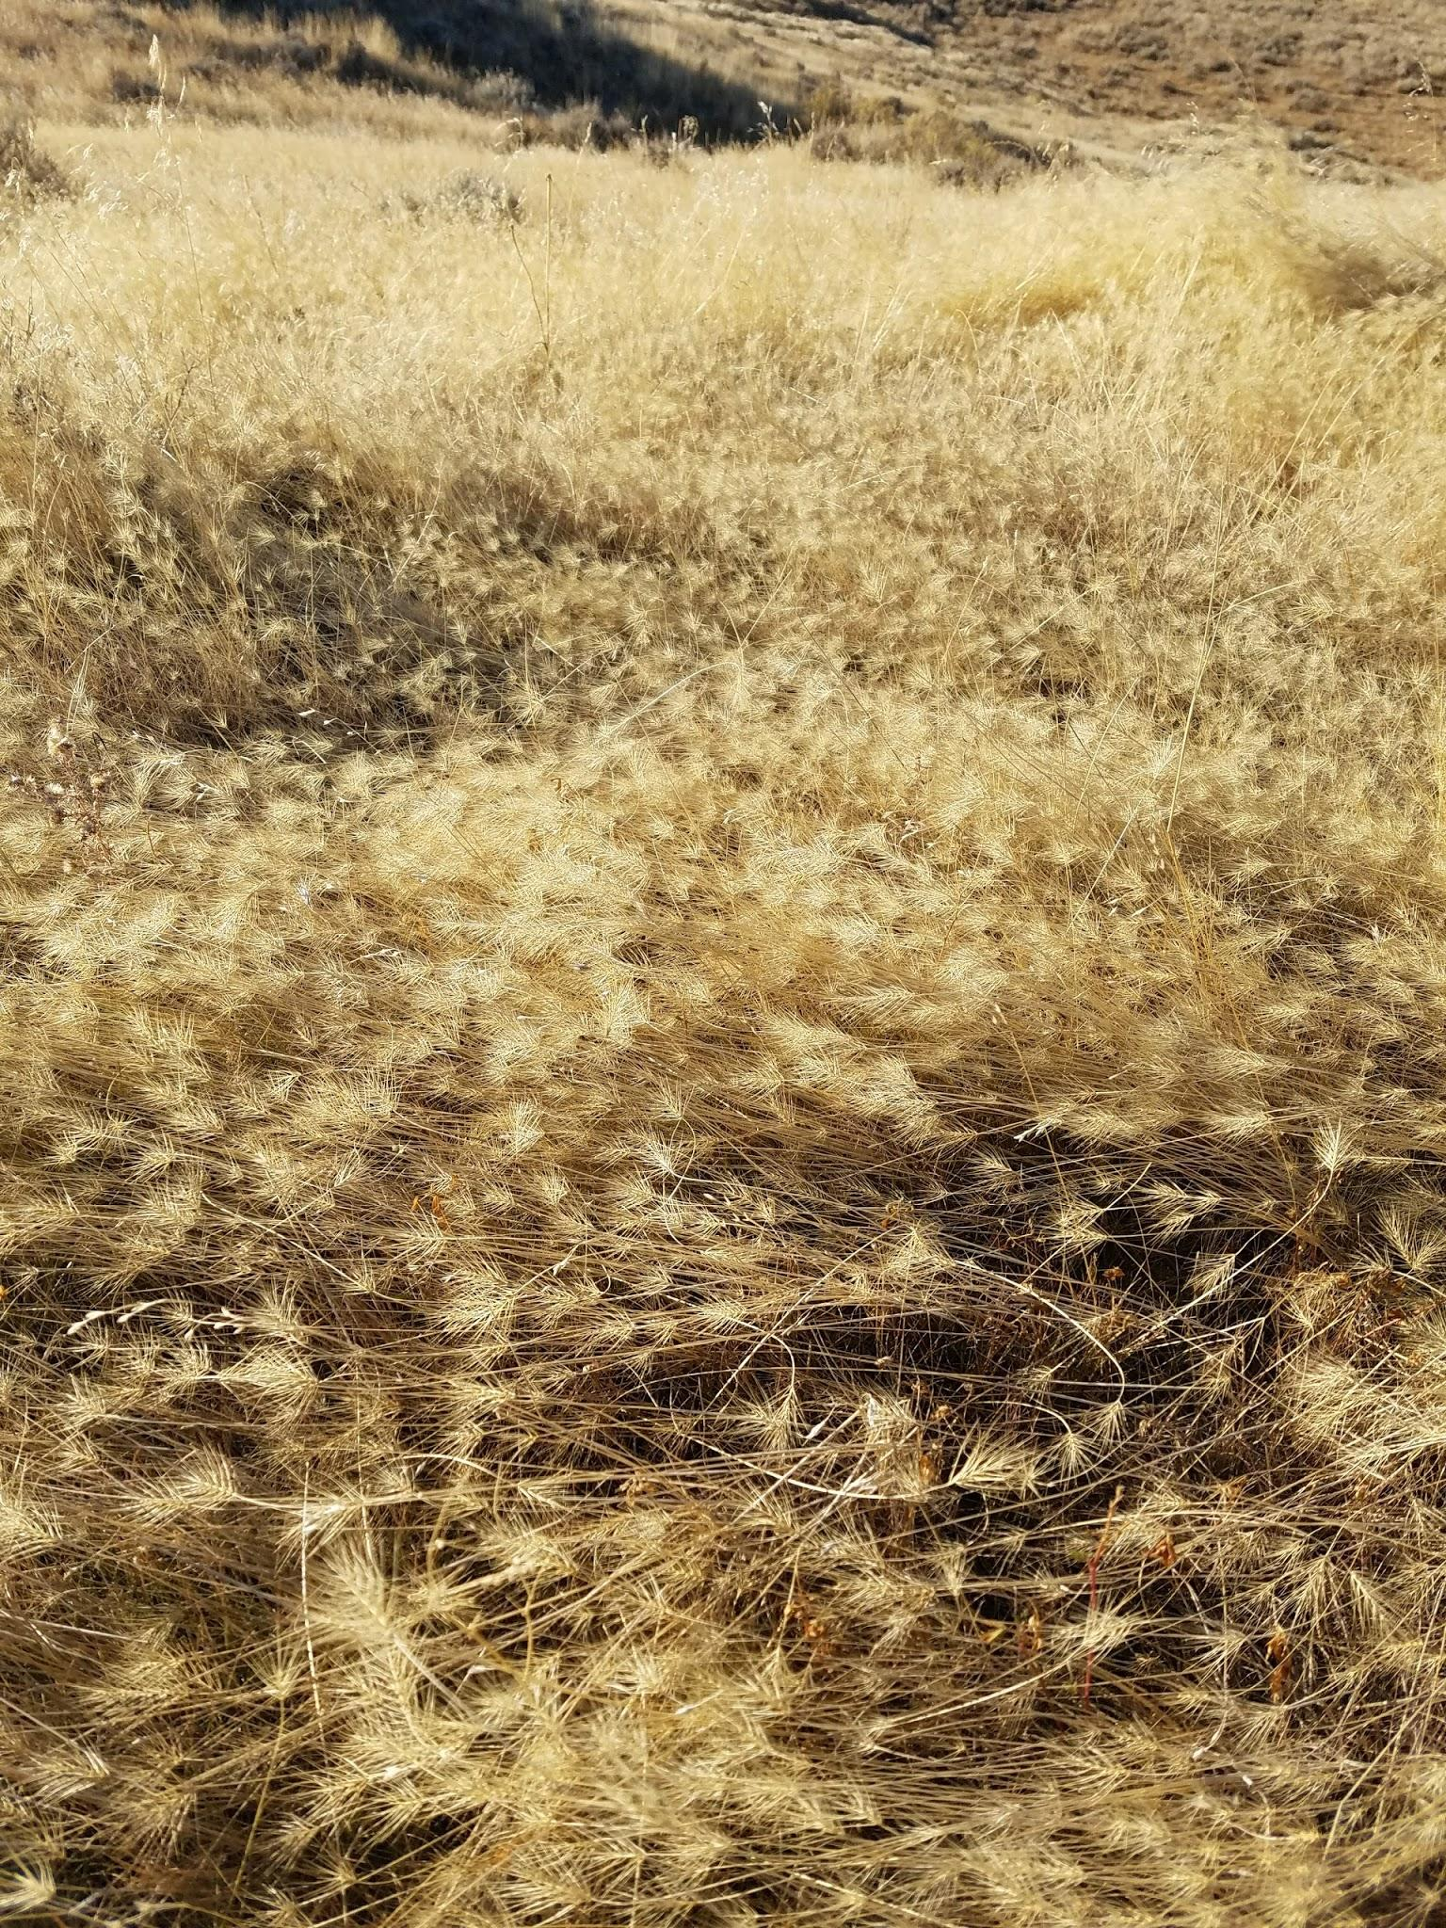

Slide 38
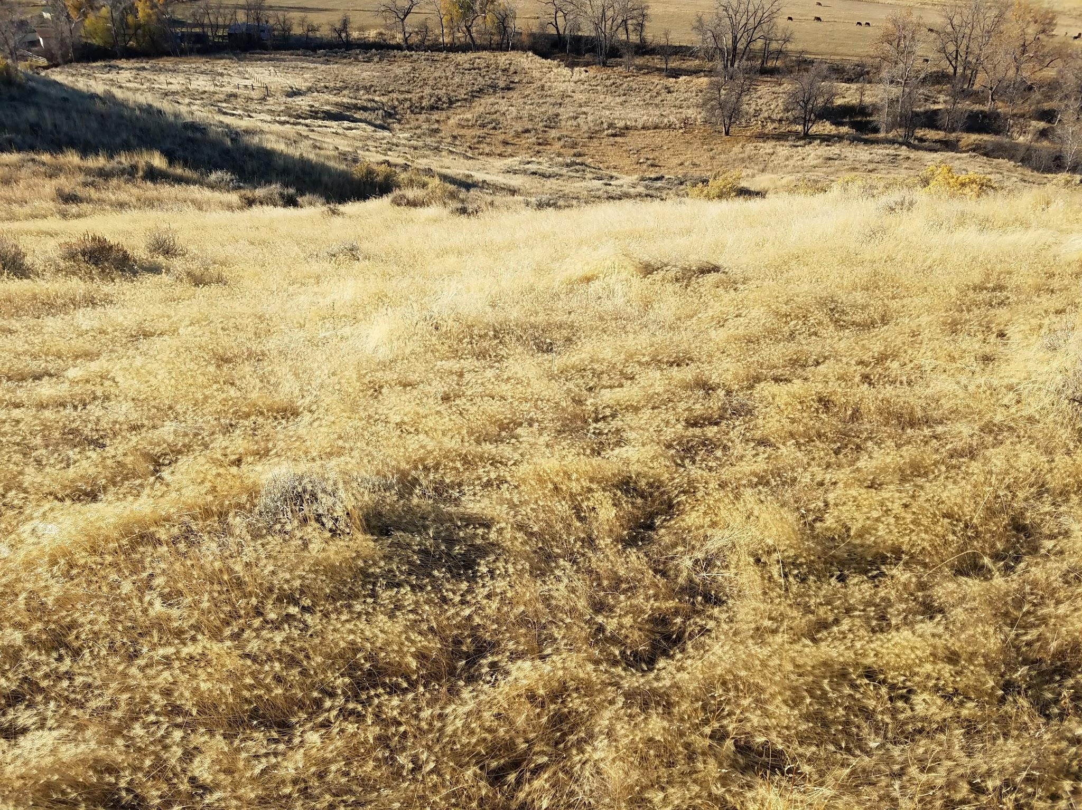

Slide 39
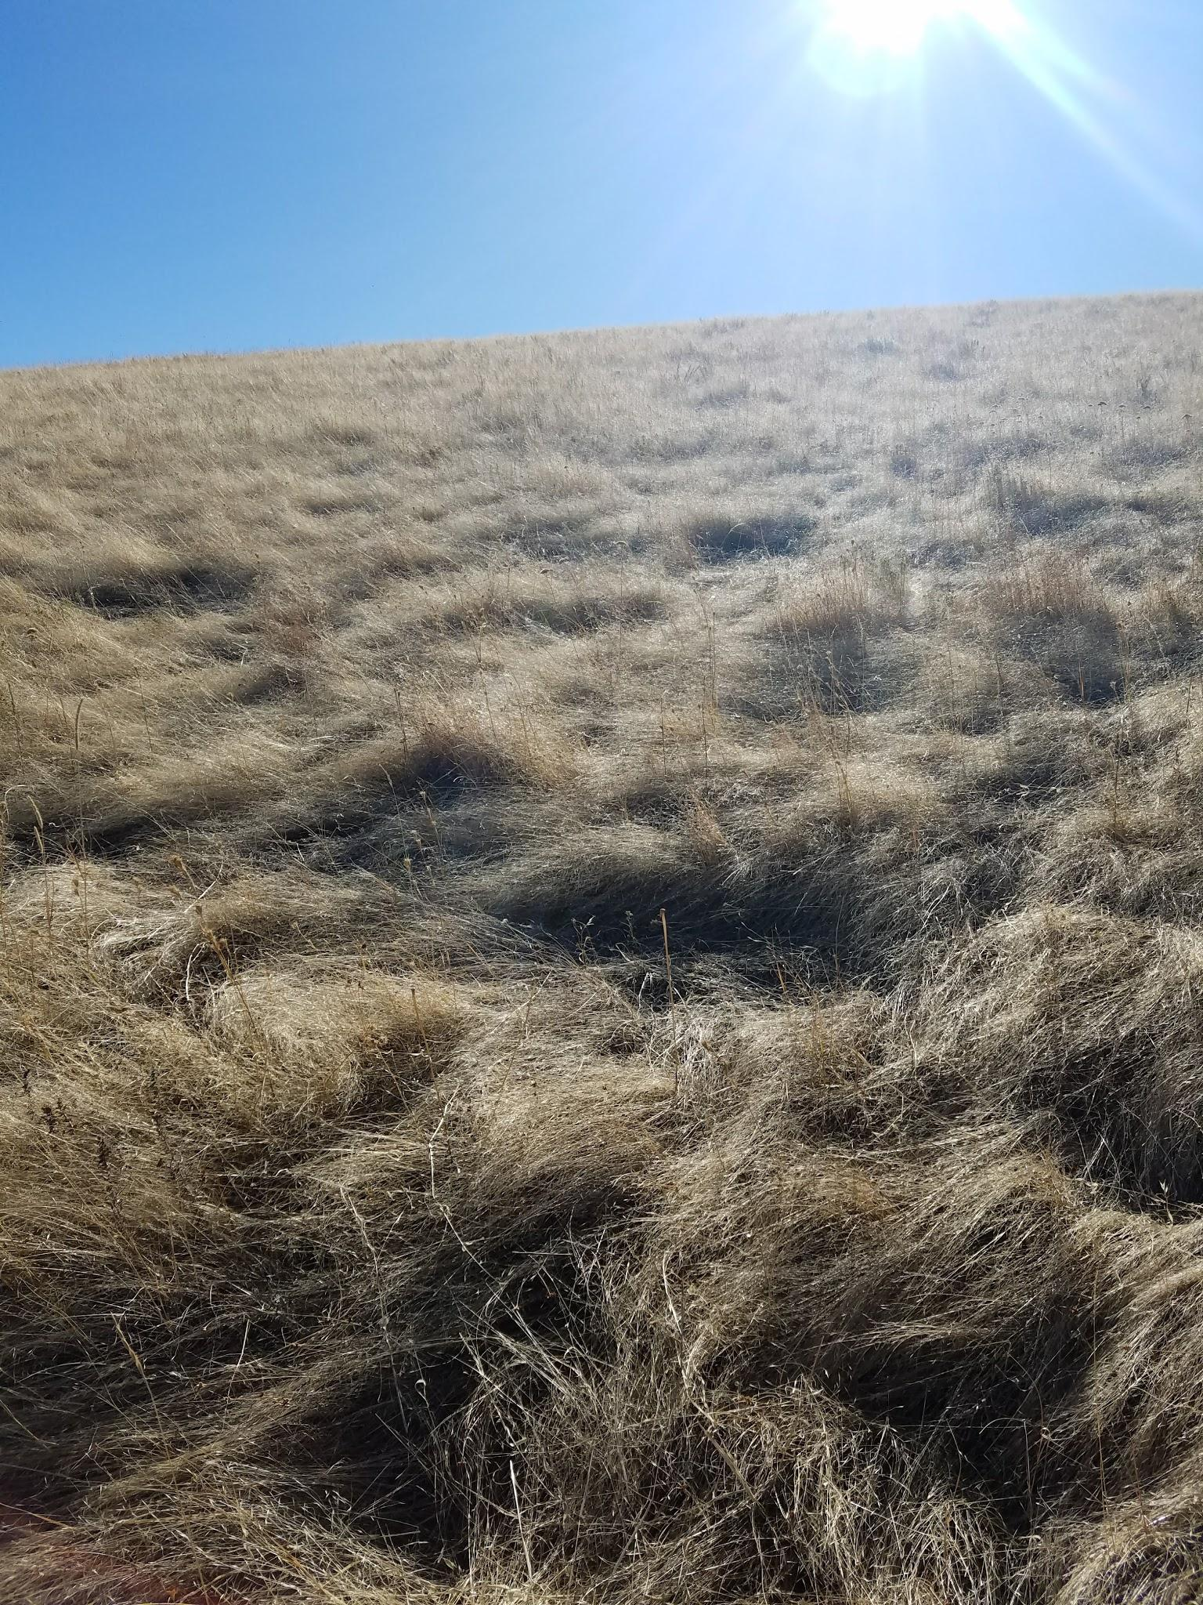

Slide 40
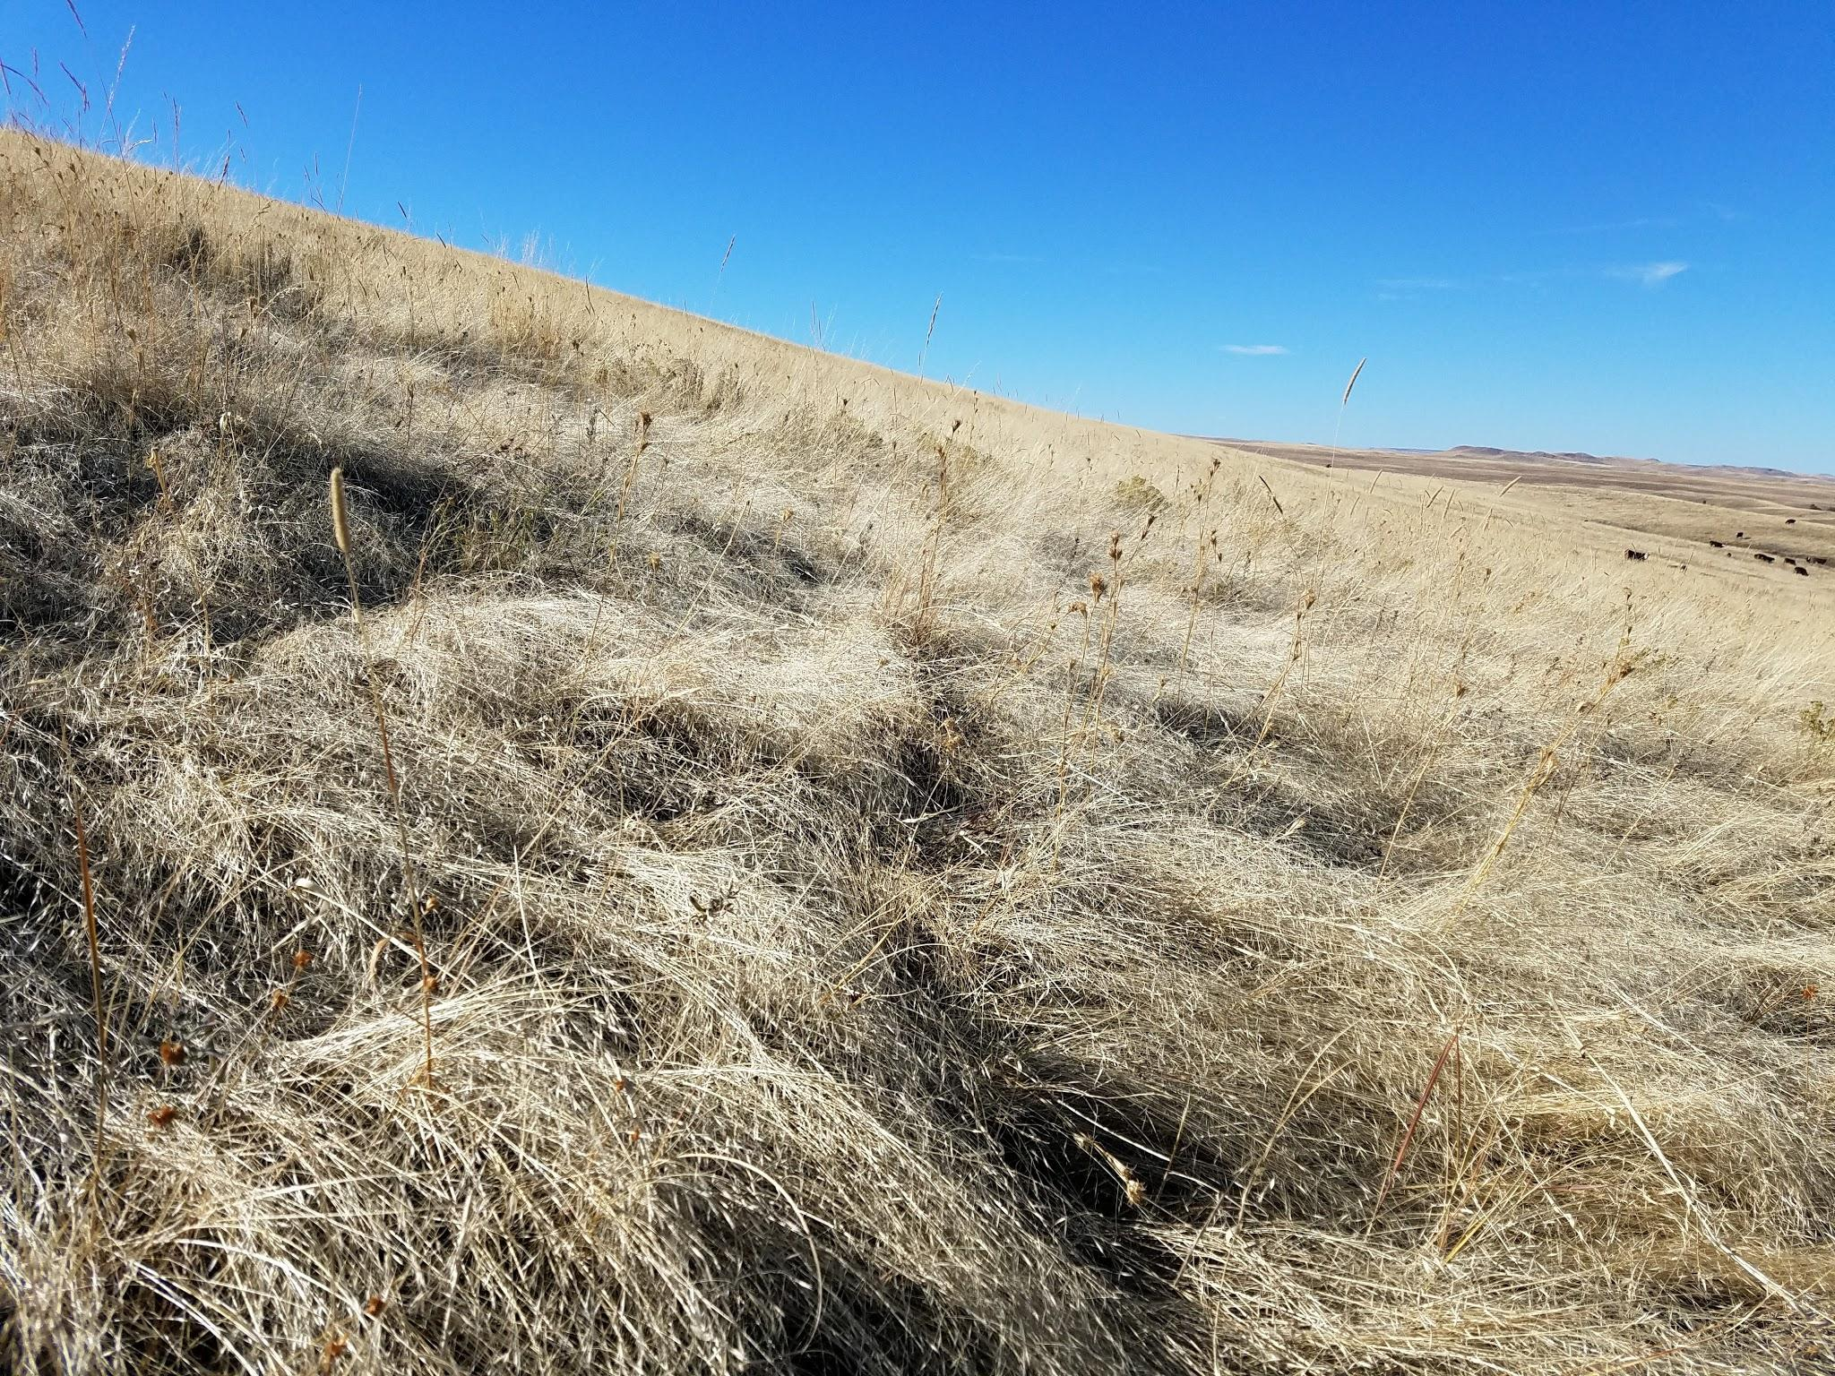

Slide 41
Northeast WY Invasive Grass EDRR Pilot Complementarity, Partnerships, Scale, Implementation, Timeliness, Resource Availability, Metrics
Opportunities
Challenges
Several partners willingness, landowners on board
Agreement for inventory
No gap between state and federal, common priorities
Big group of collaborating experts
Federal financial agreements timeliness
Dectectability with high spring production
Terrain
Identifying Vectors of spread; linked properties grazing association
Long-term funding and some tied to current year and treatment only

