Slide 1
Old World bluestems – AN INVASIVE threat TO the Southwest
Allen White
USFS Region 3 Invasive Species/Pesticides Coordinator
allenwhite@fs.fed.us
(505) 842-3280

Slide 2
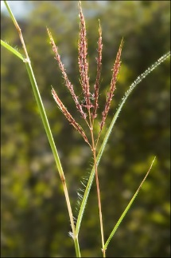
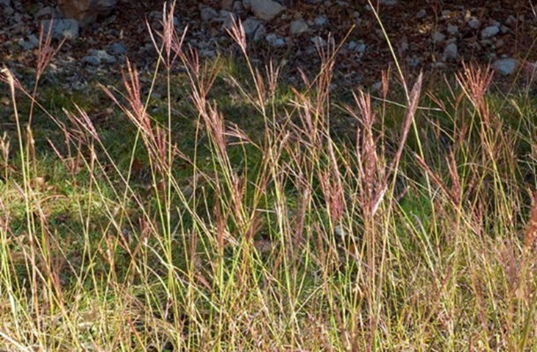
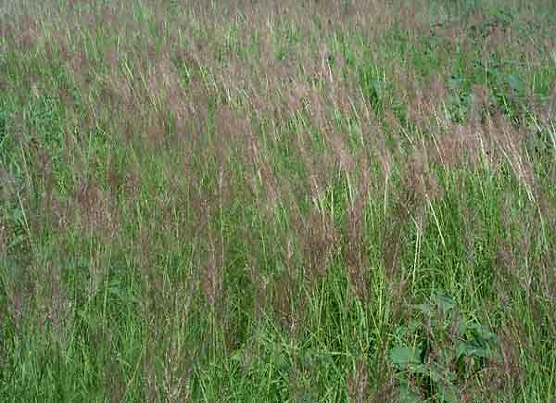
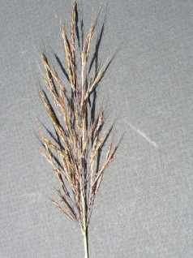
Old World bluestems
OWBs are perennial, warm-season bunchgrasses that have become invasive, particularly in the Midwest and Texas.
Includes both yellow bluestem (Bothriochloa ischaemum) and Caucasian bluestem (B. bladhii).
Originally imported from Eurasia and Africa in the early 1900s for erosion control and as forage crops for haying and grazing.
Yellow bluestem
Caucasian bluestem

Slide 3
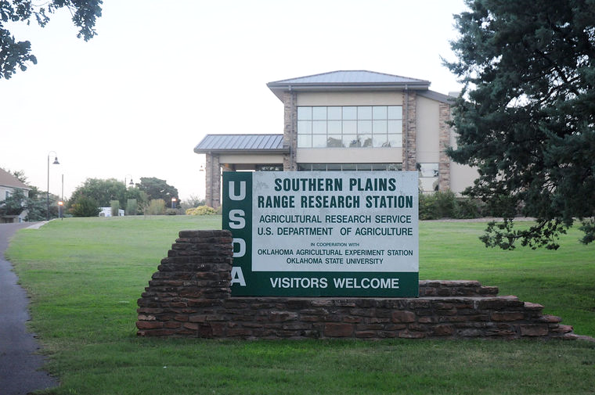
OWB cultivars
OWB cultivars originally released by USDA ARS and State agricultural experiment stations.
Six cultivars developed from varieties adapted to different disease and insect threats, climate, and soil-site conditions:
YB cultivars are King Ranch, Plains, Ganada, WW–Spar, and WW–Iron Master.
WW–B. Dahl is a cultivar of Caucasian bluestem.

Slide 4
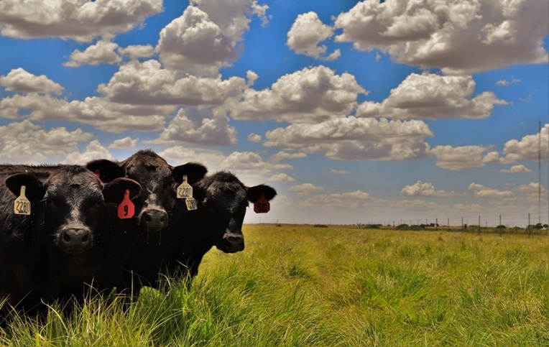
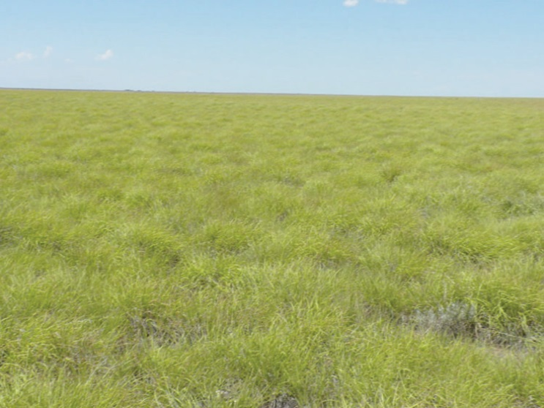
OWB uses
Most common use for OWBs is forage although it is less palatable and less nutritious to cattle than warm-season native grasses.
Some state DOTs and county highway departments have seeded OWBs in ROWs for erosion control, as they can readily establish and provide a quick ground cover.
OWBs have commonly been used in grassland plantings in the Southern Great Plains, including lands held in the Conservation Reserve Program (CRP).
OWB monoculture on CRP

Slide 5
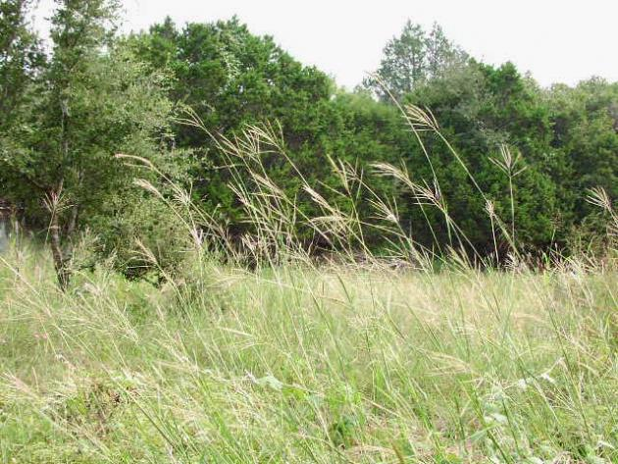
OWB traits
Highly aggressive and very adaptable, especially in disturbed areas.
Drought-resistant, extremely persistent plants that can outperform native grasses under arid conditions.
Can adapt to highly calcareous soils with high pH but do well on any well-drained, non-saline soil.
Cold and shade-intolerant
Univ. Texas

Slide 6
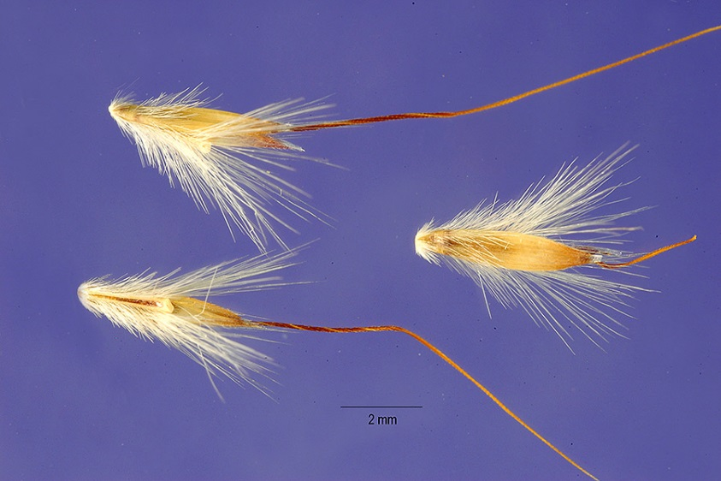
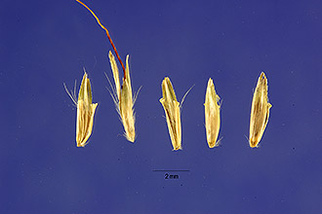
OWB traits
Both OWBs reproduce by producing seed as well as vegetatively via rhizomes and stolons under certain conditions.
If unassisted, OWB seed has relatively limited dispersion. However, seeds more readily disperse via vehicles, mowing operations in ROWs, or windy conditions in open terrain.
Seed of both OWB species is sold by a number of seed companies.
Yellow bluestem
Caucasian bluestem

Slide 7
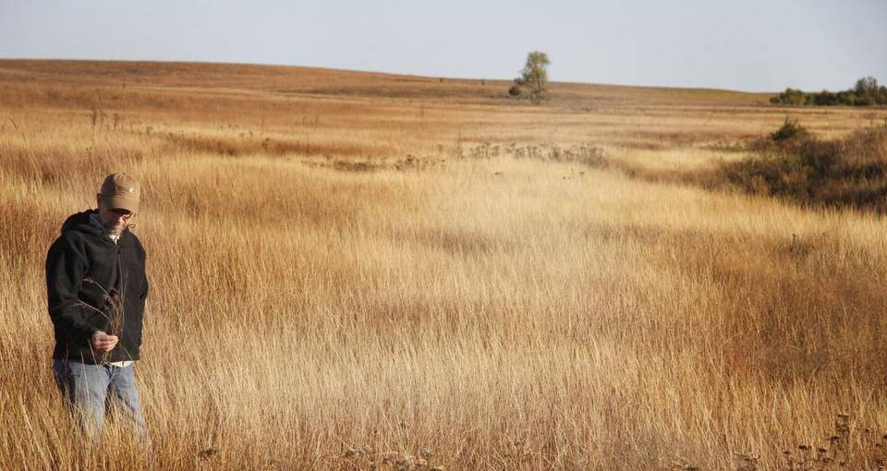
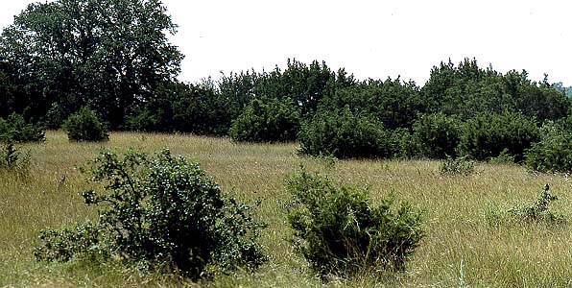
OWB impacts
Forms monocultures that lower biodiversity
Reduction in abundance, richness, and diversity in native plant communities
OWB-infested grasslands are relatively unsuitable for many grassland birds.
Alters soil C:N ratios and soil microbial communities (including arbuscular mycorrhizae), which can inhibit growth of native plants
Allelopathic compounds may inhibit seed germination in other plant species.
Wichita Eagle

Slide 8
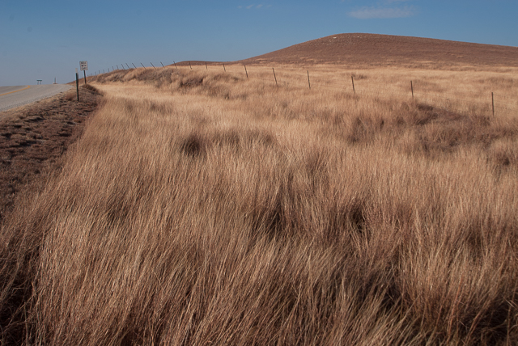
OWB establishment and spread
OWBs principally establish in native plant communities along roadsides but also establish in other disturbed areas such as dams, cattle trails, oil well pads, etc.
Some OWB infestations in native plant communities were initiated by plantings in CRP lands, ROWs, and adjacent farmland.
Mowing spreads OWB seed even further along roadsides. Mowing may also promote monocultures in ROWs (K. Hickman, OK State Univ.)
Once established along a roadside, OWBs then spreads outward in an “advancing front.”
The Nature Conservancy

Slide 9
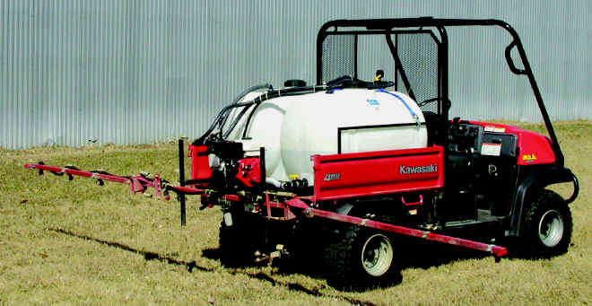
OWB management
OWBs are not listed on State noxious weed lists for AZ and NM, nor are they found on invasive weed lists of national forests.
Once established, OWBs are practically impossible to eradicate. Control becomes progressively more difficult and expensive over time.
Only non-selective herbicides are available for OWB control. Primary herbicides are glyphosate and imazapyr.

Slide 10
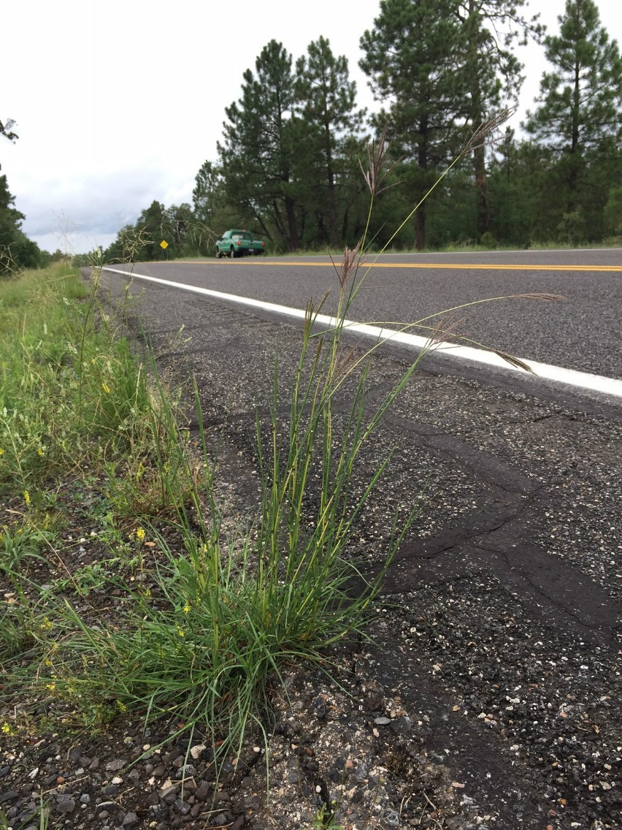
Survey for YB on NFS lands in Region 3
In FY17, Region 3 performed informal “windshield” surveys on all forests for YB presence.
Forests were asked to identify presence of YB (if any) across all Districts as much as possible.
Alex Heeren, Mogollon Rim RD

Slide 11
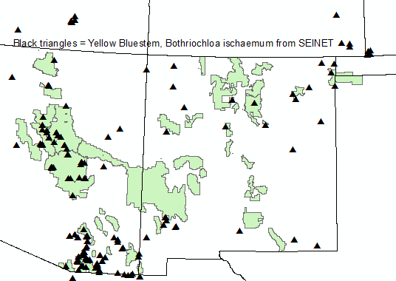
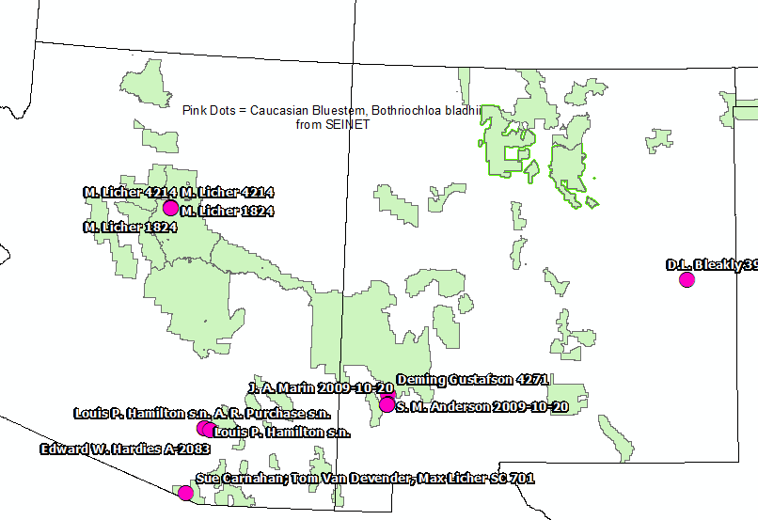
OWB locations in SEINet plants database*
Yellow bluestem
Caucasian bluestem
* National Forest System lands are highlighted in green.

Slide 12
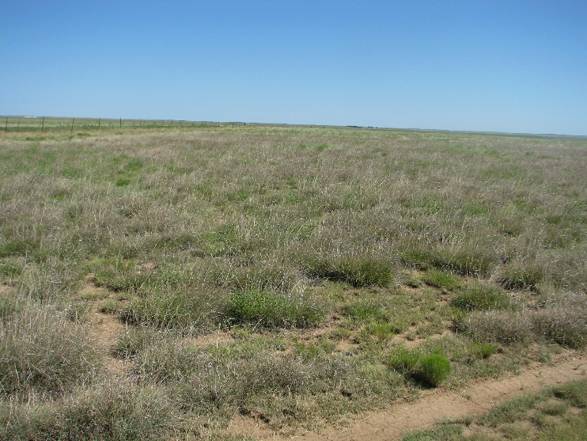
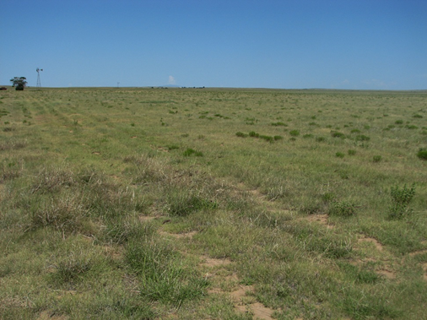
YB in Region 3
Yellow bluestem has been reported either on or near all national forests and national grasslands in Region 3.
Caucasian bluestem has been found on the Coconino NF along Forest Road 535. May also be present on the Coronado and Gila NFs according to SEINet.
Kiowa (shown), Rita Blanca, and Black Kettle National Grasslands in NM and OK all have yellow bluestem infestations.
CRP land w/ YB
New YB patch in 2-track road

Slide 13
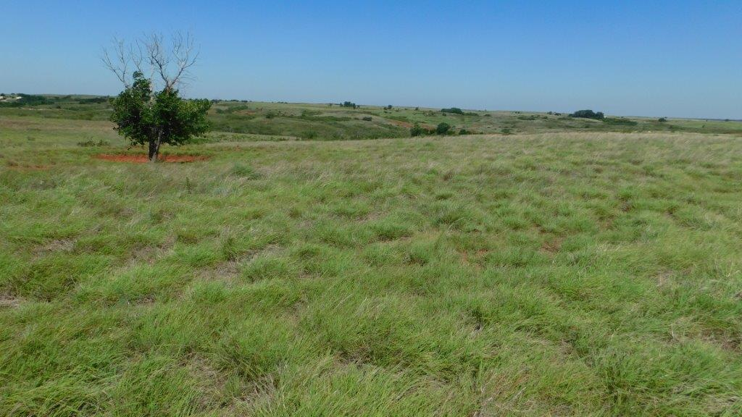
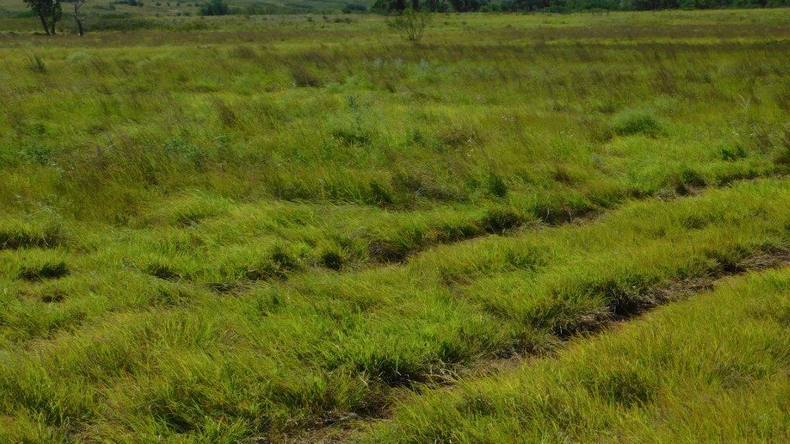
YB on Black Kettle NG
Some pastures on the Black Kettle NG in western Oklahoma have 5 to 15% YB cover after a drought, although a few pastures have reached as much as 35%.
YB is very prevalent on adjacent private lands and is still being planted by producers. The highway dept. of Roger Mills County has also planted YB along ROWs.
YB will displace most grasses, even weeping lovegrass.
Black Kettle NG manages heavy infestations by grazing them with yearlings during growing season.
Chuck Milner, Black Kettle NG
Chuck Milner, Black Kettle NG

Slide 14
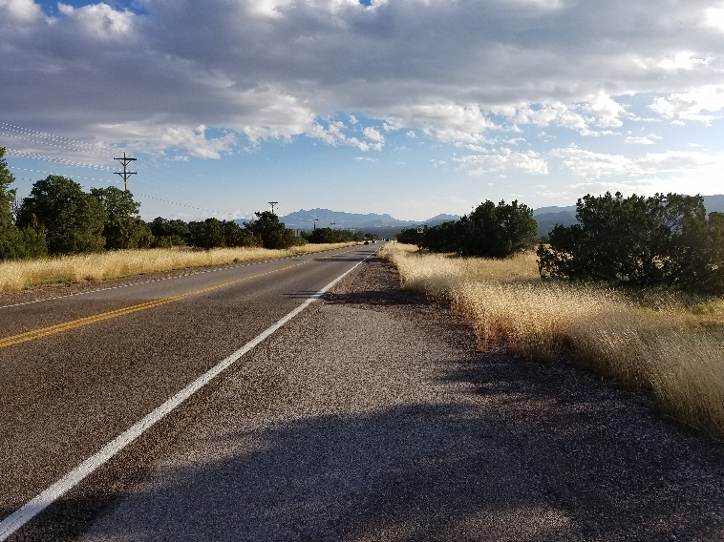
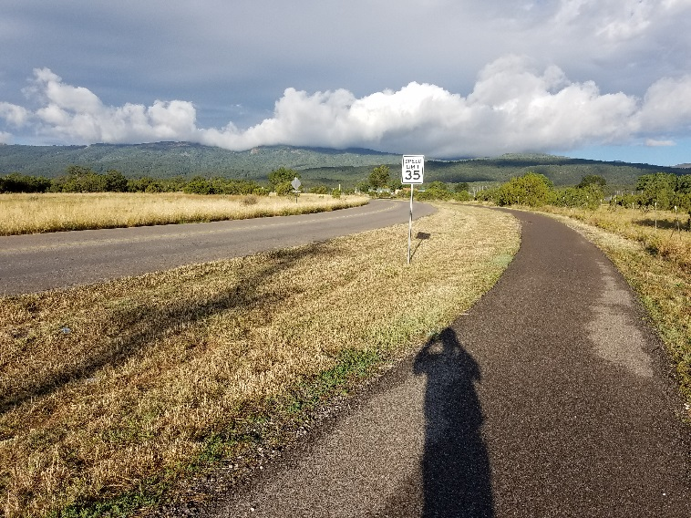
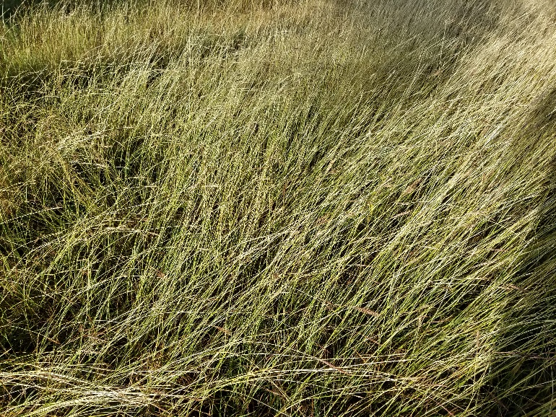
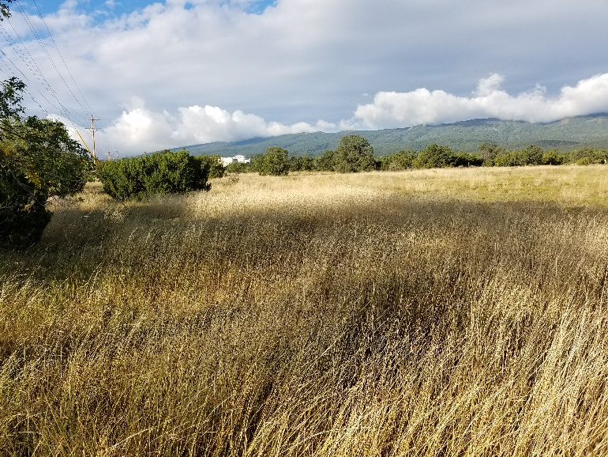
YB along SH 14 east of Albuquerque
USFS
USFS
USFS
USFS

Slide 15
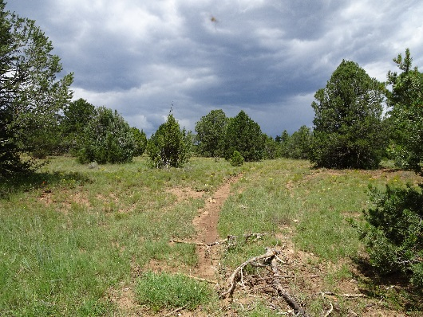
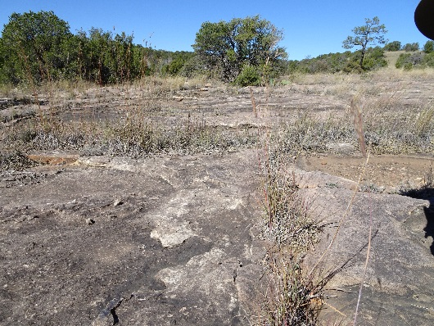
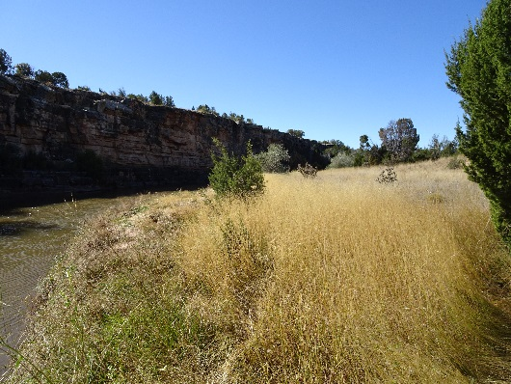
YB on Santa Fe NF
YB is growing in P/J grassland and rocky escarpments away from any road or disturbed area.
YB and silver bluestem occur in thick complexes along riparian areas of the Pecos River.

Slide 16
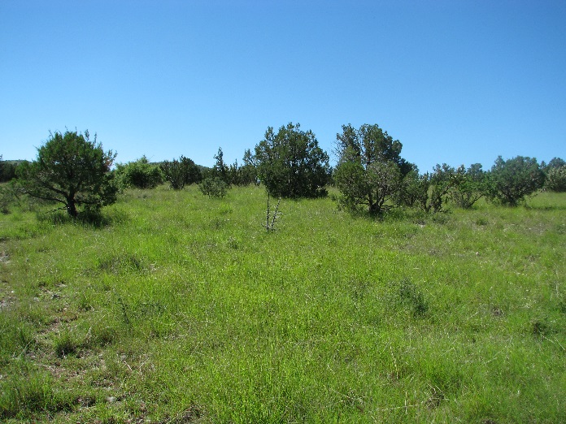
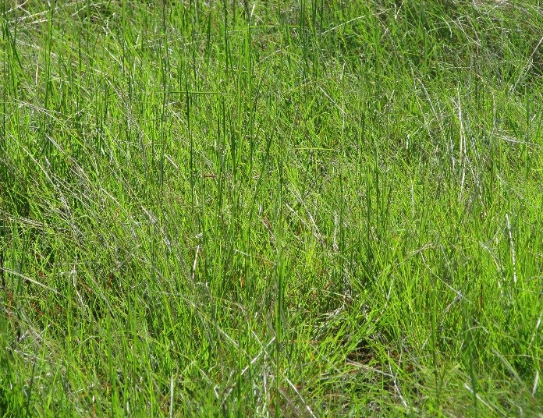
YB on Coronado NF
Sierra Vista and Nogales Ranger Districts on Coronado NF may have up to 2,000 acres of a combination of YB and Lehmann lovegrass.
Expansion of YB and Lehmann lovegrass on the two Ranger Districts has lowered biodiversity and has required changes in grazing management practices.
YB seems to establish better on calcareous soils as compared to granitic soils (J. Heitholt, Range Program Manager, Coronado NF)

Slide 17
FS options for OWB management
Add OWBs to invasive weed lists of national forests and grasslands in R3.
Survey and monitor for OWBs on National Forest System (NFS) lands.
Aggressively eradicate new OWB infestations and try to contain large infestations when feasible.
Coordinate with state DOTs and county highway depts. to limit OWB spread.
Prohibit OWB seed in mulch or seed mixes used on NFS lands.

