Slide 1
Invasives: “Call for Action” Common Priorities and Good Timing
Lindy Garner, DOI/USFWS
Sagebrush Biome Invasives Resource Team Lead
Mountain/Prairie Region
Notes:
For this project, I am going to provide just the administrative umbrella process we used to help get this project some support and funding and then Luke will go into the specifics of the project
This step was NOT the first step, these guys were full into the EDRR process and making great progress of awareness and gathering partners, hence how I found out about it. I then was just excited for them and motivated to try to find support….which is what I will talk about to hopefully show others one piece of how we can do this to get funding on the ground for conservation delivery

Slide 2
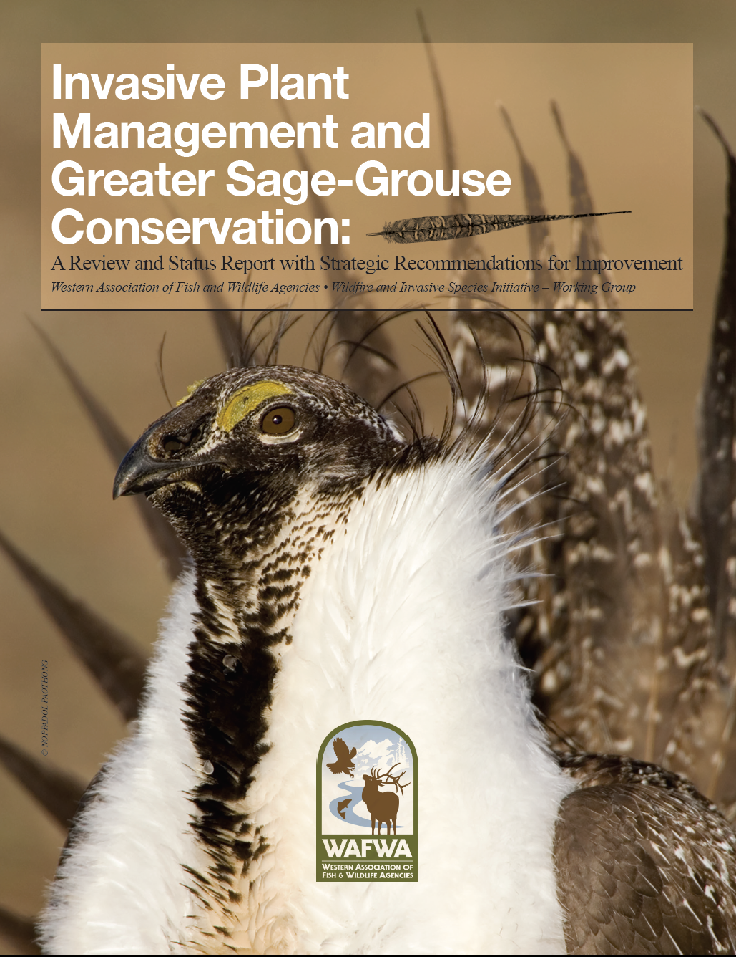
Invasives: “Call for Action”
FWS Role
Operational Capacity
Funding
Technical Assistance
Conservation Design
Collaboration and buy-in
Notes:
FWS and Partners and GRSG
Fire and Invasives Story
Highlighting Invasives and determining FWS Role
How best can we support and provide assistance, not get in the way but support from behind

Slide 3
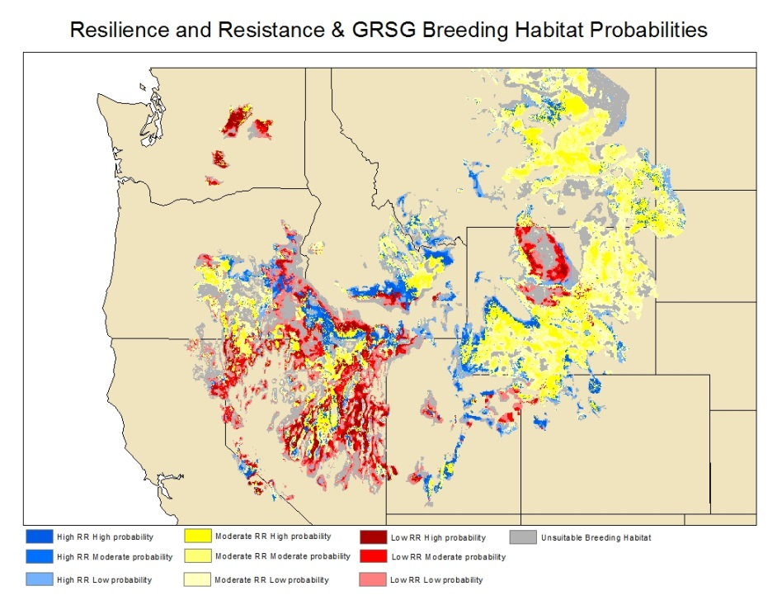
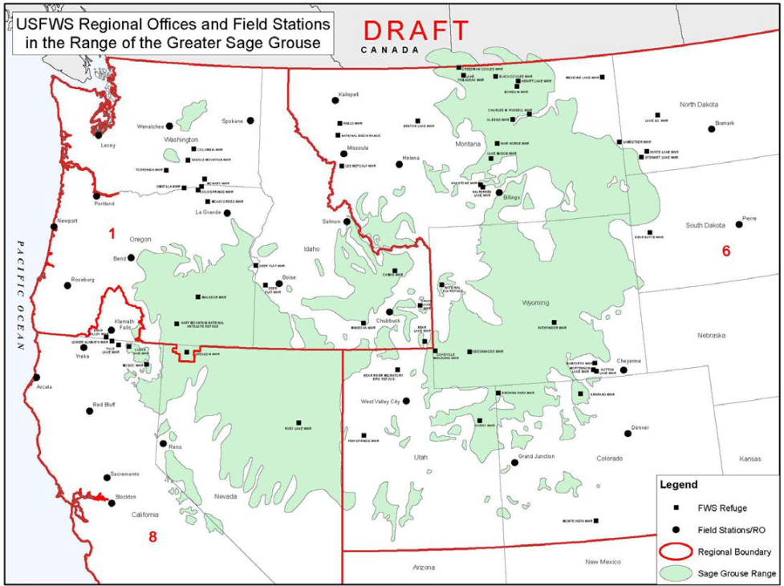





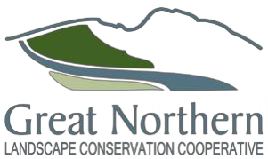




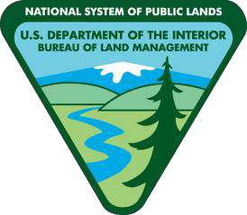
Prioritizing Place-based Conservation Delivery
Biology, Program, Partners
Notes:
And where on the landscape do we do this and how do we make that decision of where on the landscape, based on biology, where programs or partners are working,
All of the above

Slide 4

Random Acts of Conservation Kindness or Focused Triage?
Invasives Program and RRL NWR Cheatgrass Modeling
Soda Fire
Malheur Co, CCA
1,145 ac
Harney Co, BLM 45k Medusahead treatments
Lincoln and Fremont Co PFFW 1,100, 2,600, and 1500 ac cheatgrass treatments
Sheldon-Hart NWR, 15k ac
Notes:
For example Biologically…..We have great work happening on the ground, whether it is ranging from 45k ac treatment of medusahead in Harney County Or to 1200 ac treatment in Malheur Co OR to cheatgrass effort in Lincoln Co in Wy to extensive efforts with restoration from Soda fire, herbicide treatments, evaluating weed suppressive bacteria, targeted grazing, numerous partners
Sheldon-Hart 15k ac juniper removal with cheatgrass assessments and developing integrated strategies…
but it begs the question of Do we prioritize where we work (proactive) or work with willing partners or in response to fires (reactive)? If we work with willing partners or in response to fires are we in the paradigm of a shotgun array of conservation acts or triage gone wrong? Should we focus our triage from a FWS perspective or in other words, biggest positive impact for the GRSG and other partner priority resources of concern????

Slide 5
Common Priorities and Timing
National Framework for Early Detection and Rapid Response 2016
FWS trying to initiate “Hold the Line” pilot project
quickly detect and aggressively treat the spread of invasive annual grasses within high quality sagebrush habitat
NISC 2016-2018 National Management Plan, Action Item 2.5.4
“…to promote pilot projects across a variety of U.S. ecosystems that explore innovative, multi-stakeholder approaches to the early detection of and rapid response to invasive species.”
Notes:
Meanwhile, EDRR framework came out in 2016
FWS trying to initiate hold the line
And NISC mgmt plan came out
All had common priority of highlighting EDRR
We had been trying to get some conversations going in NV, staff shortages were a barrier and meanwhile I was on calls and in discussion with Brian and Slade of what we could get going for a partnership in WY and then the new the discovery of medusahead

Slide 6
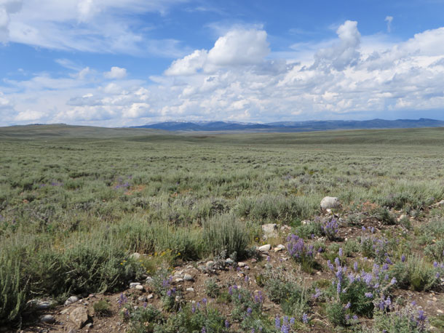
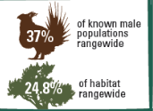
Wyoming EDRR Pilot
Most sagebrush of any state at 43 million acres and stronghold for greater sage-grouse.
Wyoming 2008, one of the first to adopt a comprehensive statewide core area strategy
Notes:
My agency was looking to also explore pilot projects, especially relative to eDRR
WY was of interest because it wasn’t infested as Great basin and still a chance, plus
43 million ac of sagebrush, and the high proportion of GRSG and habitat
NV has 21.2% of habitat rangewide

Slide 7
Notes:
Plus, the new infestations were near PAC and good example of importance of EDRR to prevent further risk and encroachment into other areas

Slide 8
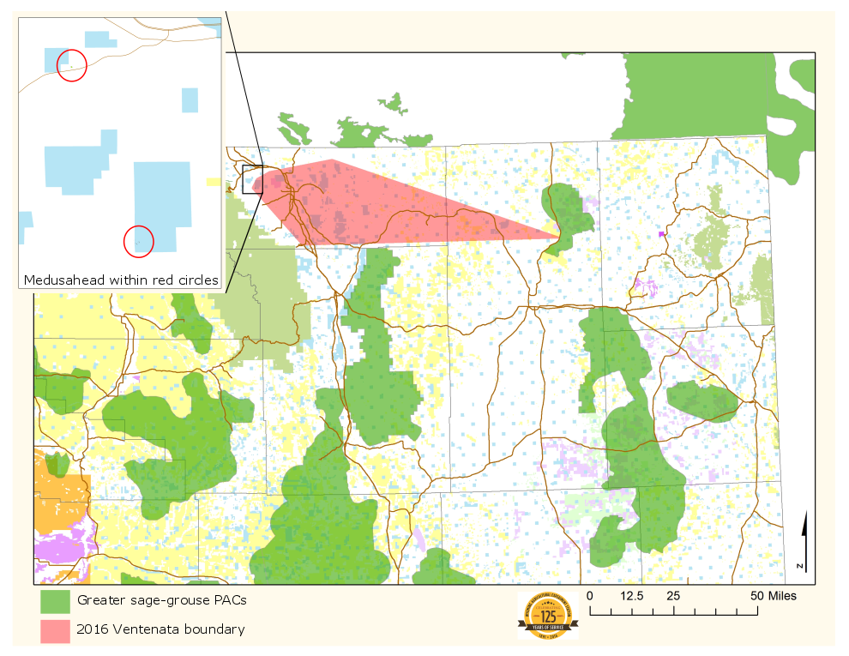
Notes:
Close up view of infestations and PACs,

Slide 9
FWS IAA NISC Proposal: Early Detection and Rapid Response to New Invasive Grasses in North Central Wyoming
Purpose: Develop a pilot project within the sagebrush biome that addresses early detection and rapid response of invasive grasses with multiple partners.
NISC 2016-2018 National Management Plan, Action Item 2.5.4 – “…to promote pilot projects across a variety of U.S. ecosystems that explore innovative, multi-stakeholder approaches to the early detection of and rapid response to invasive species.”
EO 13112 Sec 6(c) “…advance national incident response, data collection, and rapid reporting capacities that build on existing frameworks and program and strengthen early detection of and rapid response to invasive species…”
National Framework for Early Detection and Rapid Response Framework Guiding Principles; Complementarity, Partnerships, Scale, Implementation, Timeliness, Resource Availability, Metrics.
Notes:
So I asked if Brian, Luke and Slade were interested in me trying to get some funding through a proposal to NISC and this is how we did it
Service was selling entity to NISC that we would help them achieve their management plan action item and support and advance EO and EDRR framework

Slide 10
FWS IAA NISC Proposal: Early Detection and Rapid Response to New Invasive Grasses in North Central Wyoming
Partners: DOI USFWS and BLM, DOA NRCS and FS, WY Dept Ag, Sheridan County Weed and Pest, Sheridan County Conservation District, Office of State Lands and Investments, Game and Fish Dept, and University of Wyoming Sheridan Research and Extension Center, Weed Extension
Develop a process-template for the following:
identify stakeholders,
raise awareness,
facilitate collaboration and coordination
Track and identify cost-efficiencies, challenges, and opportunities for stream-lined and timely implementation of management strategies within existing federal and non-federal partnerships
leverage existing capacities and resources
Develop performance measures among all partners for an evaluation of EDRR efficiency and effectiveness.
Notes:
With partners we will develop and track a process for the steps of EDRR….

Slide 11
FWS IAA NISC Proposal: Early Detection and Rapid Response to New Invasive Grasses in North Central Wyoming
Outcomes
Identify scope and extent of current threat of medusahead and ventanata in Wyoming, starting with Sheridan County as ground zero; FY17. Subsequently identify gaps of tools, capacity or resources for EDRR coverage; FY18.
Assist multi-stakeholder Task Force working collaboratively, across jurisdictions, to identify EDRR priorities that leverage existing capacities and additional resources to reduce an invasive annual grass threat within the sagebrush biome; FY17
Explore innovative techniques to monitor and collate performance measures to evaluate efficiency and effectiveness; FY18
Identify needs and opportunities to predict areas at risk of invasion based on EDRR spatial data, pathways and vectors; FY18
Notes:
Outcomes would be ground-based conservation delivery

Slide 12
FWS Cooperative Agreement with Sheridan County Wyoming Weed and Pest
Partners for Fish and Wildlife Program
Purpose: develop an EDRR pilot project for invasive species reconnaissance through visual observation and other detection methods to define scope of recent infestation. US Fish and Wildlife Service (FWS) staff will work with the SCWP, cooperating landowners, and other partners in carrying out the EDRR pilot program jointly developed under this Cooperative Agreement.
Outcomes:
to identify the scope and extent of infestation and develop appropriate treatments of incipient populations of ventenata and medusahead.
efficiently accomplish conservation work in Sheridan and surrounding Counties that is mutually beneficial to the Service, SCWP and individual cooperators
Notes:
Purpose to get the money on the ground, so then we had to develop a cooperative agreement
Lot of conversation for what would work best, allow getting other projects on the ground, what most streamlined effort, etc…talked about options like with existing agreement with TNC or conservation districts….
Partners for Fish and Wildlife Program and Sheridan County Weed and Pest
Now Luke will provide an overview of their great project and you will see why I was interested in showcasing this project as an ideal EDRR pilot!

Slide 13
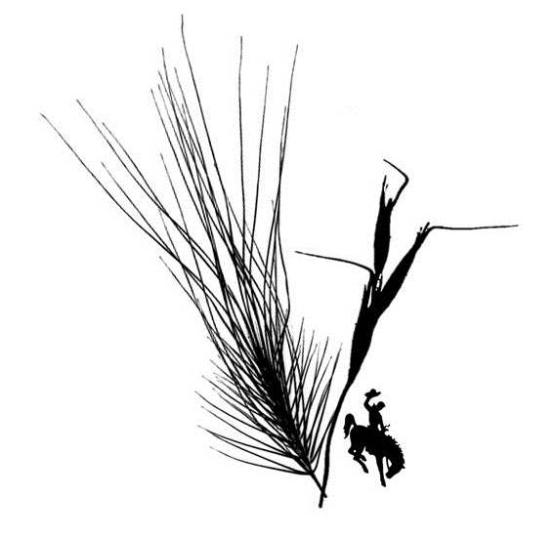


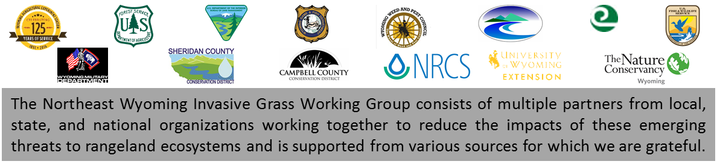
Northeast Wyoming Invasive Grass Working Group
NEWIGWG
Minimizing impacts to rangelands for wildlife and agriculture by reducing, containing, or eradicating medusahead and ventenata in northeast Wyoming
Notes:
They give their presentation

Slide 14
Northeast WY Invasive Grass EDRR Pilot Complementarity, Partnerships, Scale, Implementation, Timeliness, Resource Availability, Metrics
Opportunities
Challenges
Several partners willingness, landowners on board
Agreement for inventory
No gap between state and federal, common priorities
Big group of collaborating experts
Federal financial agreements timeliness
Detectability with high spring production
Terrain
Identifying Vectors of spread; linked properties grazing association
Long-term funding and some tied to current year and treatment only
Notes:
Use for discussion at end for more information from Luke and Slade and others in audience for what they have found
Coop agreement and contracting hurdles
Ventanata growth form tall but medusahead must smaller and finer; rough and vast terrain challenged transect completion
Need to identify grazers movement of cattle to identify areas at risk
Funding long term for eradication success and if limited to current year or treatment only then if need to survey more areas need other sources of funding

