Slide 1



Building a better presidential Transition
Bill Whitacre
Policy Advisor
JIM OGSBURY Executive Director

Slide 2
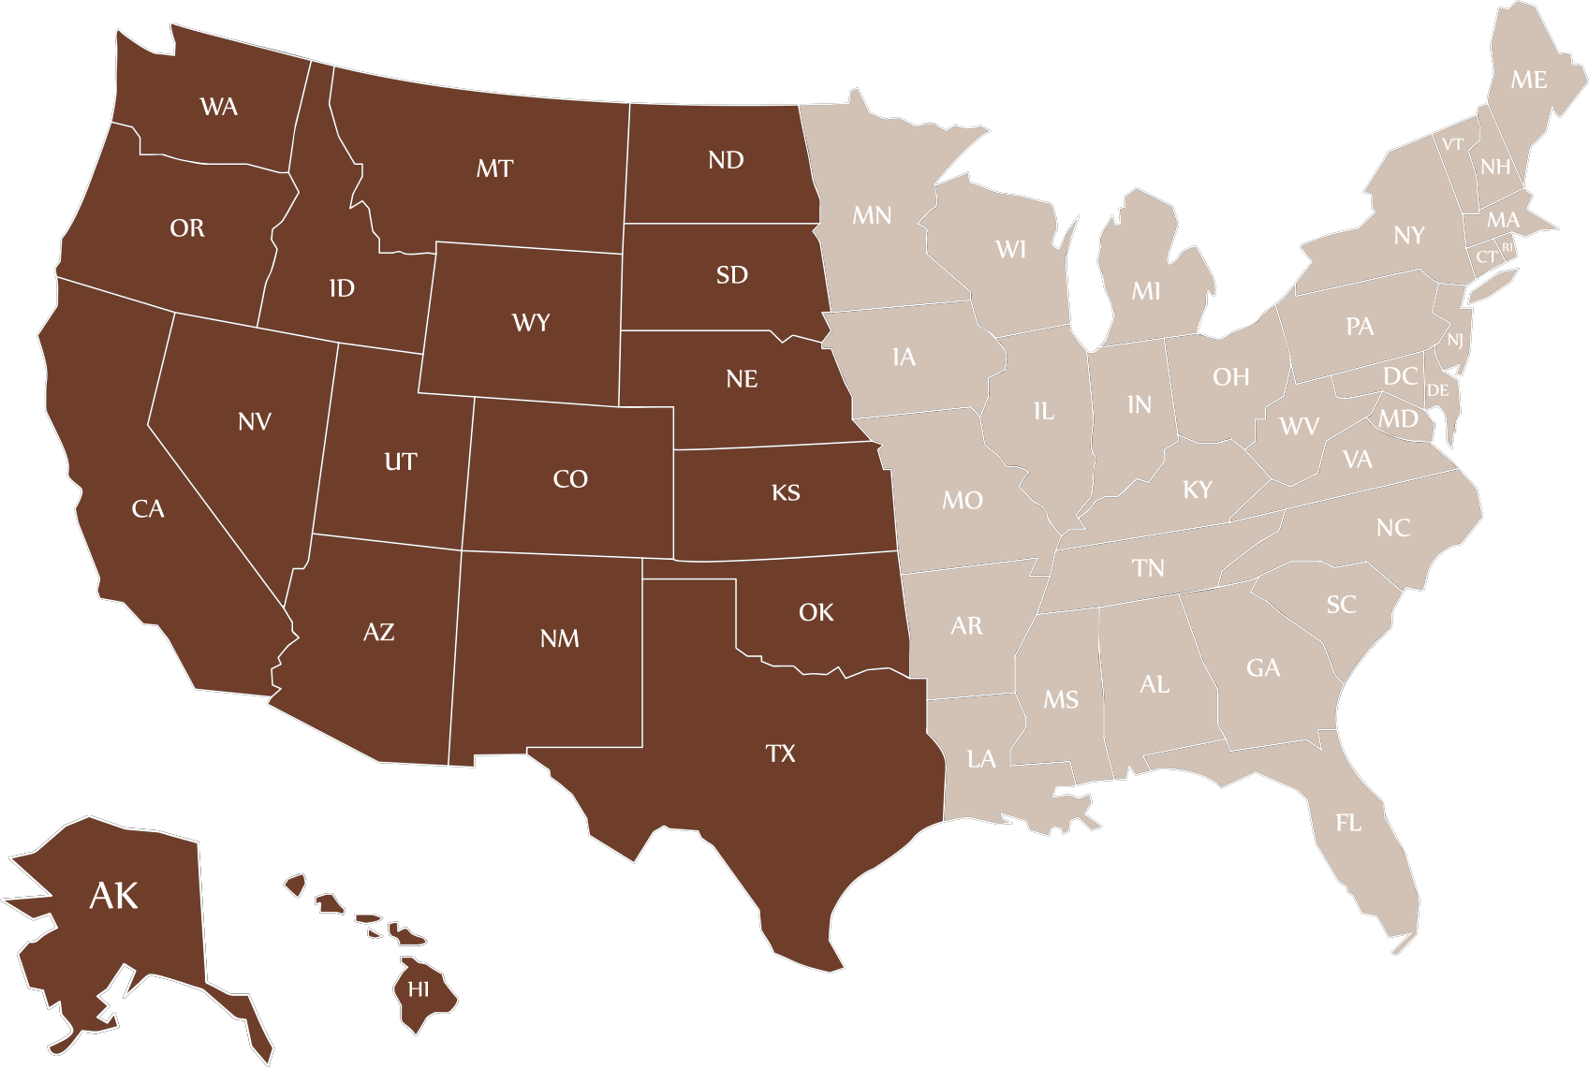
THE STATES

Slide 3
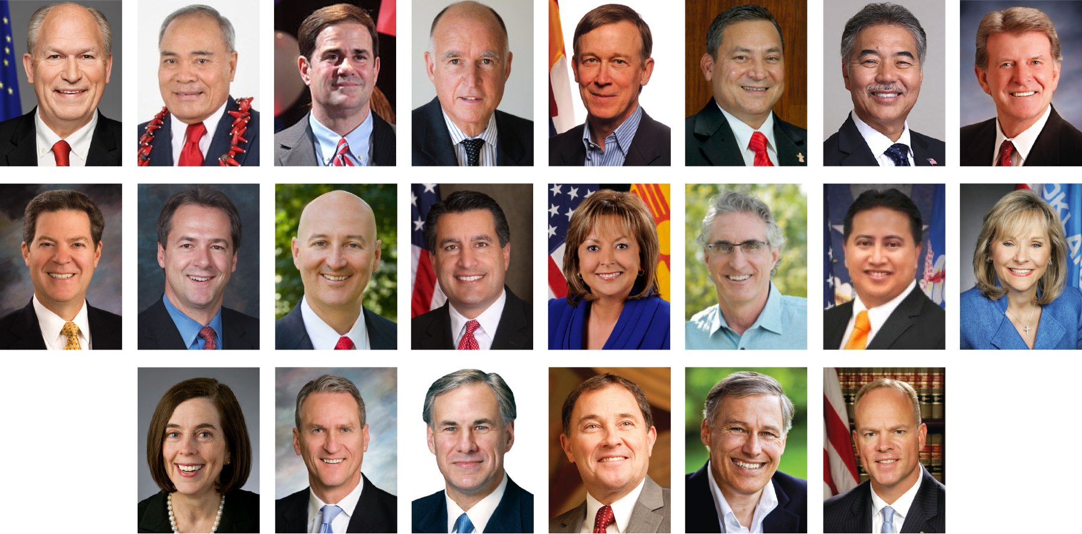
THE GOVERNORS

Slide 4

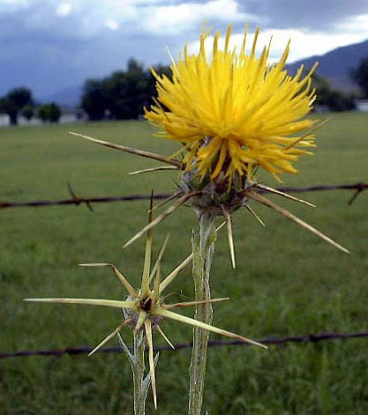
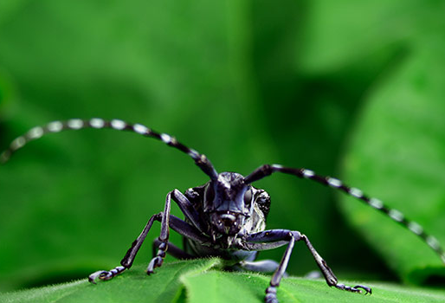
Western Governors engage on invasive species

Slide 5
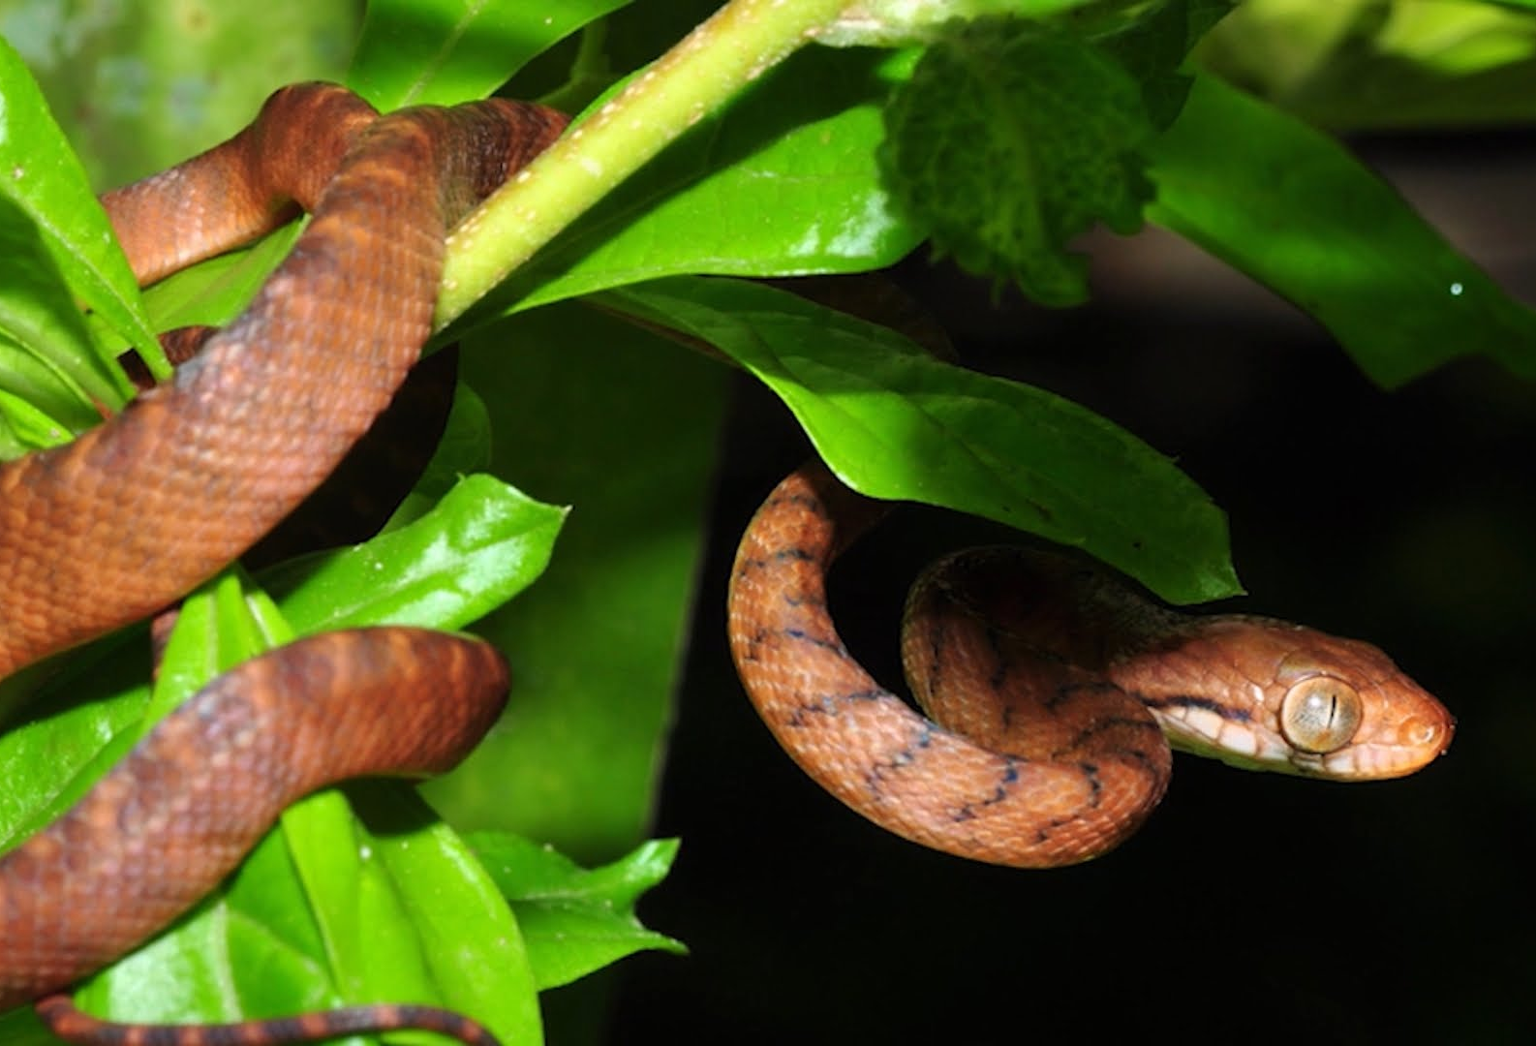
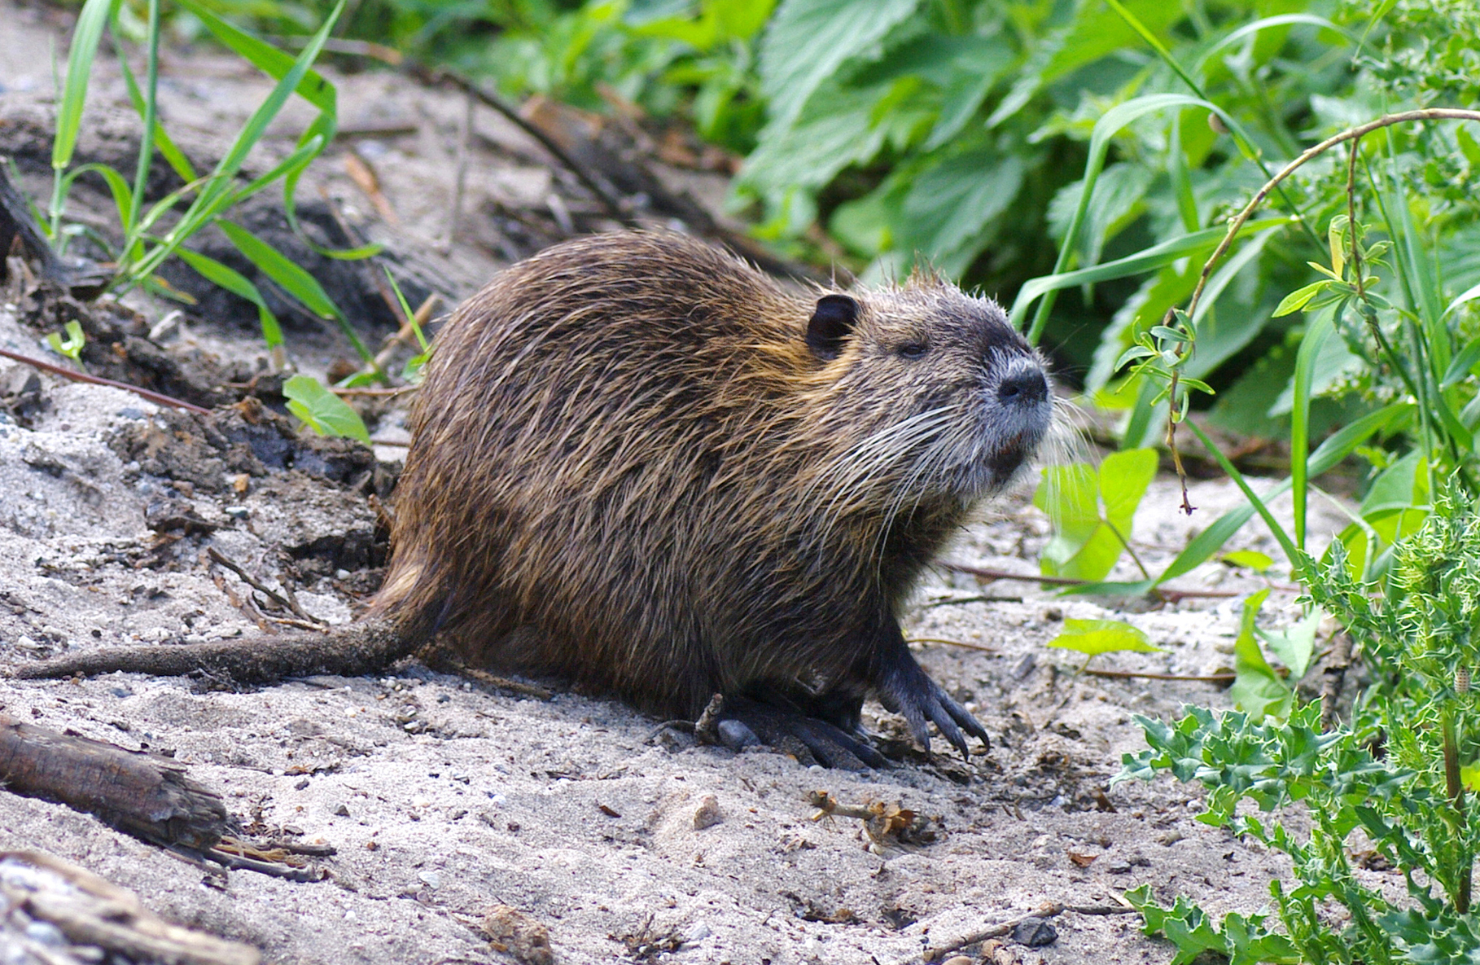
Policy Resolution:
Combating Invasive Species

Slide 6
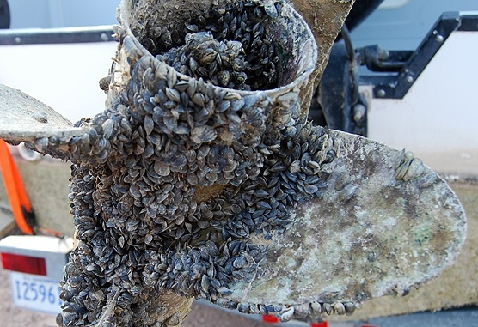
West-wide Invasive Species
Risk-assessment

Slide 7
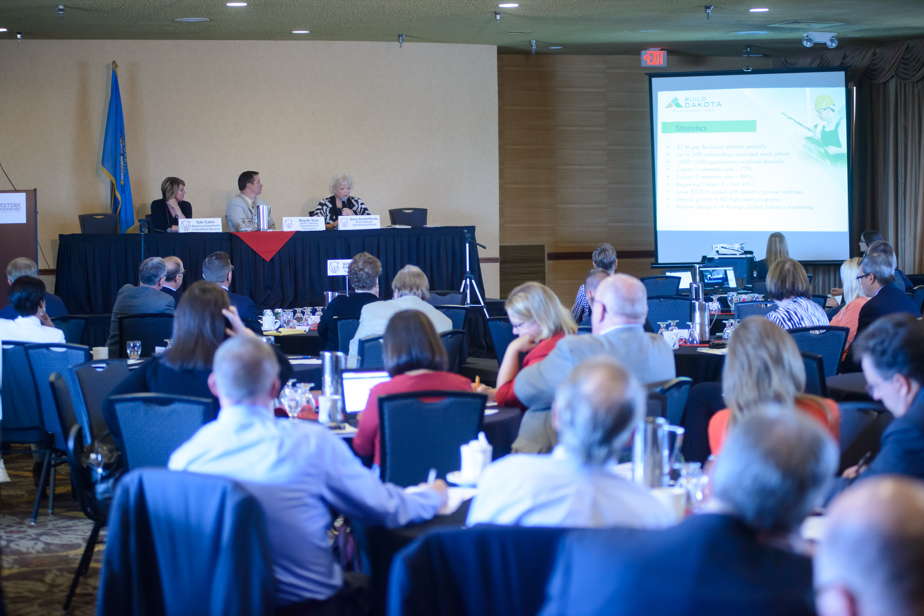
Data Management and Exchange Protocols

Slide 8
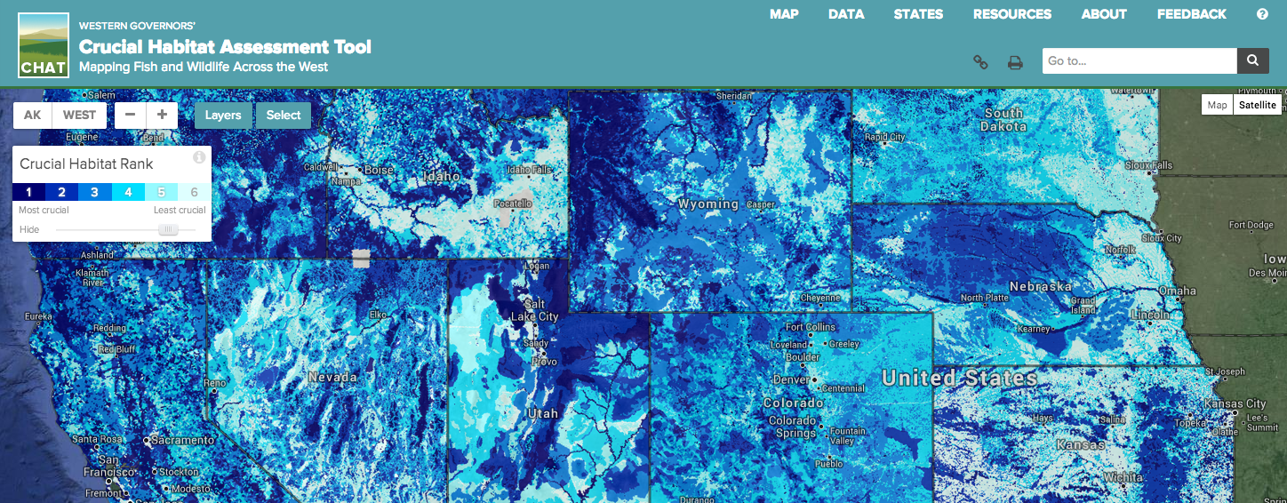
Invasive Species Data Portal and Clearinghouse

Slide 9
Building a better presidential Transition
Bill Whitacre
Policy Advisor
bwhitacre@westgov.org
720.897.4538
JIM OGSBURY Executive Director

