Slide 1




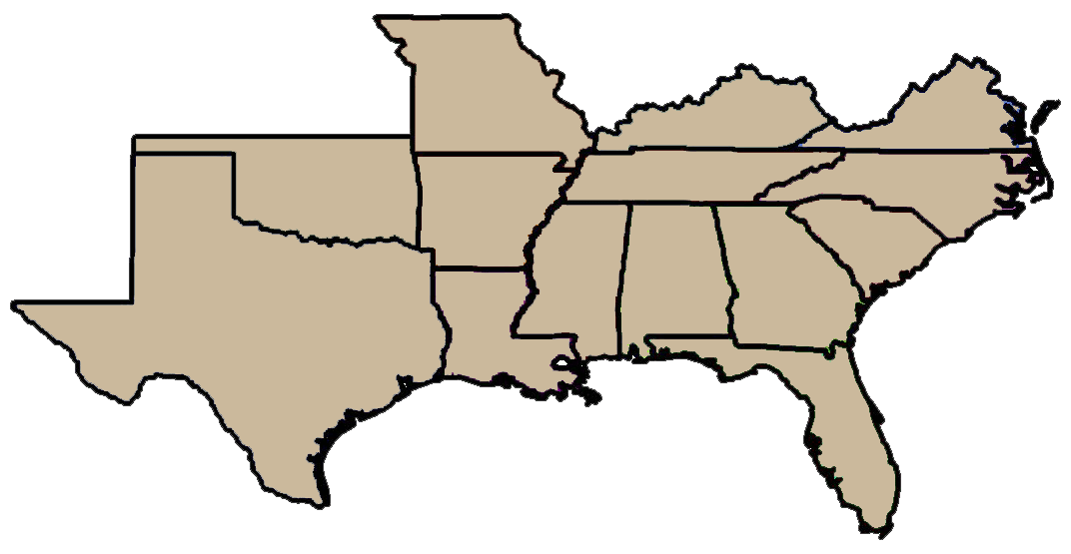

Washington DC Update on Weed Science Policy Issues
Lee Van Wychen
Director of Science Policy
The National and Regional Weed Science Societies
North Central
Weed Science Society
Southern Weed Science Society

Slide 2
Outline
New Administration & Congress
Policy Issues
NISAW
Survey of Most Common and Troublesome Weeds

Slide 3
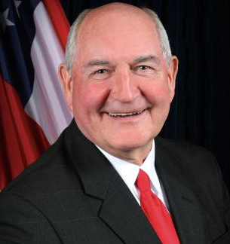
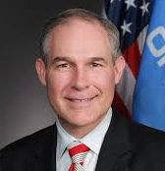
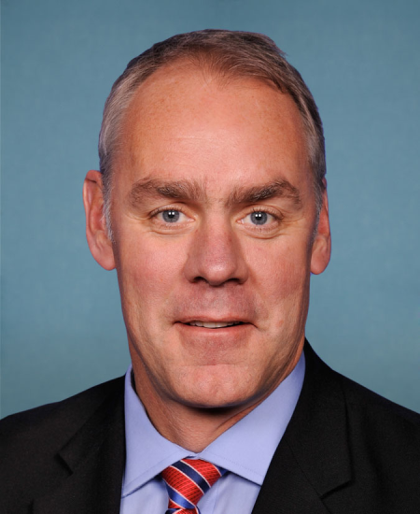

New Administration
USDA
Sonny Perdue
-Georgia-
Veterinarian;
Agribusiness
owner
EPA
Scott Pruitt
-Oklahoma-
Constitutional lawyer;
Federalism
Interior
Ryan Zinke
-Montana-
Navy Seal;
Multiuse fed’l
land mang’t
Commerce
Wilbur Ross
-New Jersey-
MBA Harvard;
Oversees NOAA
and NMFS

Slide 4
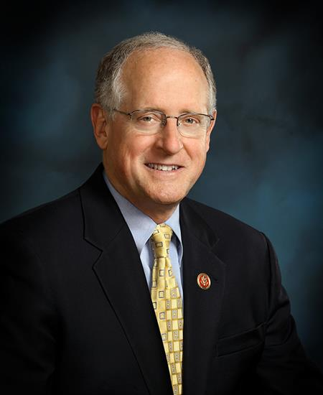
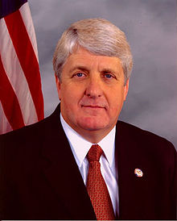
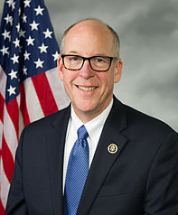
Key House Committee Chairs
Mike Conaway
-Texas-
Agriculture
Collin Peterson
-Minnesota-
Rob Bishop
-Utah-
Natural Resources
Raul Grijalva
-Arizona-
Greg Walden
-Oregon-
Energy & Commerce
Frank Pallone
-New Jersey-

Slide 5
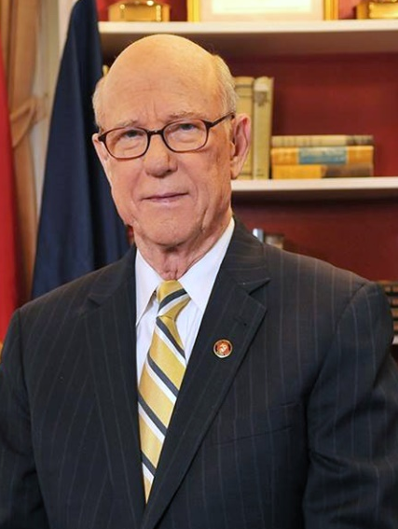
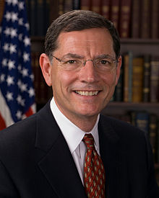
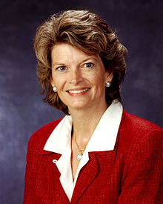
Key Senate Committee Chairs
Pat Roberts
-Kansas-
Agriculture
Deb Stabenow
-Michigan-
John Barrasso
-Wyoming-
Environment &
Public Works
Tom Carper
-Delaware-
Lisa Murkowski
-Alaska-
Energy & Natural
Resources
Maria Cantwell
-Washington-

Slide 6
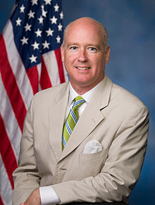
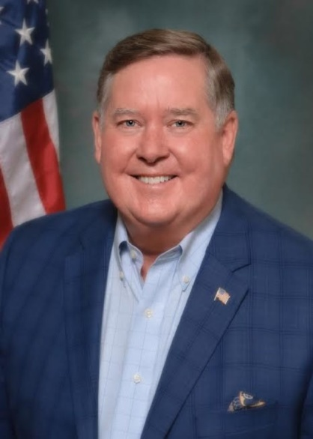

Key House Appropriation’s Chairs
Rob Aderholt
-Alabama-
Agriculture
Sanford Bishop
-Georgia-
Ken Calvert
-California-
Interior & Environment
Betty McCollum
-Minnesota-
Mike Simpson
-Idaho-
Energy & Water
Marcy Kaptur
-Ohio-

Slide 7
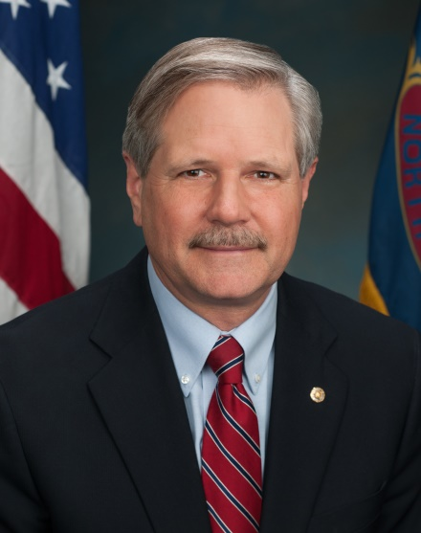
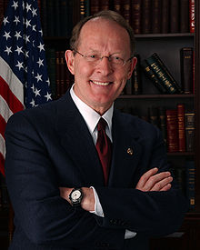
Key Senate Appropriation’s Chairs
John Hoeven
-North Dakota-
Agriculture
Jeff Merkley
-Oregon-
Lisa Murkowski
-Alaska-
Interior & Environment
Tom Udall
-New Mexico-
Lamar Alexander
-Tennessee-
Energy & Water
Dianne Feinstein
-California-

Slide 8
2018 Farm Bill Recommendations
Promote Areawide IPM programs and funding
Extend data exclusivity period for herbicide registrants in exchange for implementing resistance management stewardship practices
Add “invasive species” to the Foundation for Food and Agricultural Research’s list of national priorities
Require National Program Leaders in USDA-ARS and USDA-NIFA for Weeds and Invasive Plants

Slide 9
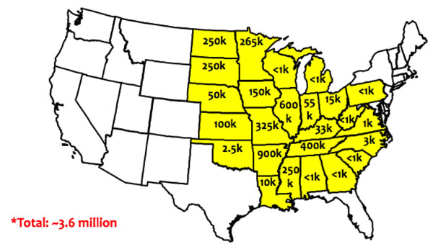
Dicamba Off-Target Movement
As of 10/15/2017:
2,708 drift complaints
~3.6 million injured soybean acres
Physical drift at time of application
Tank contamination
Temperature inversions
Volatilization

Slide 10
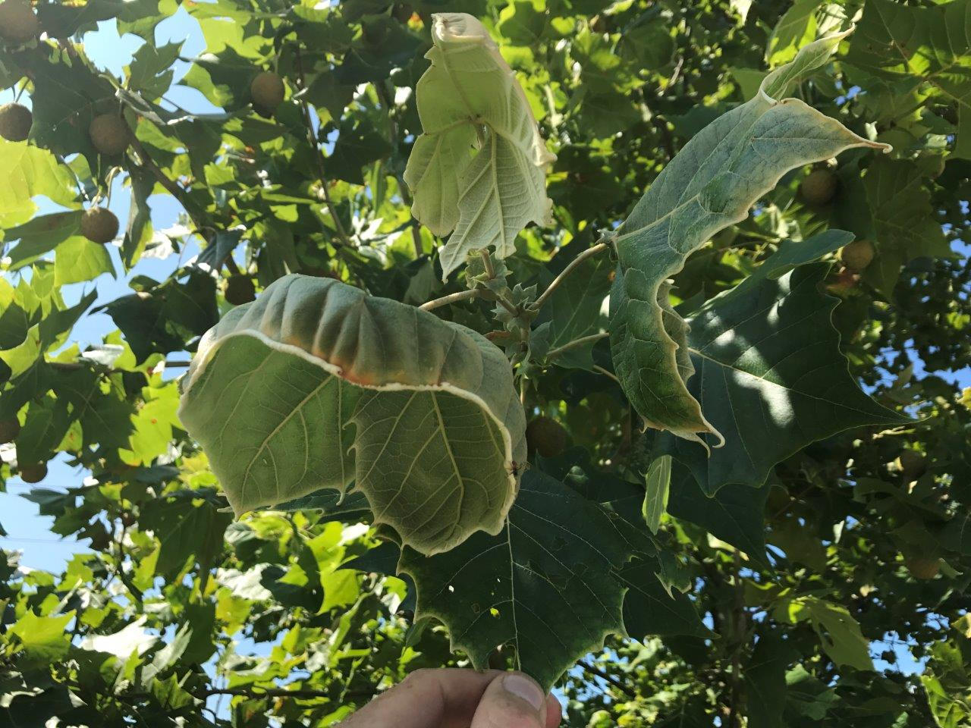
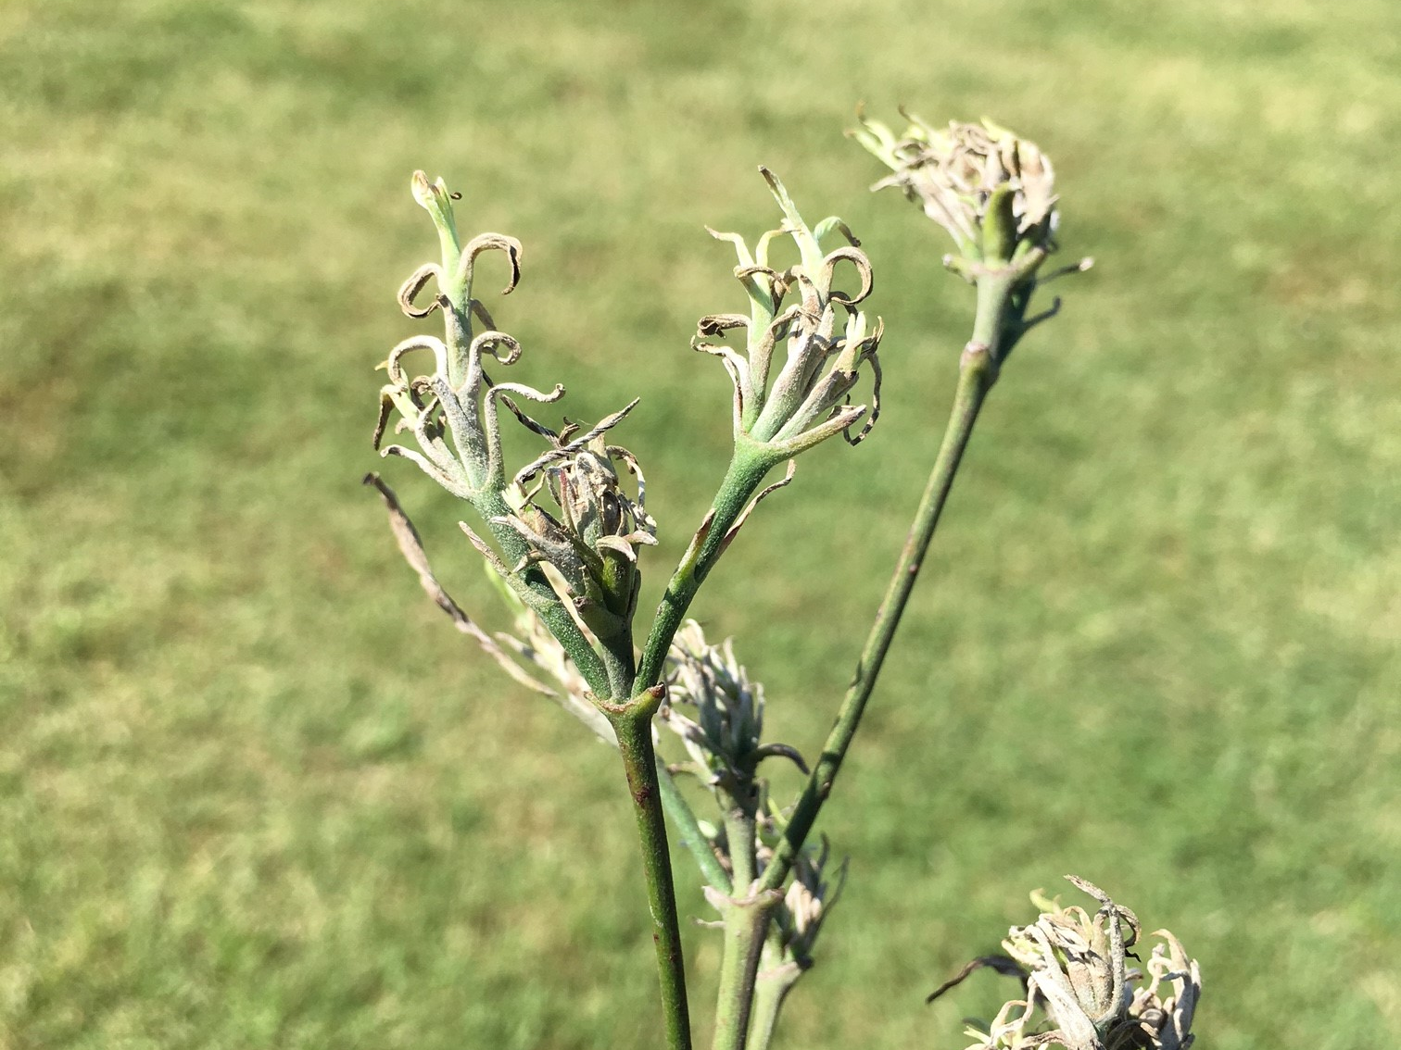
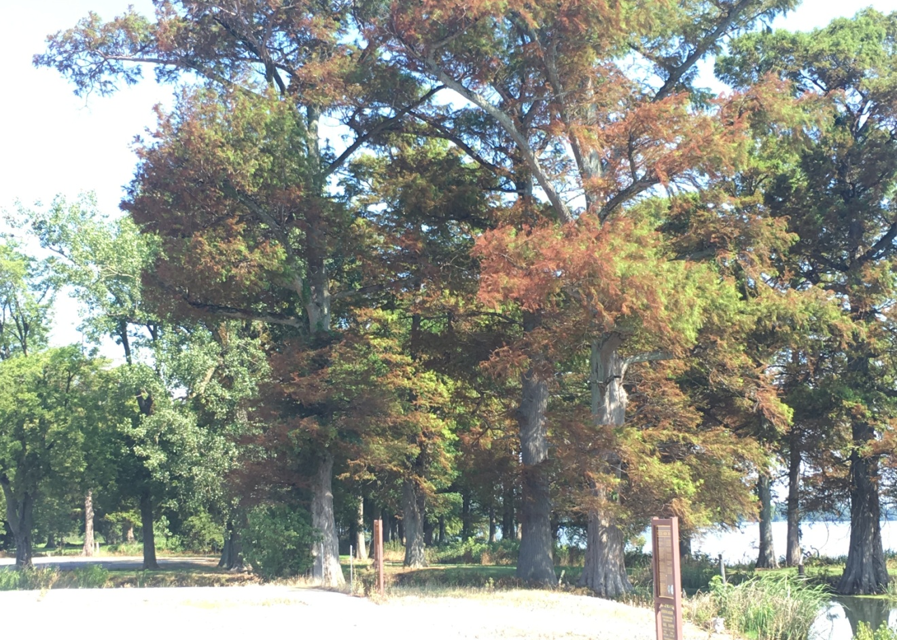
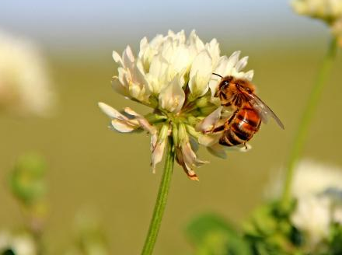
Sycamores
Dogwoods
Reelfoot Lake
State Park, TN
Effect on
pollinators?

Slide 11
EPA Herbicide Resistance Management
Label Guidance
Finalized September 2017
Applies to almost all herbicide uses (except residential)
Labels must include herbicide MOA, guidance on scouting, and how to recognize weed resistance
Registrant reporting of suspected and confirmed resistance
“Stakeholders” develop local weed resistance management plan

Slide 12
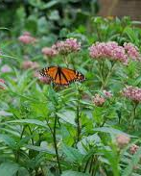
Milkweeds and Monarchs
Little info exists on milkweed population dynamics and distribution
Cornell study based on 22 years of monitoring data
  Millkweed not limiting
  Fall migration & over-wintering is critical period
US FWS assessing conservation plans. June 2019 decision on whether to list under ESA

Slide 13
Herbicide Synergism Patents
& Tank Mix Prohibitions
Synergism – largely overestimated in herbicide literature due to simplification of data analysis
  100’s of patents filed since 1960’s
  No universally accepted definitions or methods
  True synergy is relatively rare!
EPA recognizes the benefits of tank mixing……but,
“Uncertainty” of potential herbicide synergism effects on non-target organisms

Slide 14
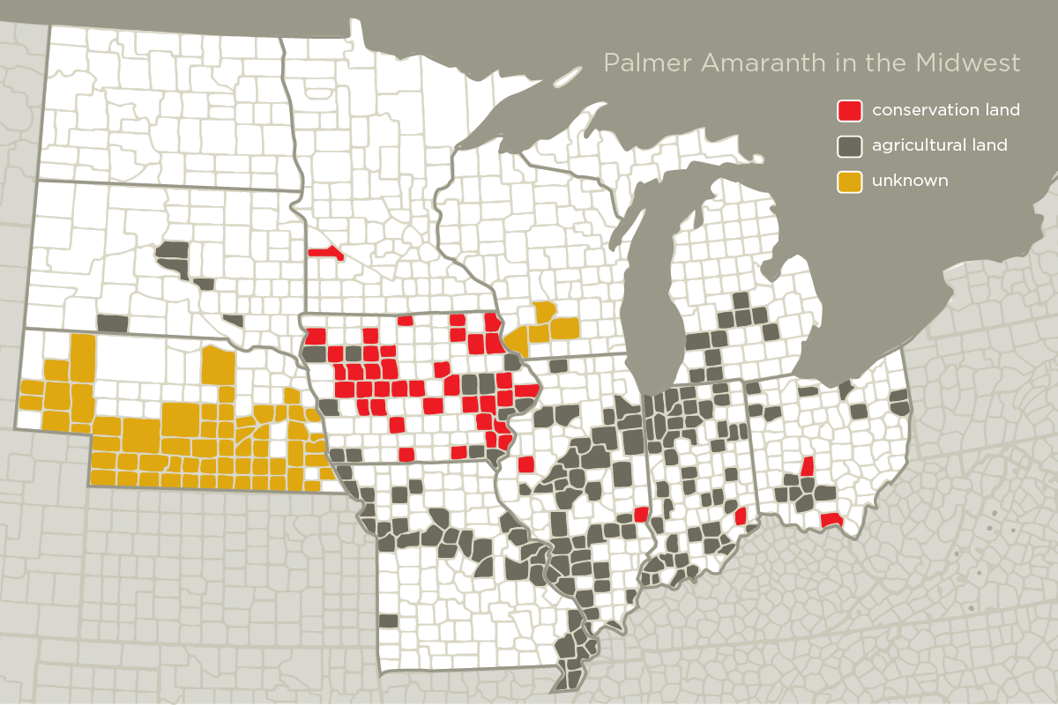
Weed Seed Spread in Native Seed Mixes

Slide 15
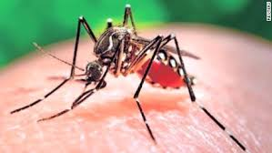
National Pollutant Discharge Elimination System (NPDES) permits
NPDES pesticide general permits (PGP) were required beginning in Oct. 2011 for applications of pesticides in, over, or near waters of the United States (WOTUS).
    Prior to 2011, aquatic use pesticides tested and approved under FIFRA were exempt from CWA
    About half the states req’d additional permitting
“Legislative fix” bills
H.R. 953 and S. 340
Need Senate Support!

Slide 16
Other Major Policy Issues Impacting Weed Management
Endangered Species Act
NEPA Reform
Glyphosate- IARC corruption and misinformation
WOTUS recodification and rulemaking

Slide 17

February 26 – March 2, 2018
www.nisaw.org
Capitol Hill seminars, webinars
Federal agency fair and awards reception
Rick Otis and Alex Hosmar: Reduce Risks from Invasive Species Coalition (RRISC)

Slide 18
Reps. Elise Stefanik (R-NY), Mike Thompson (D-CA)
  Invasive Species Caucus Co-chairs
Greater PR and awareness of invasive species events throughout the year
Cultivating the next invasive species champion

Slide 19
National Weed Survey:
Most Common and Troublesome Weeds
2015 Baseline Survey: Weeds in 26 different crop, non-crop, aquatic, and natural areas
2016 Survey: Weeds in broadleaf crops, fruits, vegetables
2017 Survey: Weeds in grass crops, pasture, and turf
2018 Survey: Weeds in aquatic, non-crop, & natural areas
http://wssa.net/wssa/weed/surveys/

Slide 20
Top 6 Weeds in Natural Areas- Parks, Refuges
(52 survey respondents)
MOST
COMMON
MOST
TROUBLESOME
1 | Bromus spp. (17)*
2 | Canada thistle (12)
3 | garlic mustard (8)
4 | Elaeagnus spp. (7)
4 | multiflora rose (7)
6 | Tie among 4 species (6)
1 | Bromus spp. (12)*
1 | toadflax spp. (12)
3 | knapweed spp. (11)
4 | Canada thistle (10)
5 | leafy spurge (7)
5 | cogongrass (7)
5 | Japanese knotweed (7)
* number of survey respondents who listed the weed species as one of their top 5 weeds in this crop.
Bromus spp. included downy brome (cheatgrass), and smooth and red brome.
toadflax spp. included yellow and Dalmatian toadflax.
knapweed spp. included Russian, spotted, and diffuse knapweed and yellow starthistle.
Elaeagnus spp. included autumn-olive and Russian-olive.

Slide 21
Top 6 Weeds in Pasture, Rangeland, other Hay
(54 survey respondents)
MOST
COMMON
MOST
TROUBLESOME
1 | Canada thistle (19)*
2 | Bromus spp. (14)
3 | Carduus spp. (13)
4 | common ragweed (8)
4 | leafy spurge (8)
4 | knapweed spp. (8)
1 | Canada thistle (18)*
2 | leafy spurge (12)
2 | toadflax spp. (12)
2 | knapweed spp. (12)
5 | Bromus spp. (10)
6 | Tie among 2 species (9)
* number of survey respondents who listed the weed species as one of their top 5 weeds in this crop.
Bromus spp. included Japanese, red, and downy brome (cheatgrass), and rescuegrass.
toadflax spp. included yellow and Dalmatian toadflax.
Carduus spp. included musk, plumeless, and Italian thistle.
knapweed spp. included Russian, spotted and diffuse knapweed and yellow starthistle.

Slide 22
Top 10 Most Troublesome Weeds among all Terrestrial Crop and Non-crop Areas
(606 total survey respondents)
MOST
TROUBLESOME
1 | Palmer amaranth (127)*
2 | morningglory spp. (101)
3 | common lambsquarters (97)
4 | horseweed (marestail) (94)
5 | waterhemp (92)
6 | nutsedge spp. (90)
6 | Canada thistle (90)
8 | kochia (89)
9 | giant ragweed (71)
9 | foxtail spp. (70)
* number of survey respondents who listed the weed species as one of their top 5 weeds.
morningglory spp. included ivyleaf, pitted, tall, and sharppod morningglory.
nutsedge spp. included yellow and purple nutsedge.
foxtail spp. included giant, green, and yellow foxtail.

Slide 23
Top 10 Most Troublesome Weeds among
all Aquatic Areas
(84 total survey respondents)
MOST
TROUBLESOME
* number of survey respondents who listed the weed species as one of their top 5 weeds.
Myriophyllum spp. included Eurasian, variable and northern watermilfoil, watermilfoil hybrids, and parrotfeather.
Potamogeton spp. included curlyleaf, Illinois, leafy, American and Richardson’s pondweed
Salvinia spp. included giant salvinia and water fern.
algae spp. included filamentous and planktonic algae and “harmful algal blooms”.
Lemna spp. included common duckweed.
Ludwigia spp. included creeping and Uruguay waterprimrose and primrose-willow.
1 | Myriophyllum spp. (47)*
2 | hydrilla (45)
3 | Potamogeton spp. (26)
4 | waterhyacinth (19)
5 | Salvinia spp. (14)
6 | algae spp. (13)
6 | Lemna spp. (13)
6 | Ludwigia spp. (13)
9 | waterlettuce (12)
10 | Tie among 2 species (9)

Slide 24
Future Weed Research Focus
  Automation, Robotics, Precision Weed Management
  Biotechnology - Gene drives, RNAi

Slide 25
Lee Van Wychen
Director of Science Policy
The National and Regional Weed Science Societies
5720 Glenmullen Pl
Alexandria, VA 22303
Lee.VanWychen@wssa.net
202-746-4686

