Slide 1
U.S. Geological Survey
Agency Report – Invasive Plants
Annie Simpson
asimpson@usgs.gov
Western Weed Coordinating Committee
November 29, 2017
Las Vegas, Nevada
Notes:
Top five things for the next 3-5 yrs on invasive plant issues:
1. Using remote sensing to document presence or condition of invasive plants.
E.g., work on tamarisk and buffelgrass
3. Improve decision making for managing invasive plants
E.g., structured decision making for control of melaluca in South Florida, adaptive management in control of Phragmites at the landscape scale, management of sage steppe in the Great Basin
4. Forecasting potential range or range shifts
E.g., some of the work coming out of FORT (variety of species) and Hawaii (predicting range shifts in response to climate change)
5. Restoration, especially after application of control efforts
E.g, work on cheatgrass
Agency Structure and priorities...who does what/where/when with weeds
USGS has scientists across the country conducting research on invasive plants. The vast majority of our work is done to benefit particular partners with specific management needs for invasive plants.
Authorities/mandates that steer our work:
No specific mandates or authorities for invasive species in USGS beyond Executive Order 13112
Funding sources, key partners
Primarily DOI agencies (especially NPS, FWS, BLM) and states
Web links
http://fresc.usgs.gov/research/researchPage.aspx?Research_Page_ID=131
http://fresc.usgs.gov/research/researchPage.aspx?Research_Page_ID=129
http://www.usgs.gov/ecosystems/pierc/invasive-plants.html
http://www.glsc.usgs.gov/keywords/phragmites
https://www.fort.usgs.gov/science/keyword/tamarisk-(Tamarix-spp)

Slide 2

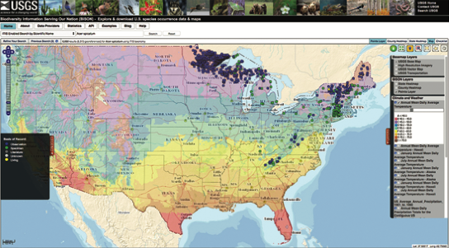
Seven Mission Areas at USGS
BISON map
Database
Notes:
Since you may not yet be very familiar with USGS and how we are organized to do science within our agency, this describes a little bit about our structure, which is based on Mission Areas that focus on different kinds of work.
Two of those mission areas have databases that collect and display crowd sourced information that is useful to the early detection of invasive species. NAS accepts citizen reports for aquatic non-native species. The BISON mapping application includes crowd-sourced data from organizations like eBird, iNaturalist, and the National Phenology Network.

Slide 3
USGS Structure
(who does what)
4 mission areas deal with invasive plants:
  Ecosystems
  Core Science Systems
  Water
  Climate and Land Use Change
Overall Mission:
serve the nation by providing reliable scientific information to describe and understand the earth
Scope:
As a non-regulatory agency, provide needed science support to other DOI and federal agencies
Cindy Kolar
Ecosystems
Earl
Campbell
Ecosystems
Annie Simpson
Core Science Systems
Notes:
Although USGS has been working with maps, geology, natural disasters, and water resources for more than 100 years, the biological component of USGS created by absorbing the National Biological Survey in 1996, and it became the Biological Resources Division of USGS. In 2010, a reorganization split off the Biological Information Management part of Biology at USGS and Biology was renamed as Ecosystems.
Invasive plant science in the Water Mission area in quite limited. I know only of Dr. Nancy Rybicki who studies aquatic invasive plants at the sub-cellular level.
Created by an act of Congress in 1879, USGS has evolved over the ensuing 125 years, matching its talent and knowledge to the progress of science and technology and meeting partner research needs. In 1993 the National Biologic al Survey (NBS) was established (S.O. 3173) whose mission was to gather, analyze & disseminate the biological information necessary for the sound stewardship of our Nation's natural resources and to foster understanding of biological systems and the benefits they provide to society. Functions necessary to perform the mission of the NBS were transferred from the USFWS, NPS, BLM, MMS, OSM, USGS and BOR. In 1995, Congress merged biologists from the National Biological Survey with the USGS to create an integrated Earth science agency. USGS has limited authority to address the management of AIS on Federal lands, but plays an integral role in conducting the invasive species and fish and wildlife disease science that management agencies need for EDRR efforts and decisions. For example, USGS is leading several invasive species EDRR efforts in collaboration with USFWS, NPS and other agencies including the Brown Treesnake RRT in Guam and early detection of invasive fish and Burmese Python in the Everglades using eDNA technologies. These are critical actions that are part of our mission to serve the Nation by providing reliable scientific information to describe and understand the Earth; minimize loss of life and property from natural disasters; manage water, biological, energy, and mineral resources; and enhance and protect our quality of life.

Slide 4
Top 5 things for next 5 years with invasive plants
Remote sensing to document spp. presence or condition
Improve decision making for managing invasive plants
Forecasting potential range or range shifts
Structured – Melaleuca (FL)
Adaptive – Phragmites
Mgmt – sage steppe (Great Basin)
Developing/testing invasive plant control methods
Work on Phragmites & cheatgrass
FORT and Hawaii
Work on tamarisk & buffelgrass
Data aggregation for maps and models
Taxonomy, distribution, species lists, & species watchlists
Notes:
Top five things for the next 3-5 yrs on invasive plant issues:
1. Using remote sensing to document presence or condition of invasive plants.
E.g., work on tamarisk and buffelgrass
3. Improve decision making for managing invasive plants
E.g., structured decision making for control of melaluca in South Florida, adaptive management in control of Phragmites at the landscape scale, management of sage steppe in the Great Basin
4. Forecasting potential range or range shifts
E.g., some of the work coming out of FORT (variety of species) and Hawaii (predicting range shifts in response to climate change)
5. Restoration, especially after application of control efforts
E.g, work on cheatgrass
this slide covers the majority of our work (like 90% of the money we spend in the invasives program that is spent on plants).
Most of our funding goes to developing and testing methods of controlling invasive plants,
sometimes with the goal of restoring native plant communities (as in we're reseeding and have a desired state we're helping our partners to achieve or move towards),
sometimes just to get rid of the invasives.
Sometimes the focus of research is on developing control tools for invasive plants (like for Phragmites and cheatgrass);
sometimes research focuses on determining the optimal treatment strategy given management goals.
Develop/test invasive plant control methods
Restore native plant communities
Remove invasive plants
Develop control tools for Phragmites & cheatgrass
Determine optimal treatment strategies

Slide 5





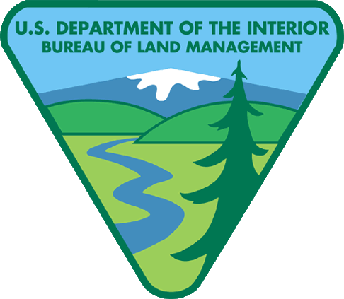
Major partners
USDA
Forest Service
States
Academia
NGO's
Notes:
Beyond the water mission area, our biological origins at USGS don’t go back very far. We came from a short-lived DOI agency formed in 1993, as the National Biological Survey, with the intention of removing scientists from policy pressure and regulatory responsibilities. Because there were no new funds for the new agency, it was staffed with 1,200 scientists and 600 other employees transferred from the seven existing DOI agencies. In 1995 NBS was renamed the National Biological Service, but it didn’t help the negative attention it was receiving from Congress, so the Clinton Administration effected the merger with USGS in 1996.
Because of our origins, many of our major partners are other DOI agencies, and our field scientists are often embedded in DOI lands.
Funding sources, key partners
Primarily DOI agencies (especially NPS, FWS, BLM) and states, but also USDA, especially FS. We also work extensively with states, academia and NGO partners.

Slide 6
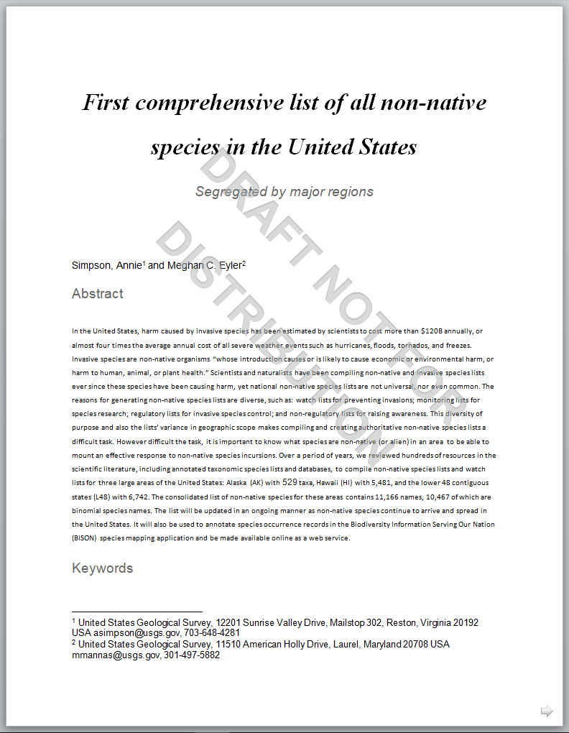

Establishment Means
(Designation of Non-Natives)
11,166 Taxa
10,467 Species
Alaska: 529
Hawaii: 5481
L48: 6742
Search/Filter
capability
to be included in
the BISON GUI and
web services in FY18

Slide 7
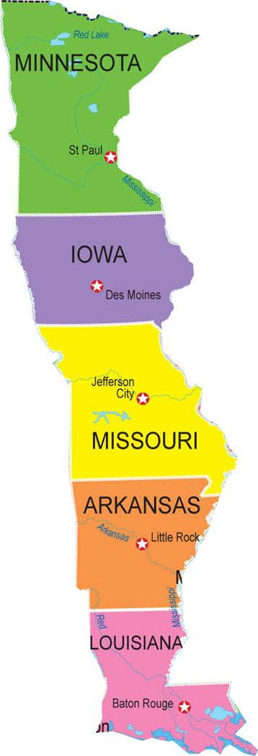
BISON non-native species search generated a draft version of a species watch list
A Simple Watchlist
1 Non-native Diatom
50 Non-native
Animal Species
In BISON 189 total non-native species are found in the buffer states but not in the Western (WGA) States
138 Non-native
Species of Plants

Slide 8
Web links about the programs
Ecosystems: Invasive Species Program
https://www2.usgs.gov/ecosystems/invasive_species/
Biodiversity Information Serving Our Nation (BISON)
https://bison.usgs.gov
USGS Pubs Warehouse search on Invasive Plants (n=341):
https://pubs.er.usgs.gov/search?q=invasive+plants
Forest and Rangeland Ecosystem Science Center: Invasive Annual Grasses
http://fresc.usgs.gov/research/researchPage.aspx?Research_Page_ID=131
Proceedings of the Workshop on Databases for Nonindigenous Plants
https://nas.er.usgs.gov/publications/plant_workshop/npwrkshp/introduct.htm
Notes:
All USGS Websites are currently being updated and moved to a Drupal platform, and so some of these links may change in the near future.
I include the link to the project that I work on, BISON. Although not invasive plant specific, there are hundreds of thousands of invasive plant species localities mapped on BISON, and in the future we plan to implement a system that can tag any nonnative species in the whole BISON database.

Slide 9
Web links about specific invasive plants
Western Ecological Research Center: Sahara mustard
https://www.werc.usgs.gov/Project.aspx?ProjectID=95
Great Lakes Science Center: Phragmites
http://www.glsc.usgs.gov/keywords/phragmites
Fort Collins Science Center: Tamarisk
https://www.fort.usgs.gov/science/keyword/tamarisk-(Tamarix-spp)
Geosciences & Environmental Change Science Center: Cheatgrass
https://gec.cr.usgs.gov/projects/sw/previous/cheatgrass/
Notes:
One last slide with a few links on specific invasive plant species

