Slide 1
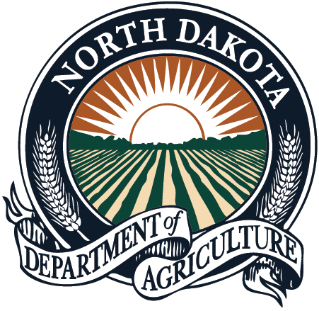
North Dakota
Chelsey Penuel

Slide 2
2017
Legislative year – no changes to noxious weeds law
Budget cuts
Noxious weeds - stable funding
New Plant Industries division director

Slide 3
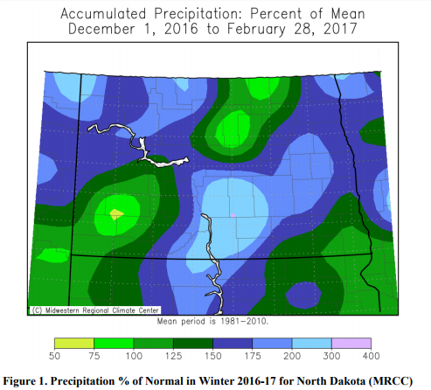
2017 Winter and Spring
2016-2017 winter - 6th wettest on record
Areas of spring flooding
Delayed planting in many areas
NDSU Climate Bulletin

Slide 4
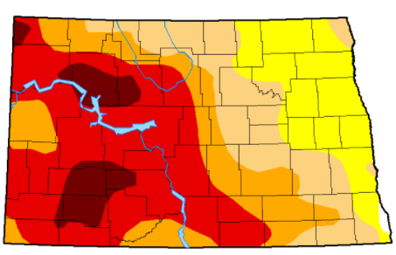
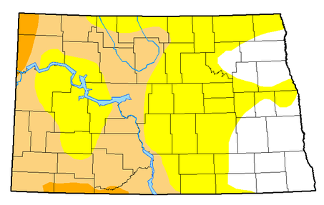
2017 - Drought
Hay movement
East to west
Out of state
CRP opened to haying and grazing
Left - drought map from mid-August
Right - current map from November
Week | None | D0-D4 | D1-D4 | D2-D4 | D3-D4 | D4
Current 11/21/2017 | 18.30% | 81.70% | 36.83% | 3.15% | 0.00% | 0.00%
Three Months Ago 8/22/2017 | 0.41% | 99.59% | 62.79% | 53.42% | 22.08% | 0.39%

Slide 5
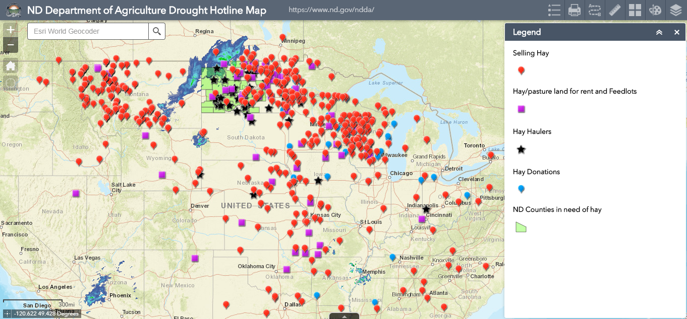
Drought Related Press
Drought meetings
Hotline
CRP acres released for grazing
Natural disaster declaration in many counties
Expansion of CRP areas released for grazing
CRP acres released for haying
Hay lottery
Donations of hay and transportation
Hay transportation assistance

Slide 6
Noxious Weeds Programs
WSFF program
Acres inspected down significantly
Biocontrol
Leafy spurge
Spotted knapweed
Yellow toadflax
State funding
New biennium July 2017

Slide 7
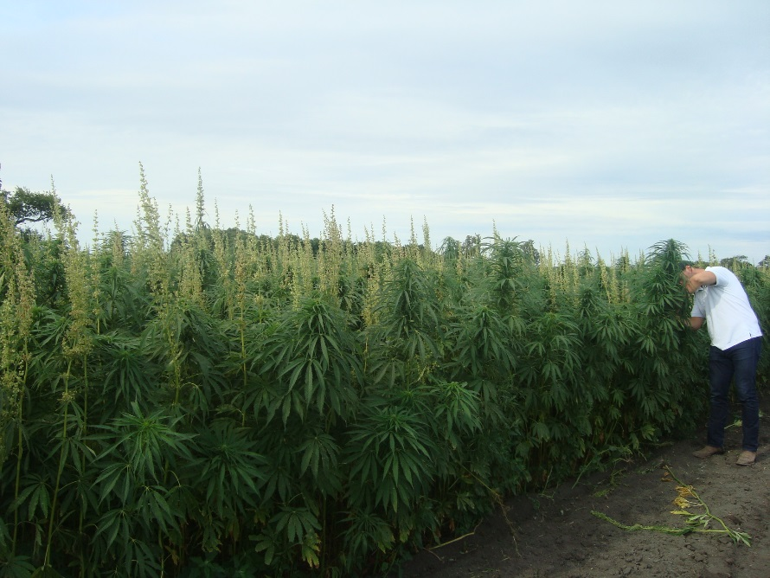
Industrial Hemp Pilot Program
Maturity checks
2016 - 70 acres (9 producers)
2017 - 3,020 acres (36 producers)
Hemp field during maturity check

Slide 8
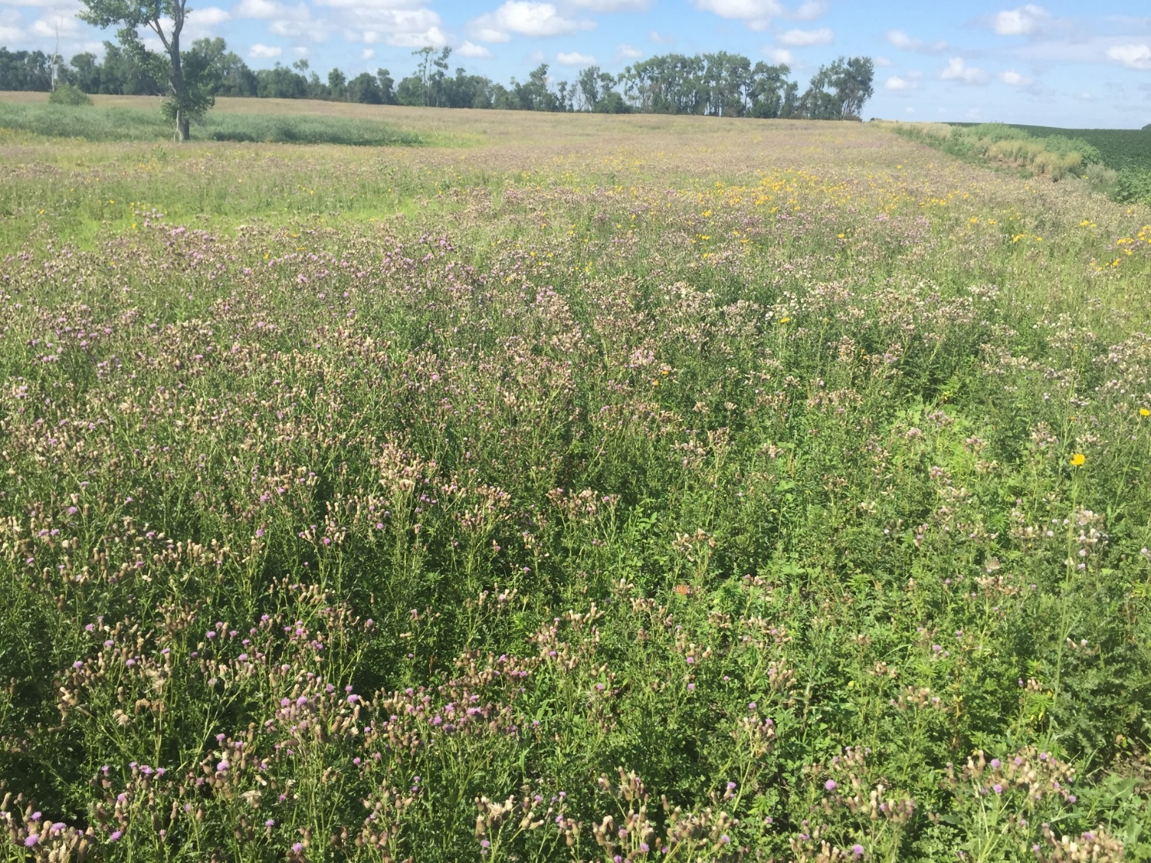
Hemp field during maturity check?

Slide 9
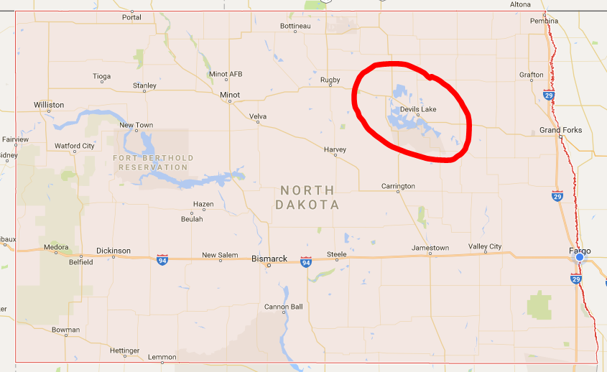
Saltcedar on Devils Lake
Roughly 30 plants
Cooperation among agencies
NDG&F
CWBs

Slide 10
Around ND
Negative PR for CWBs - landowners noticing weeds
Herbicide control not effective
Desirable plants competition
Dicamba complaints
34 complaints
Anonymous survey conducted
207 responses indicating damage
184 responses that NO tissue analysis

Slide 11
Plans for 2018
Pushing CWBs to do additional scouting
New invasive weeds
Spreading of current noxious weeds
Public outreach
Agency cooperation

