Slide 1

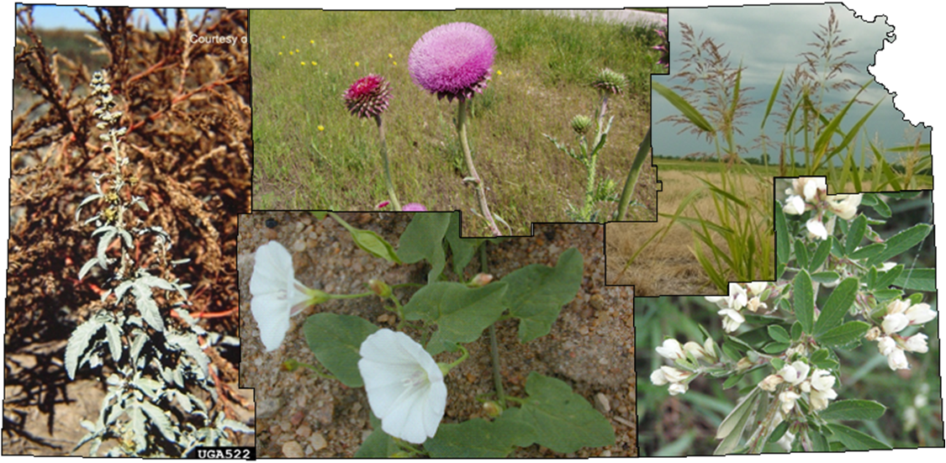
2017 Program Update

Slide 2
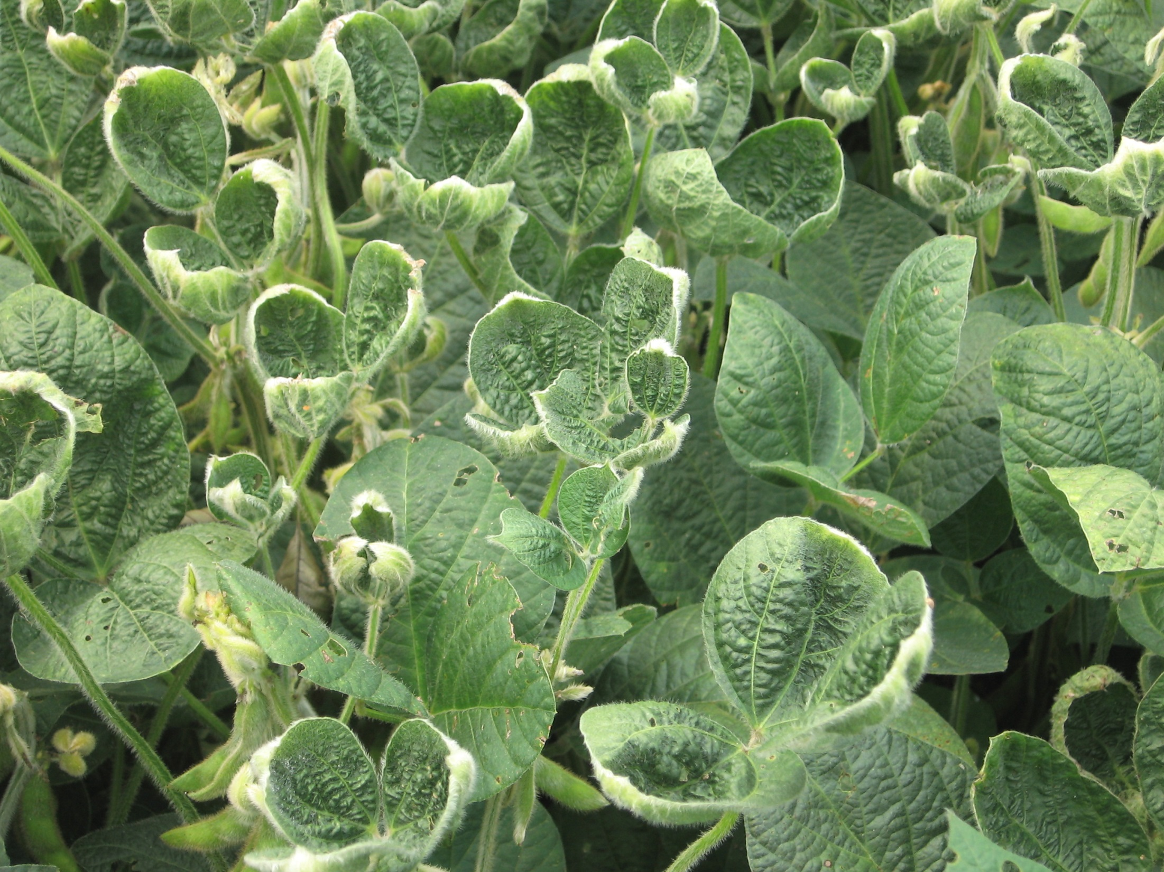
Dicamba
120+ Complaints Statewide
~75 Lab Tests for confirmation
Dicamba tolerant
vs
non-tolerant soybeans

Slide 3
Partners for Fish and Wildlife
Phreatophyte Grants
Remove phreatophytes on 3,000 acres of the Ark river corridor
Establish native grass and willow and cottonwood communities
Reimburse landowner’s expense on shovel ready projects
Educate landowners on restoration techniques
Update a state-wide action plan for the comprehensive control of tamarisk & other non-native phreatophytes
2017 Grant - $300,000
10 projects underway in the Rattlesnake River
restored 13.8 stream miles
3,277 upland acres
5-8 wetland/riparian acres
2018 Grant - $300,000
“Ranked extremely high”

Slide 4
Noxious Weed Meeting
Attendees
Audubon of Kansas
County Weed Departments (x 20)
Flint Hills Extension
Kansas Association of Counties
Kansas Cooperative Council (x 2)
Kansas Corn Growers Association
Kansas Department of Agriculture (x 5)
Kansas Department of Transportation (x 2)
Kansas Department of Wildlife, Parks and Tourism (x 7)
Kansas Farm Bureau (x 2)
Kansas Grain Sorghum
Kansas Grazing Lands Alliance (x 2)
Kansas Legislature (x 4)
Kansas Livestock Association
Kansas Rural Center
Kansas Sierra Club
Kansas State University (x 2)
KGFA/KARA
Sowder Seed Company
Tallgrass Legacy Alliance (x 2)
The Nature Conservancy
County Highway Department
US Army Corps of Engineers (x 2)

Slide 5
Noxious Weed Meeting
Old world bluestem
  Noxious / quarantine / seed / NAISMA
Changing/updating weed programs
List in statute vs. regulations
  County gov’t funding new species control
Collateral damage
Cost share for non-noxious species
Resistance in sericea lespedeza
Education

Slide 6
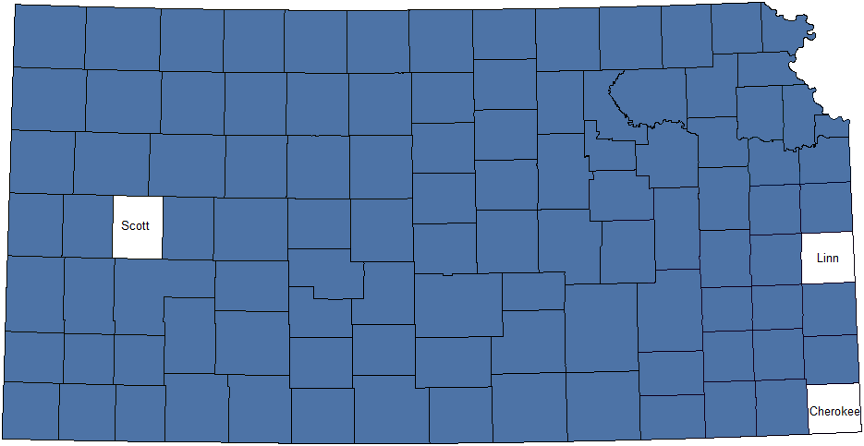
Old World Bluestems in Kansas
Bothriochloa bladhii and B. ischaemum
102 counties are currently known to be infested with Bothriochloa bladhii and/or B. ischaemum
Sources
Dr. Keith Harmony, KSU | David Kraft, NRCS | County Weed Directors | EDDMapS West Database
Dr. Walt Fick, KSU | Dr. Karen Hickman, OSU |  | USDA PLANTS Database

Slide 7
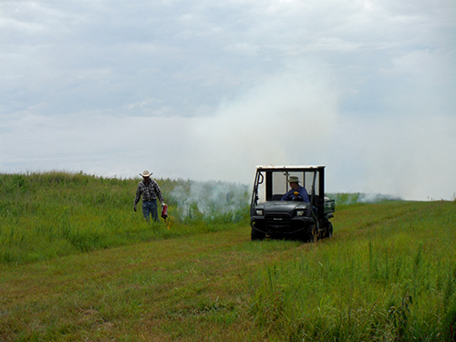
Late Season Burning
for Sericea Control

Slide 8
K.S.A. 2-1415
"Noxious weed seed" means the seed of Kudzu (Pueraria lobata), field bindweed (Convolvulus arvensis), Russian knapweed (Centaurea repens), hoary cress (Cardaria draba), Canada thistle (Cirsium arvense), leafy spurge (Euphorbia esula), quackgrass (Agropyron repens), bur ragweed (Ambrosia grayii), pignut (Indian rushpea) (Hoffmannseggia densiflora), Texas blueweed (Helianthus ciliaris), Johnson grass (Sorghum halepense), sorghum almum, and any plant the seed of which cannot be distinguished from Johnson grass, musk (nodding) thistle (Carduus nutans L.) and sericea lespedeza (Lespedeza cuneata).
K.S.A. 2-1415
"Noxious weed seed" means the seed of Kudzu (Pueraria lobata), field bindweed (Convolvulus arvensis), Russian knapweed (Centaurea repens), hoary cress (Cardaria draba), Canada thistle (Cirsium arvense), leafy spurge (Euphorbia esula), quackgrass (Agropyron repens), bur ragweed (Ambrosia grayii), pignut (Indian rushpea) (Hoffmannseggia densiflora), Texas blueweed (Helianthus ciliaris), Johnson grass (Sorghum halepense), sorghum almum, and any plant the seed of which cannot be distinguished from Johnson grass, musk (nodding) thistle (Carduus nutans L.) and sericea lespedeza (Lespedeza cuneata).
K.S.A. 2-1415
"Noxious weed seed" means the seed of Kudzu (Pueraria lobata), field bindweed (Convolvulus arvensis), Russian knapweed (Centaurea repens), hoary cress (Cardaria draba), Canada thistle (Cirsium arvense), leafy spurge (Euphorbia esula), quackgrass (Agropyron repens), bur ragweed (Ambrosia grayii), pignut (Indian rushpea) (Hoffmannseggia densiflora), Texas blueweed (Helianthus ciliaris), Johnson grass (Sorghum halepense), sorghum almum, and any plant the seed of which cannot be distinguished from Johnson grass, musk (nodding) thistle (Carduus nutans L.) and sericea lespedeza (Lespedeza cuneata).

Slide 9
Restricted Weed Seed
45 Seeds/Lb. | 18 Seeds/Lb. | 9 Seeds/Lb.
silverleaf nightshade | wild onion or garlic | wild oats
horsenettle/bullnettle | charlock | climbing milkweed/sandvine
dock | wild mustards | jointed goatgrass
oxeye daisy | treacle | black nightshade complex
perennial sowthistle | wild carrot | black bindweed/wild buckwheat
giant foxtail | morning glory/purple moonflower | velvetleaf
cheat | hedge bindweed | butterprint
hairy chess | dodder | cocklebur
buckthorn plantain | pennycress

Slide 10
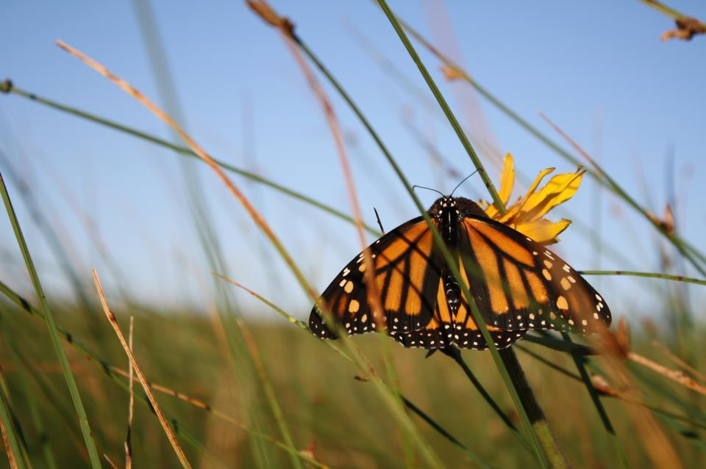
Kansas Monarch Task Force
A statewide effort of outreach, education and conservation to identify and protect pollinator habitat to prevent the monarch from being listed...
…without interfering with noxious weed control.

Slide 11
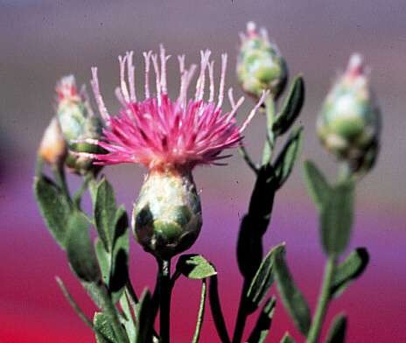

Slide 12
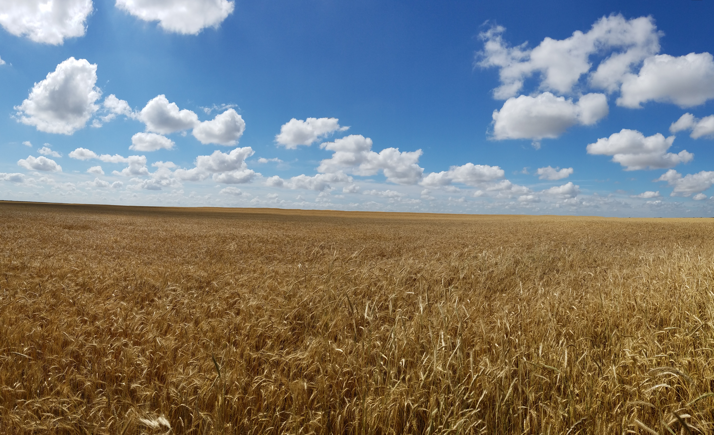
Scott S. Marsh
State Seed and Weeds Specialist
1320 Research Park Drive
Manhattan, KS 66502
(785) 564-6697
(785) 207-2118 (c)
scott.marsh@ks.gov

