Slide 1
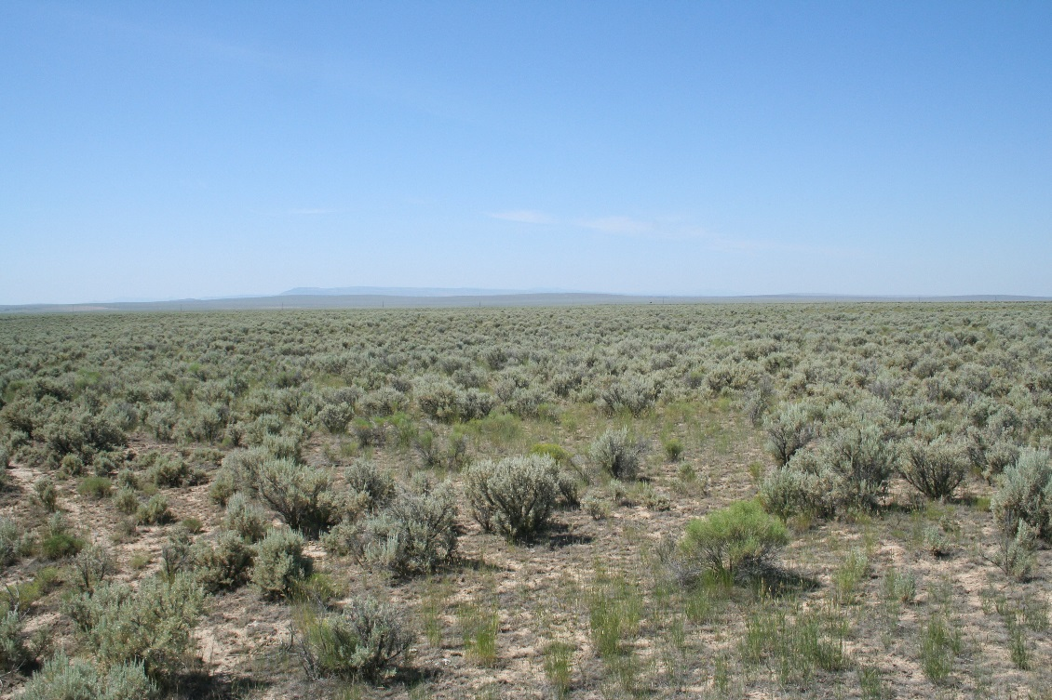
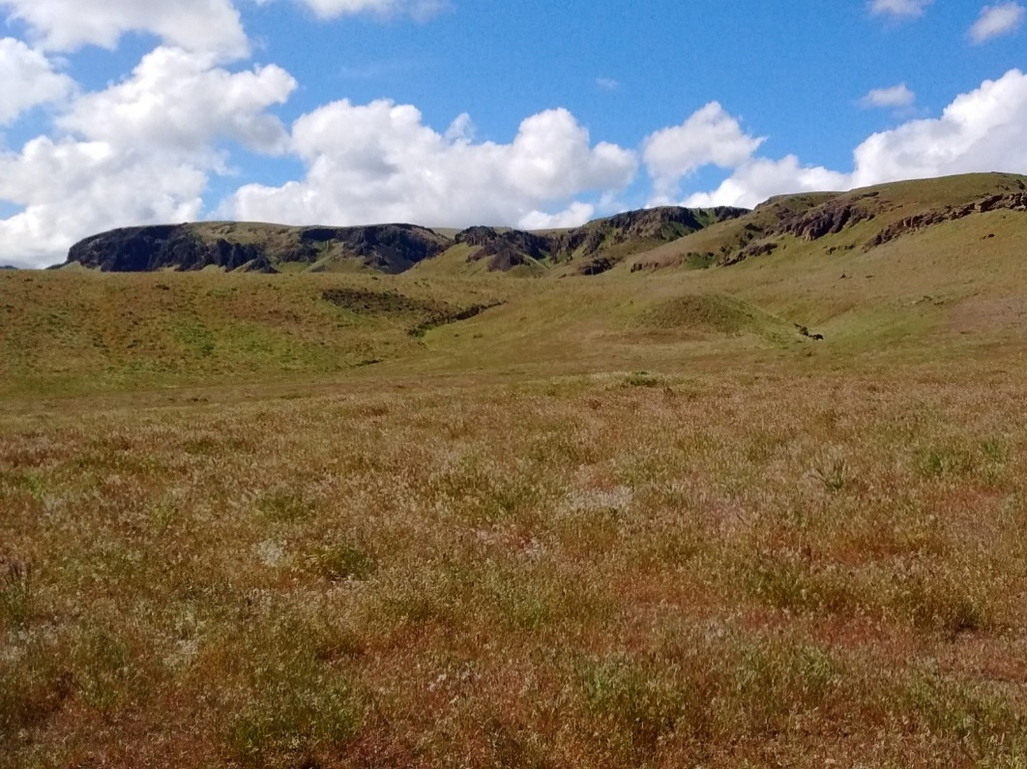


The weed-suppressive bacteria prospect in western rangelands
Matt Germino, Brynne Lazarus
US Geological Survey
Forest and Rangeland
Ecosystem Science Center
Notes:
As I think most of you know already: Cheatgrass and medusahead invasions have contributed to the degradation or pose a serious threat to Great Basin ecosystems, and control measures are needed.
These exotic annuals have altered the environment, particularly fire regimes, to their benefit over native perennials….feedbacks like this combine with variable weather to create one of the most significant and challenging invasive plant and restoration challenges in the world.

Slide 2

Exotic annual grasses are impacting the west; reinforcing feedbacks
Weed-suppressive bacteria - WSB - is on the market and being used with limited field pre-testing
Need to determine if WSB works, and if so: where, when and why or why not?
Notes:
I have some introductory points to get us started:
Managers and scientists are hopeful that strains of the bacterium Pseudomonas fluorescens that have been selected for their weed-suppressive properties in laboratory, greenhouse and wheat-field trials will also be able to selectively inhibit root growth of annual weeds in more complex rangeland ecosystems.
Weed-suppressive bacteria (WSB) are now commercially available in many states and have been applied on tens of thousands of acres, yet results are variable and largely unpublished, andmuch remains to be understood about when, where and why WSB are or are not effective.
The proper way to introduce a control measure for exotic plants such as herbicides is to first test that they are effective in decreasing the target exotic, in this case exotic annual grasses, and that non-target impacts are minimal.
WSB are not well tested, in spite of their availability. In a very real sense, the cart has been put before the horse! Not the most efficient way to proceed, but fortunately a small number of individuals have risen up to try to correct the situation and get the horsepower of scientific guidelines in front or at least alongside the cart.
Any land management action will require taking some risk in light of uncertainty, and our presentations convey how our different managers and researchers are trying to deal with uncertainty in WSB effects
Here are a few points to consider for our discussion on WSB

Slide 3
Overview for WSB presentation
Intro and history of weed-suppressive bacteria (WSB)
Current WSB strains and their availability
WSB coordination project results
What makes an effective study or trial?
Examples of WSB trials currently underway

Slide 4
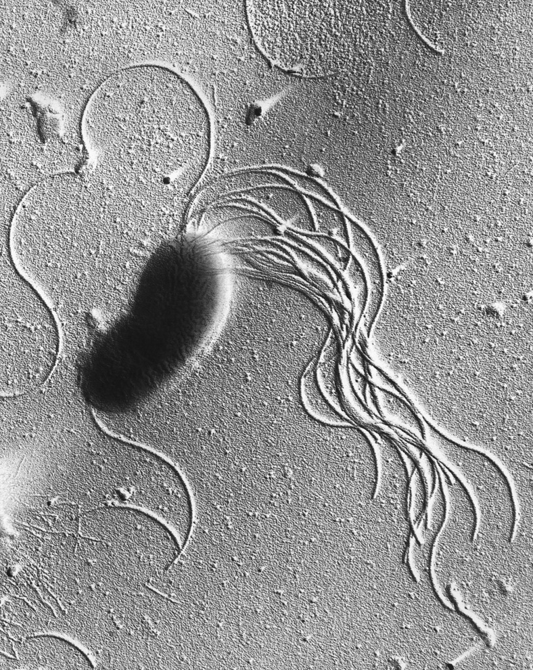
What are weed-suppressive bacteria?
Pseudomonas fluorescens occurs naturally in soil and water
A highly diverse “species”
Strains of P. fluorescens are used to kill invasive zebra and Quagga mussels (Zequanox®), or make yogurt, or to protect strawberries from frost and apples from disease
Weed-suppressive strains were isolated by Dr. Ann Kennedy (ARS) and colleagues in the late 1980’s
American Society for Microbiology
Notes:
Pseudomonas fluorescens is a bacteria that is commonly occurring in soil and water. Different strains of this bacteria have been cultivated for use in a variety of applications, including biocontrol of invasive zebra and quagga mussels.
Weed suppressive strains were isolated by Dr. Ann Kennedy and colleagues in the late 1980’s

Slide 5
How were WSB isolated?
81 strains inhibited cheatgrass germination without affecting winter wheat root growth in petri dishes
6 strains inhibited cheatgrass but not winter wheat in growth chamber studies
1000+ strains isolated from wheat field soils
Laboratory tests
Growth chamber studies
Wheat field trials
Strain D7 decreased cheatgrass density, growth, and seed production leading to increased wheat yield
More laboratory tests
D7 produces a compound that inhibits root growth in cheatgrass
Kennedy et al. Soil Sci. Soc. Am. J. 55:72-727, 1991
Notes:
Back in the late 1980’s/ early 1990’s Dr. Ann Kennedy and her colleagues at ARS in Pullman, WA sifted through more than a thousand of strains of bacteria they isolated from Eastern Washington wheat field soils. Strains that inhibited germination of cheatgrass but not root growth of winter wheat seed in petri dishes were further tested in growth chamber studies. The most promising of these were then tested in three wheatfields with variable but generally promising results after one year of treatment, and the D7 strain came out on top.
Subsequent laboratory studies showed that D7 acted by producing a compound that selectively inhibited root growth of cheatgrass.
Further testing showed this strain to also be effective on medusahead (unpublished) and jointed goat grass (Kennedy and Stubbs 2007) while having little to no effect on a number of non-target plant species in one greenhouse study (Kennedy et al. 2001)
Extra info
The herbicidal compound produced by the D7 strain was identified as a complex of chromopeptides and fatty acid esters in a lipopolysaccharide matrix (Gurusiddaiah et al. 1994). This complex selectively inhibits root growth in B. tectorum via disruption of lipid synthesis and membrane integrity and not via disruption of cell division, respiration, protein synthesis, RNA synthesis, or DNA synthesis (Tranel et al. 1993b).

Slide 6
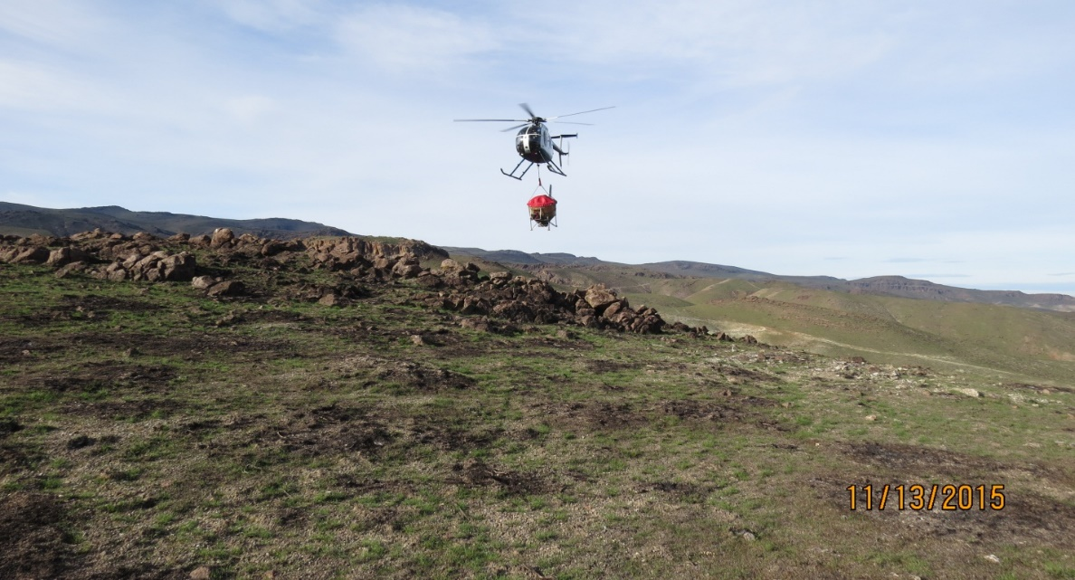
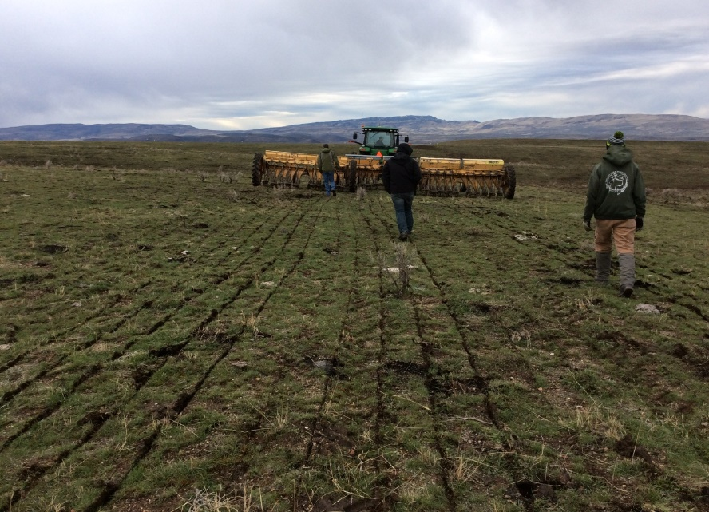
The hope for WSB
Potentially greater social acceptance
Cost is in the range of conventional herbicides ($8/acre)
Able to be applied over large areas using conventional equipment
Potential “temporal bridge” between short-term action of herbicides and longer-term benefits of perennial bunchgrass re-establishment.
Notes:
So given all this research WSB sounds like a promising tool to try in rangelands, but rangelands are a lot more complex than petri dishes, greenhouses, or even wheatfields, with many more plant (and potentially also microbial) species in the mix. Here’s one way to think about it: if you put two boxers in a boxing ring, they’ll box, but if you put two boxers on opposite ends of a crowded subway car, the outcome is not quite as predictable….
Here are some of the questions that occur to us regarding use of weed-suppressive bacteria in rangelands:
Much information is needed and very little is available

Slide 7
Questions for WSB use in rangelands
How does WSB affect:
Target weeds
Non-target plants (natives or weeds) and other taxa
The soil microbial community
Naturally-occurring cheatgrass pathogens (e.g., black fingers of death)?
What is the best application method?
How long does WSB remain in soil?
How does WSB interact with herbicide (additive, synergistic, or antagonistic)?
How do soil type, temperature, moisture, and plant community affect WSB success?
Notes:
So given all this research WSB sounds like a promising tool to try in rangelands, but rangelands are a lot more complex than petri dishes, greenhouses, or even wheatfields, with many more plant (and potentially also microbial) species in the mix. Here’s one way to think about it: if you put two boxers in a boxing ring, they’ll box, but if you put two boxers on opposite ends of a crowded subway car, the outcome is not quite as predictable….
Here are some of the questions that occur to us regarding use of weed-suppressive bacteria in rangelands:
Much information is needed and very little is available

Slide 8
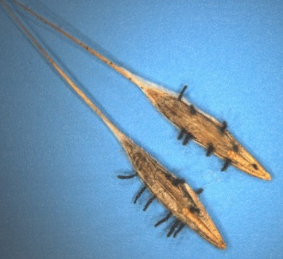
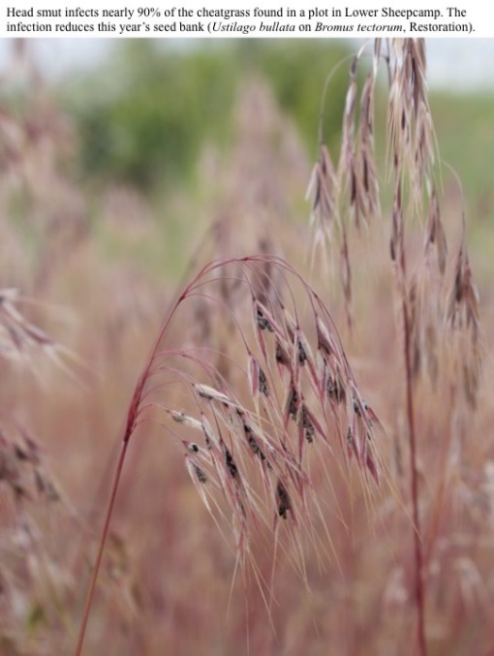
What about other, natural pathogens?
Dense monotypic grass stands can be “fertile ground” for pathogens
Temporary stand failure known as “cheatgrass dieoff” can result from fungal pathogens.
Cyclical ecology of 5 fungal species is relatively well known, from S Meyer et al.
Dieoffs can be unplanned “natural herbicide”, but applying fungi is thus far not a feasible tool.
Susan Meyer, USFS
Notes:
So given all this research WSB sounds like a promising tool to try in rangelands, but rangelands are a lot more complex than petri dishes, greenhouses, or even wheatfields, with many more plant (and potentially also microbial) species in the mix. Here’s one way to think about it: if you put two boxers in a boxing ring, they’ll box, but if you put two boxers on opposite ends of a crowded subway car, the outcome is not quite as predictable….
Here are some of the questions that occur to us regarding use of weed-suppressive bacteria in rangelands:
Much information is needed and very little is available

Slide 9
Background/native microbial context of affected ecosystems
Poorly understood, black box
Pathogen effects not well known in semiarid areas: (cheatgrass dieoff/fungi is a rare example)
Microbes and substrates for them are relatively scarce in semiarid rangeland soils
Semiarid soil surfaces have inhospitable climate for bacteria

Slide 10
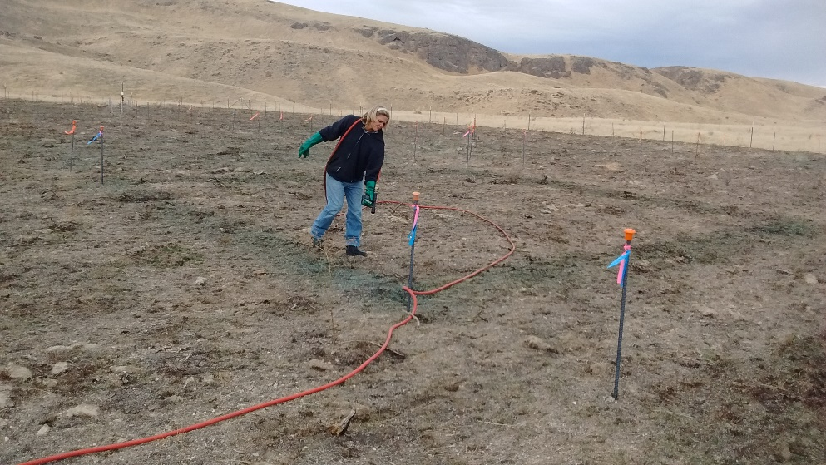
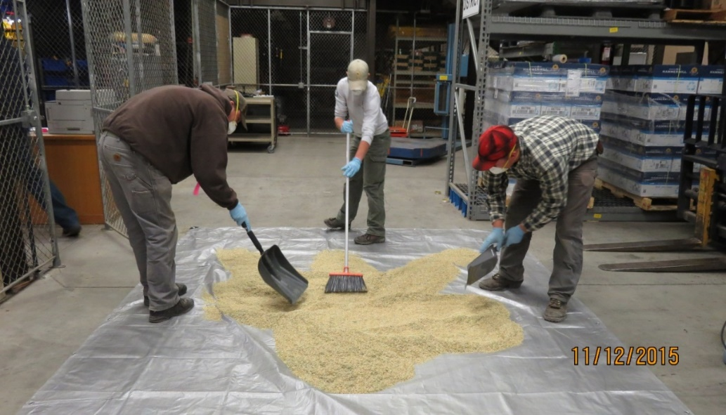
How are WSB applied?
Sprayed on surface as liquid or applied to seed
Manufacturer’s recommendations:
1) Apply in fall (<50°F) with moisture
2) Ensure contact with soil
3) Desirable plants needed (present or seeded)
4) Apply with herbicide (for some strains)
5) Be patient
Amy Stillman, BLM
Notes:
To answer these questions, researchers and managers are doing test applications at a variety of scales all over the Western US
Some spray bacteria directly on the soil surface, others coat seed that is then drilled or broadcast.
It is recommended that WSB be applied in fall when temperatures are cool (<50F) and rain or snow is expected soon. Getting the bacteria in contact with the soil is important and that has been achieved under different circumstances by burning or mowing prior to treatment, applying with extra water, or even discing to turn soil.
As with any treatment designed to kill weeds, it is recommended that desirable plants be present or planted to fill the space left vacant by the weeds (otherwise, you may kill one invader only to open up space for an even less desirable invader)

Slide 11
Current WSB strains
D7: Registered bioherbicide, via Verdesian. Currently not for sale.
ACK55: undergoing registration, projected for 2018–available in very small quantities from ARS Culture Collection (Peoria, IL) for research purposes.
MB906: available as a “soil amendment” from Biowest Ag Solutions. “Stop orders” issued by Idaho (March 2017), Oregon (November 2016), and Montana (Nov 2017). Will continue to be available as soil amendment while Biowest pursues a bioherbicide label for a new WSB product.
Notes:
There are three strains of Pseudomonas fluorescens that have been isolated with the goal of weed suppression.
D7 is the first strain isolated by Ann Kennedy in 1989 and it is by far the best studied of all the strains. It has been through the EPA registration process for bioherbicide (this registration process involves things like ensuring lack of toxicity for aquatic organisms, bees, etc. – it does not include a test of efficacy) and was licensed to Northwest Agricultural Products, which was later acquired by Verdesian Life Sciences.
ACK55 is another strain isolated more recently (2001) by Ann Kennedy. It is currently working its way through the EPA process and may be available in time to spray next fall.
MB906 is manufactured by Biowest in Nampa and is labeled as a soil amendment rather than a bioherbicide. This means it has not undergone any EPA testing. The label states that it is to be applied with herbicide. Oregon and Idaho have both issued stop sale orders on this product. Biowest is continuing to make MB906 available for those allowed to buy it while working on a bioherbicide label for a new WSB product.

Slide 12
What efforts are underway to assess WSB?
BLM funded USGS to lead a WSB-coordination effort
Collate, compare, and contrast existing manager’s trials and researcher’s studies
Identify what information is or will be available (and when)
Identify gaps in information for new studies
Enhance efficiency of collection of efforts underway
Connect researchers and managers working with WSB to exchange ideas and compare results
Notes:
The WSB coordination project emerged from conversations my boss Matt Germino had with Rick Lee and Gina Ramos, the national BLM weed program leads, about the need coordinate information on existing work with WSB in order to have a collective understanding of what information is or will be available (and when), identify gaps, and bring efficiency.
My role in this project has been to help gather information about the use of weed-suppressive bacteria across the Western US and to connect the researchers and managers working with it to exchange ideas and share results.
I have been in touch with many of you in that capacity to ask you about applications you’ve been doing and to add them to a spreadsheet I’ve been collating and to add you to the network of researchers and managers working with WSB.
It’s been a lot of fun talking with folks and learning what they’re up to, and it’s been particularly interesting to hear from folks who’ve been at it a little longer and are beginning to see results. What particularly strikes me is the variation in responses – for example, I spoke with
To me, this makes our collective results all the more critical to helping sort out where, when, and why these bacteria successfully control weeds.

Slide 13
Findings from WSB coordination of 52 projects implemented by different people/agencies to date, across nearly all states in Western US:
38 manager trials, totaling >30,000 acres, 7 trials after wildfire
Only 18 known to have controls for the specific WSB effect,
14 combined herbicide+WSB, ~½ of these cannot separate WSB effect
5 have replication of sites in a project – but, collectively they make replication
23 have quantitative monitoring
few have all the study elements
14 scientific studies, <500 acres combined, plots ranging from 1 m² to 50 acres, 4 after fire
Notes:
Now I’d like to give you a very brief overview of our findings to date from the coordination project:
We have tallied 48 projects – 34 of these are manager trials, and these total more than 30,000 acres and occur throughout the western US (click)
With respect to the three elements – controls, replication, and monitoring: we can only confirm that 16 of these trials definitely have some comparable untreated areas either inside or just outside WSB-treated areas. 14 of these trials combined herbicide and WSB but only about ½ of them also separated these treatments out individually. Only 5 of these have replication within sites, but, the many trials considered collectively comprise among-site replication. 22 are doing some kind of quantitative monitoring (click). Just a few, though have all 3 elements. (click)
We’ve also tallied 14 scientific studies, which do have controls, replication (sometimes within sites, sometimes among sites, sometimes both), and monitoring. (click)
This table shows that the majority of studies have focused on D7, with only two including MB906, while there have been at least 13 manager trials with MB906. (click)
This figure shows the number of studies (blue) or management trials (red) on the y axis for each time period on the x axis, and you can see that the number of manager trials has boomed in the past two years, reflecting the recent commercial availability of MB906. However, despite the fact that 7 studies were completed between 2001 and 2013, there exists to date only one peer-reviewed publication on the effects of weed suppressive bacteria in rangeland ecosystems. We therefore very much hope to see more published information in the next several years.

Slide 14
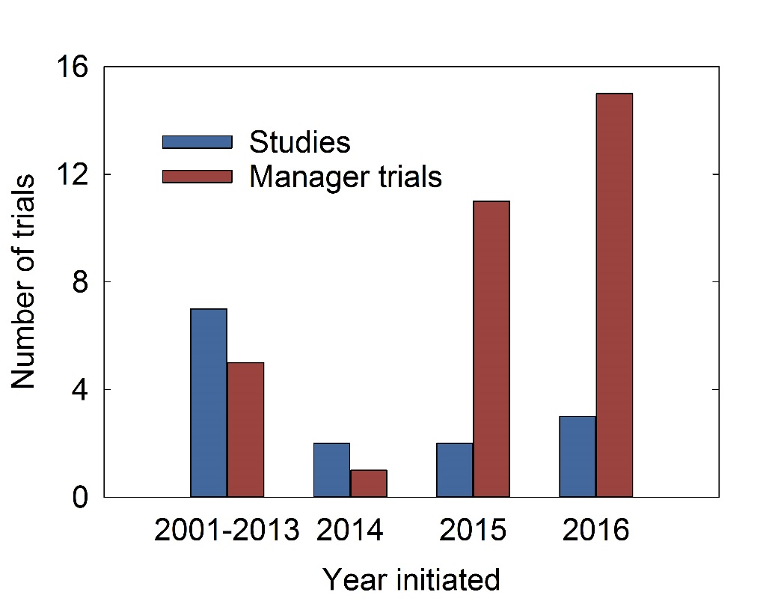
Assymetry in which WSB strains have been tested and when testing has begun b/w scientists and managers
 | D7 | D7 liquid | ACK55 | MB906 | MB906 + D7 | D7 + ACK55 |  | Surface sprayed | Coated seed | Both
Studies | 7* | 2 | 3 | 1 | 1 |  |  | 11 | 1 | 2
Manager trials | 14 | 1 | 5 | 13* |  | 1 |  | 29 | 4 | 1

Slide 15

What is needed to learn from a study or manager trial?
Controls
Replication
Monitoring
Notes:
So, especially with the rollout of MB906 prior to much if any study, turns out you all are doing the research whether you meant to or not, which means I will now give my stump speech on the three critical elements needed to learn from a study or manager trial: controls, replication, and monitoring.
I’ll talk about each of these three elements in my next few slides and at the same time give examples from studies or manager trials here in Idaho

Slide 16
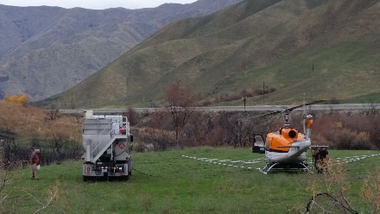
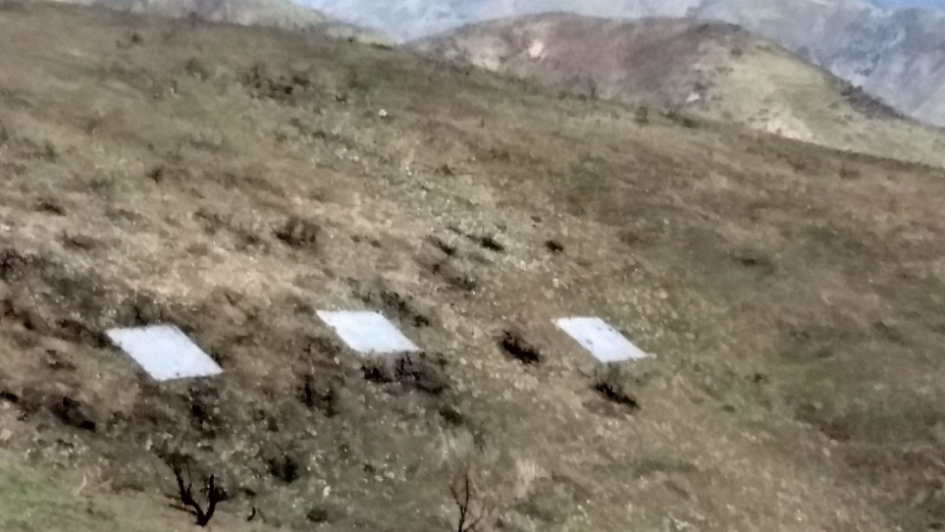
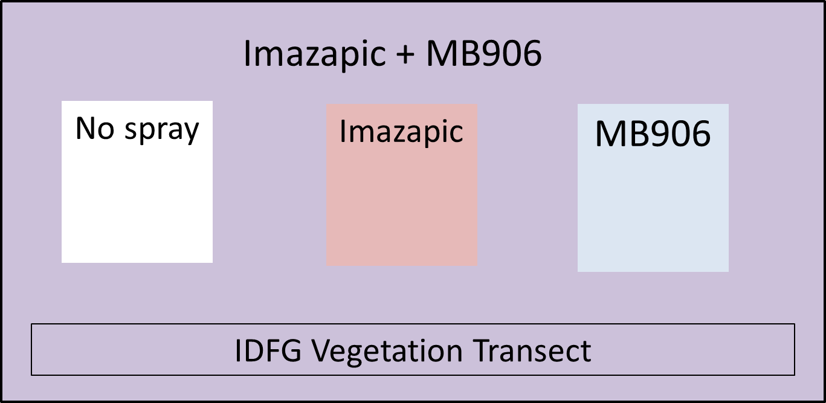
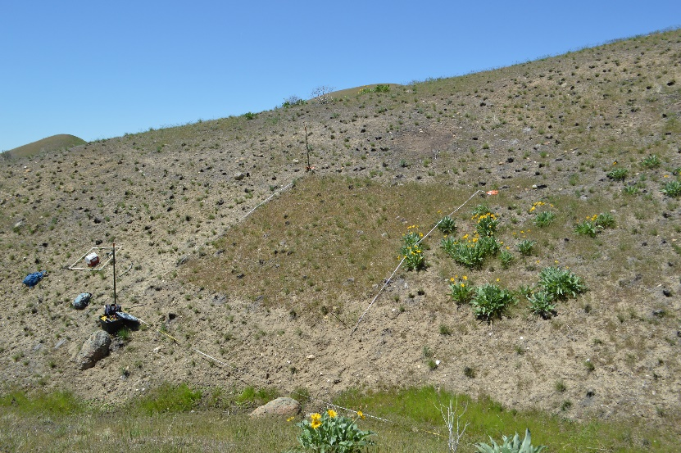
1) Controls 2) Replication 3) Monitoring
Controls = Comparable untreated areas within or directly outside treated areas
Must control for each co-treatment type (fire, herbicide, rangeland drill, etc)
Example: Controls folded into an Idaho Fish & Game application using tarps!
Tarps spread out to block spray
Control tarp configuration– repeated along 6 transects
Unsprayed plot the following spring
Notes:
Controls – by controls I mean comparable untreated areas
Studies generally have control plots built in, but manager trials do not always -- different managers have used different methods to create control plots – everything from looking at areas just outside treated areas, to temporarily turning off an ATV or helicopter sprayer
If multiple treatments are combined, then a complete set of controls must include each individual treatment alone in addition to completely untreated areas (For example – if bacteria and herbicide are applied together, a complete set of controls includes bacteria only and herbicide only in addition to no treatment).
I’d like to give you an example of how USGS worked with IDFG to get a full set of controls into a large scale management operation. After a 2016 wildfire, Krista Biorn at the Boise River Wildlife Management Area notified us of her plans to treat 1200 acres with tank-mixed MB906+imazapic via helicopter. (click) We were able to work with Fish and Game to spread three tarps along each of six pre-existing vegetation transects within the fire and spray boundary to block the combined spray. (click) After spraying, we removed the tarps and left one in each set untreated, sprayed another with imazapic only, and sprayed the third with MB906 only. (click)
The photo on the lower right shows an unsprayed plot within the Imazapic+MB906 matrix.

Slide 17
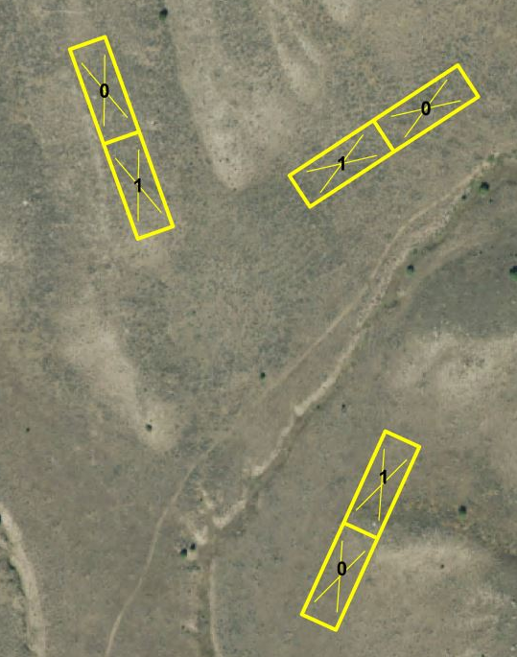
1) Controls 2) Replication 3) Monitoring
Necessary to show repeatability and also to characterize variability (+/-)
Important to replicate both among sites and within sites
Example: MB906 application by IDFG at Tex Creek WMA -- 8 replicates for every treatment combination!
Ryan Walker, Logan Peterson, IDFG
Notes:
Another critical element needed to make it possible to learn from studies and manager trials is replication, by which I mean treating (and leaving controls) both for multiple sites and for multiple plots within a site.
Replication is needed to establish repeatability and also to characterize variability, the plus minus, if you will. If I want to compare a treatment against a control, for example, I need an measure of variability for each to help me understand whether the difference between them is significant or not.
I’d like to share an example of fantastic within-site replication for a manager trial at the Tex Creek Wildlife Management Area in Southeastern Idaho. After a wildfire burned the area in summer of 2016, Fish and Game sprayed 6800 acres with MB906 in multiple non-contiguous patches (the pink “cheatgrass treatment” patches on this map). They then stripped in herbicide (imazapic) in 90 ft wide strips (like the ones shown on the lower map) in 8 different locations that were treated with MB906 and also at another 8 locations that were not treated. They set up monitoring transects (the x’s on the map) and measured cover in both the herbicide-treated plots (the 1’s on the map) and also adjacent plots not treated with herbicide (the zeros on the map). Matt and I have enjoyed consulting with these guys, and we are looking forward to seeing their results – this is going to be very informative.

Slide 18
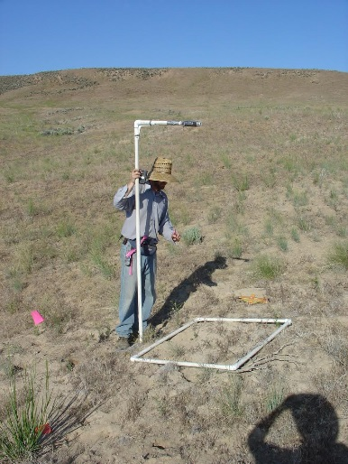
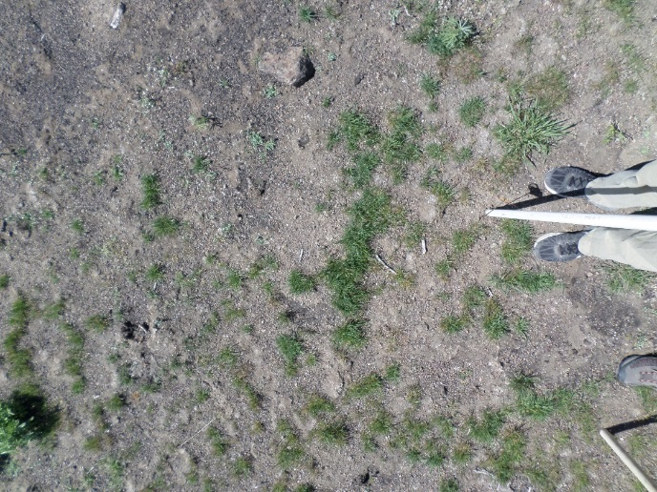
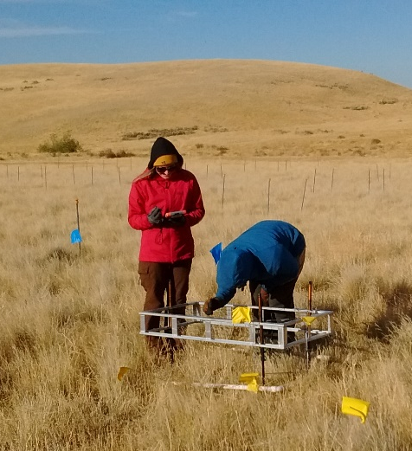
1) Controls 2) Replication 3) Monitoring
Needed to advance collective knowledge
Common measurements include
Cover (proportion of area covered)
Density (individuals/area)
Monitoring Resources:
Sample point: http://www.samplepoint.org/
DIMA (Databse for Monitoring, Inventory, and Assessment): https://jornada.nmsu.edu/monit-assess/dima
Unpublished prelim results, Lazarus & Germino
Notes:
The third critical element needed to learn from a study or management trial is monitoring – results must be quantified if they are to be shared with other managers and researchers and thereby contribute to our collective knowledge
A variety of monitoring methods exist, many of them are concerned with measuring either 1) cover 2) density
I’ll talk just briefly about a couple of the most commonly used methods in the studies and manager trials we have heard of. (click) One method is to take downward facing photos of the ground surface with a camera mounted on a pole and then use a free software program called sample point to quantify the area covered by each species. Work in our lab has shown that this goes much better if the person analyzing the photo has a list of the species in the photo.
Another method is line point intercept (LPI). With this method, a pin flag is dropped at a point and all species that it touches are recorded. This is repeated many times, either within a frame or along a transect.
I have included websites for a couple of useful monitoring resources on this slide (click). One link is to sample point, free software for image analysis. The other is a link to DIMA
This graph shows an example of cover data we collected in a study I am leading with Matt Germino and the Idaho Sage Grouse Action Team, installed in fall of 2016 in SW Idaho. This study includes many treatments (listed here along the x axis)– two strains of Pseudomonas bacteria (D7 and MB906), two herbicides (imazapic and rimsulfuron), and it also includes tilling with a drill seeder to work the bacteria in. This study is replicated at three sites with three replicates per treatment at each site. This graph shows cheatgrass cover in late spring of the first year after treatment at one site. Untreated plots and those treated only with bacteria have cheatgrass cover around 80%, while plots treated with herbicide have cheatgrass cover of 20% or less. I should emphasize, though, that this is just preliminary year 1 data for one site only…stay tuned for updates from this project.

Slide 19
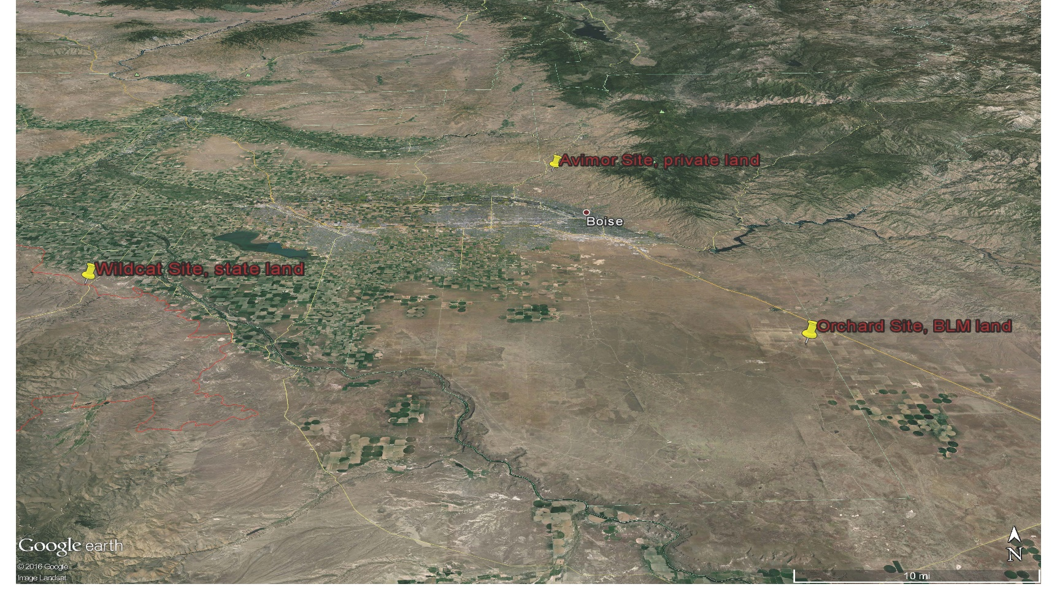
1) Controls 2) Replication 3) Monitoring
Example study underway:
Idaho SG Action Team Bacteria Study
replicated 3x/site across 3 sites in SW Idaho,
many factors and controls
Notes:
The third critical element needed to learn from a study or management trial is monitoring – results must be quantified if they are to be shared with other managers and researchers and thereby contribute to our collective knowledge
A variety of monitoring methods exist, many of them are concerned with measuring either 1) cover 2) density
I’ll talk just briefly about a couple of the most commonly used methods in the studies and manager trials we have heard of. (click) One method is to take downward facing photos of the ground surface with a camera mounted on a pole and then use a free software program called sample point to quantify the area covered by each species. Work in our lab has shown that this goes much better if the person analyzing the photo has a list of the species in the photo.
Another method is line point intercept (LPI). With this method, a pin flag is dropped at a point and all species that it touches are recorded. This is repeated many times, either within a frame or along a transect.
I have included websites for a couple of useful monitoring resources on this slide (click). One link is to sample point, free software for image analysis. The other is a link to DIMA
This graph shows an example of cover data we collected in a study I am leading with Matt Germino and the Idaho Sage Grouse Action Team, installed in fall of 2016 in SW Idaho. This study includes many treatments (listed here along the x axis)– two strains of Pseudomonas bacteria (D7 and MB906), two herbicides (imazapic and rimsulfuron), and it also includes tilling with a drill seeder to work the bacteria in. This study is replicated at three sites with three replicates per treatment at each site. This graph shows cheatgrass cover in late spring of the first year after treatment at one site. Untreated plots and those treated only with bacteria have cheatgrass cover around 80%, while plots treated with herbicide have cheatgrass cover of 20% or less. I should emphasize, though, that this is just preliminary year 1 data for one site only…stay tuned for updates from this project.

Slide 20
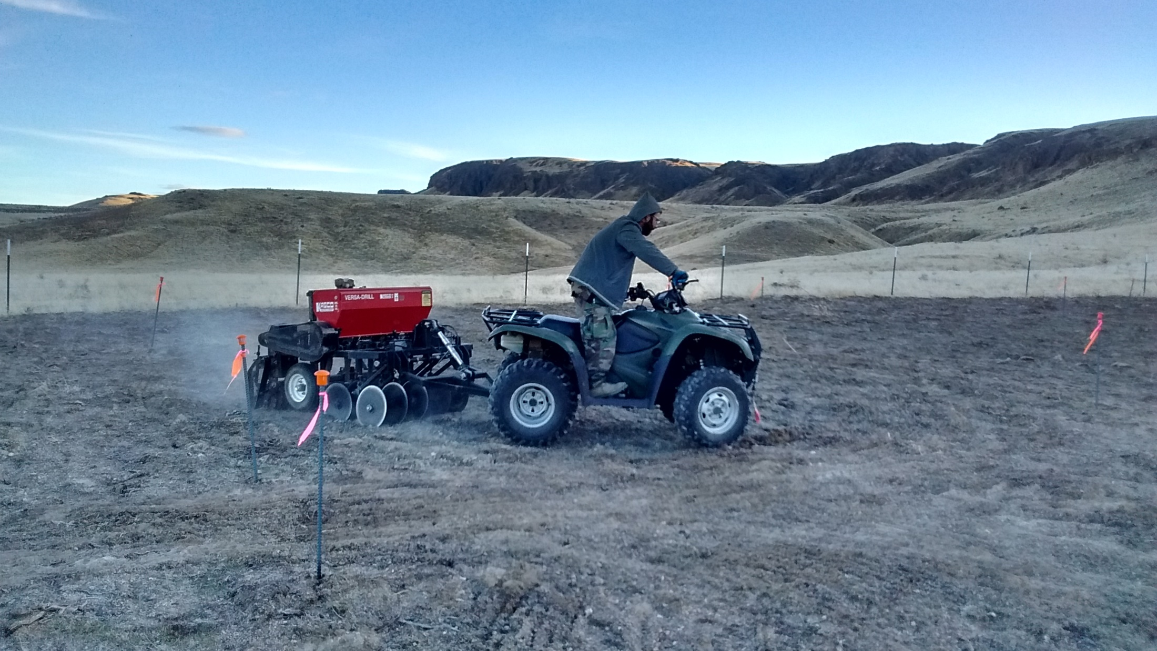
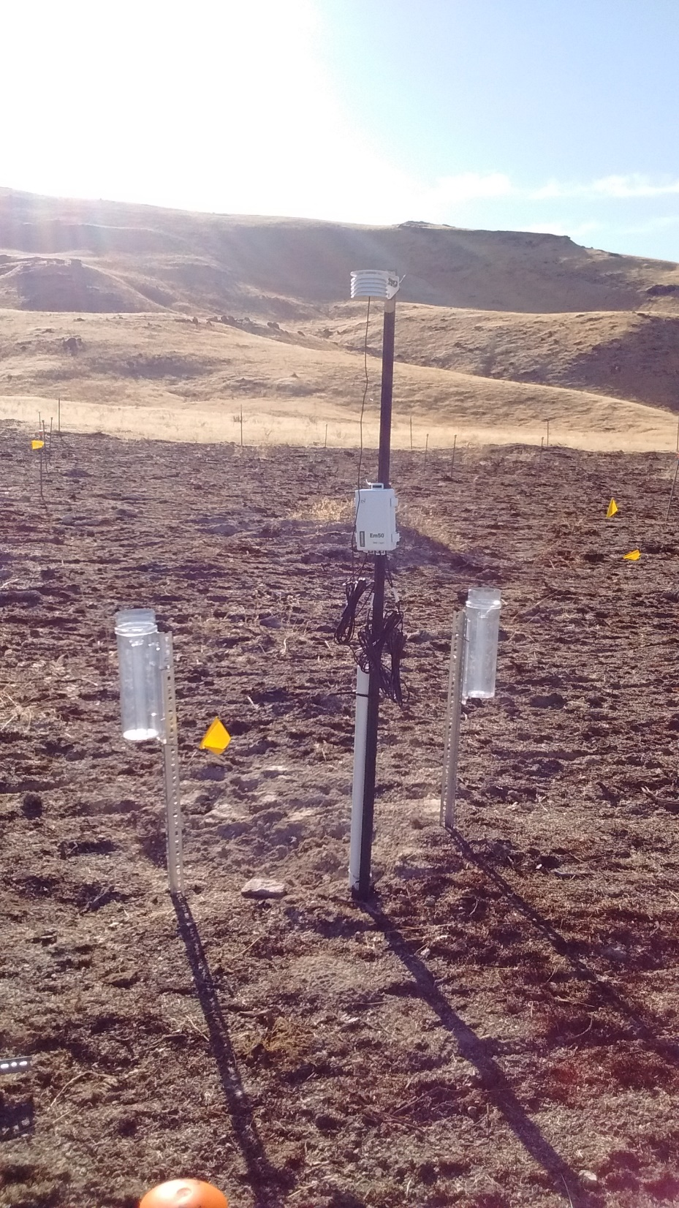
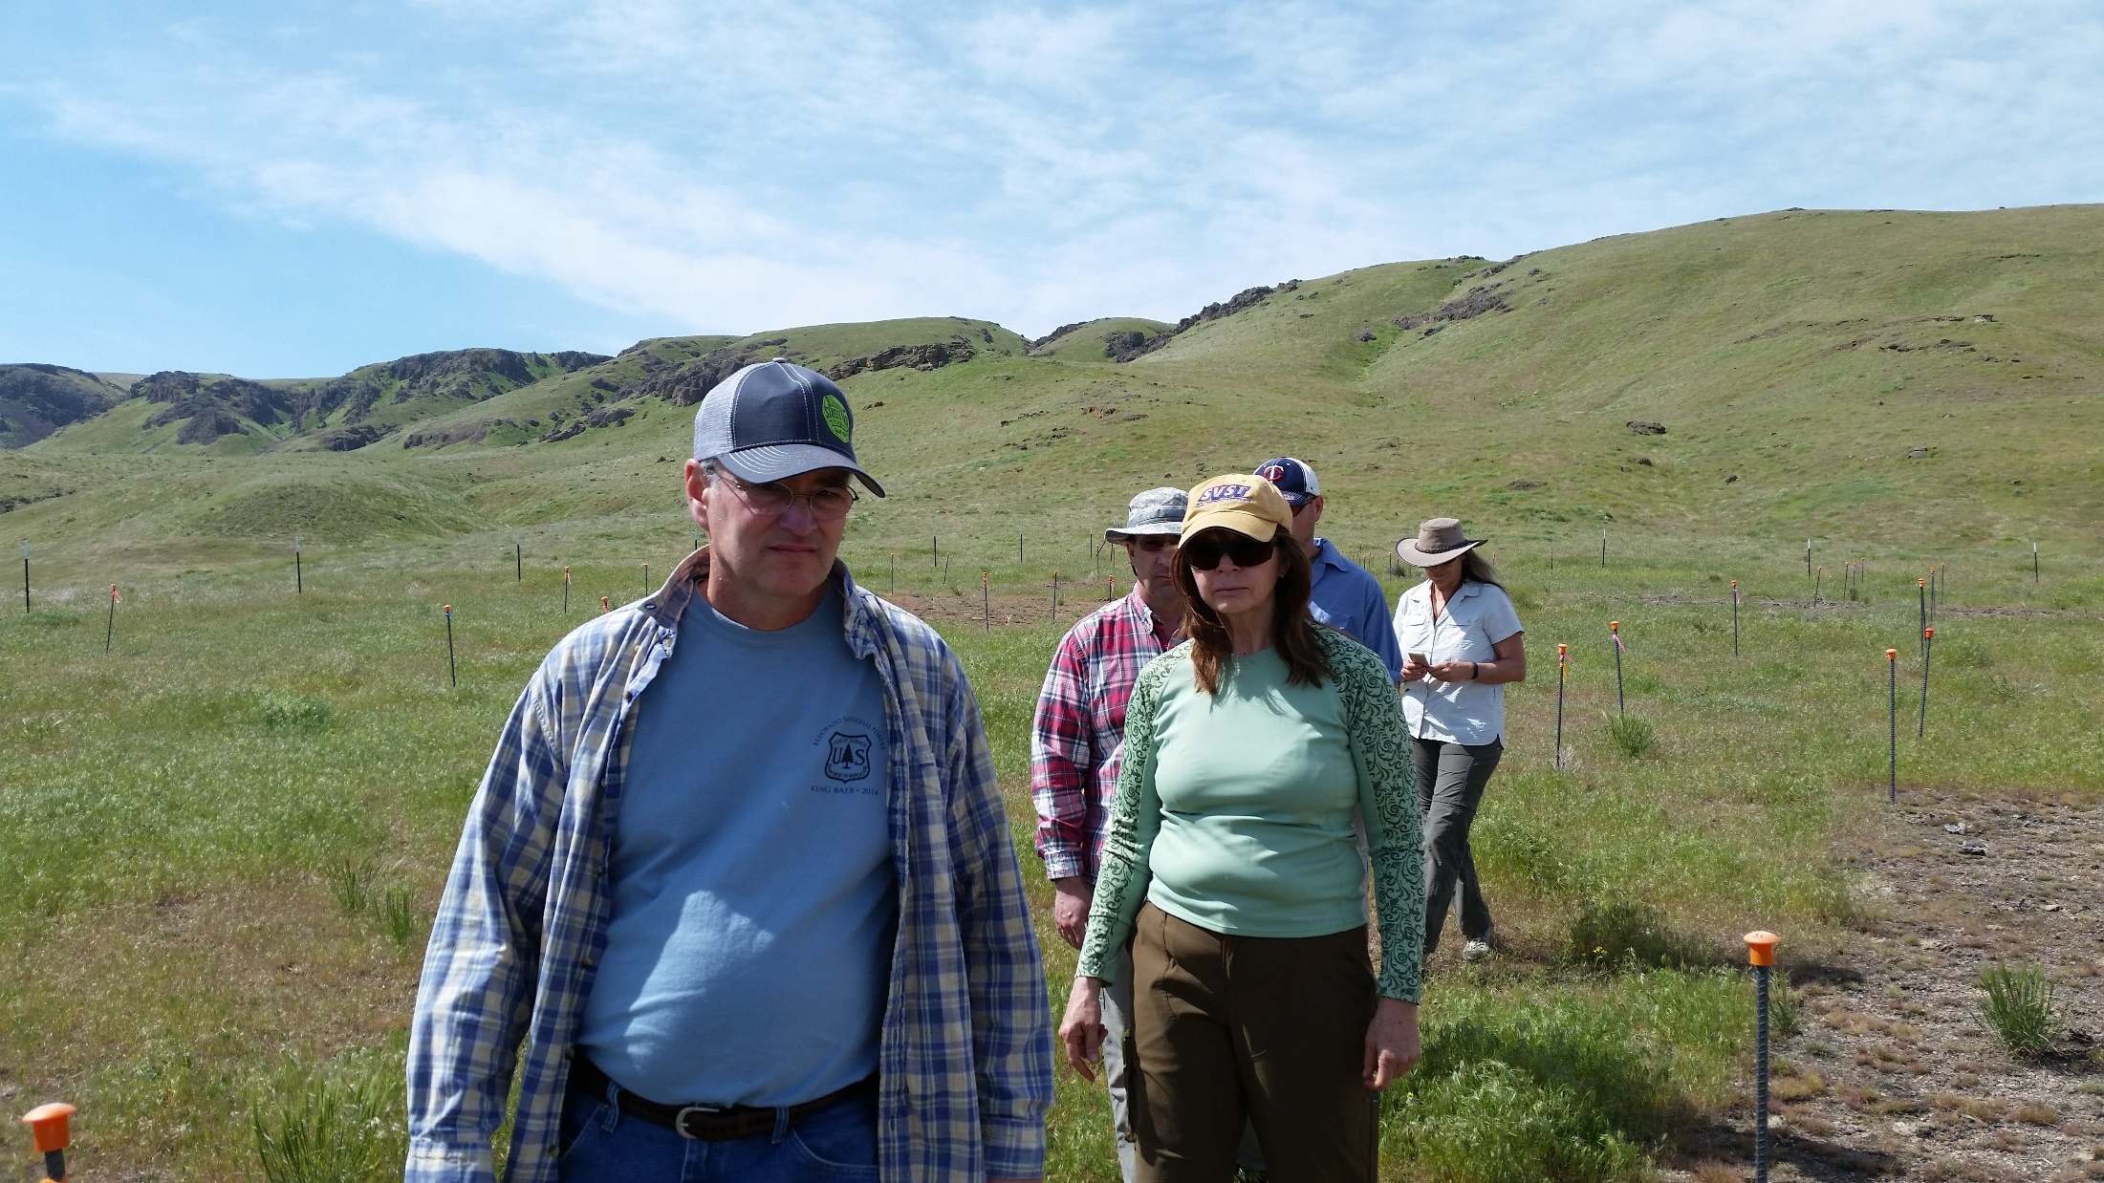
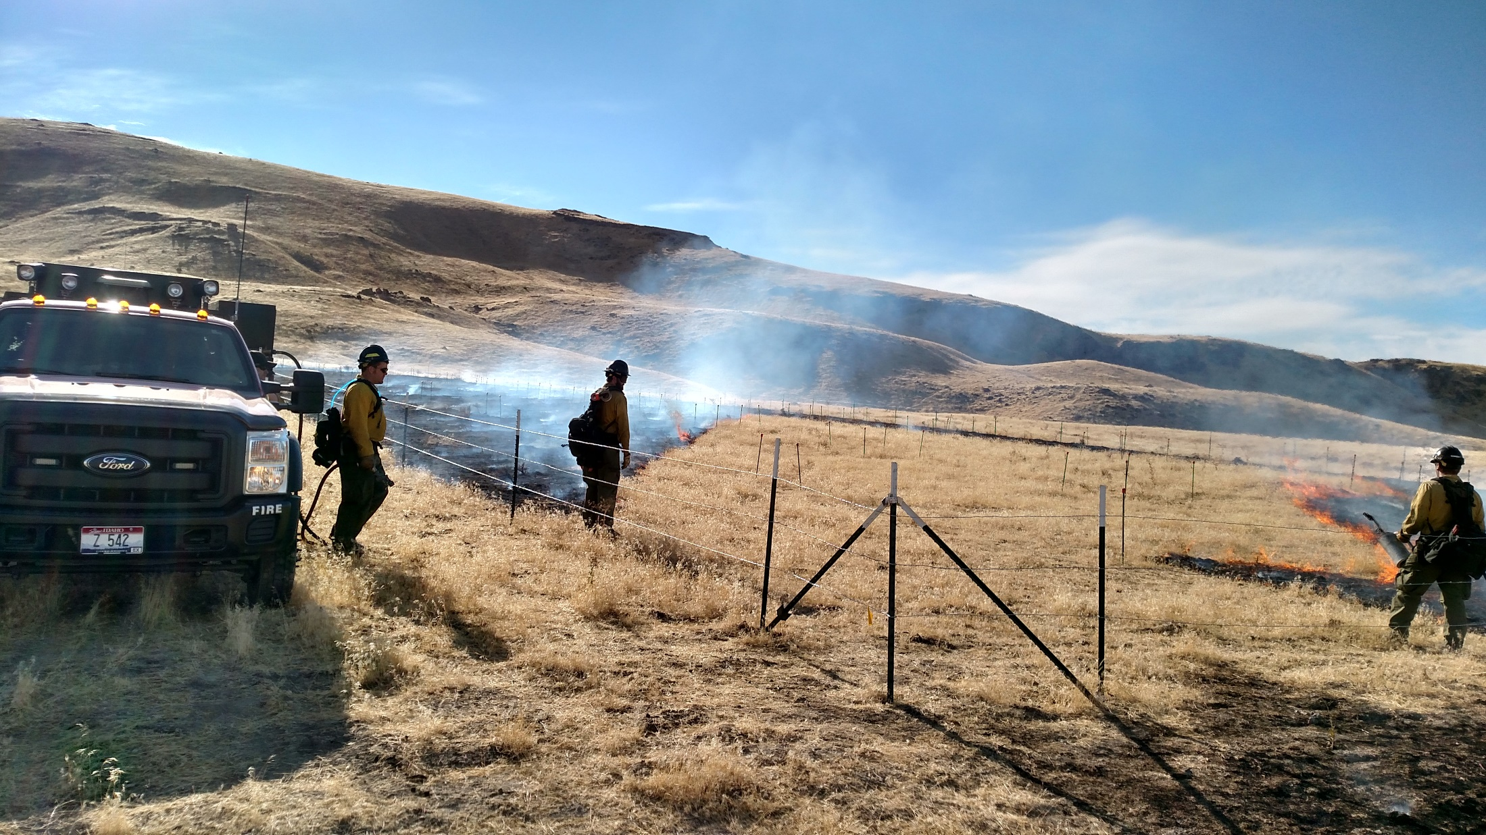
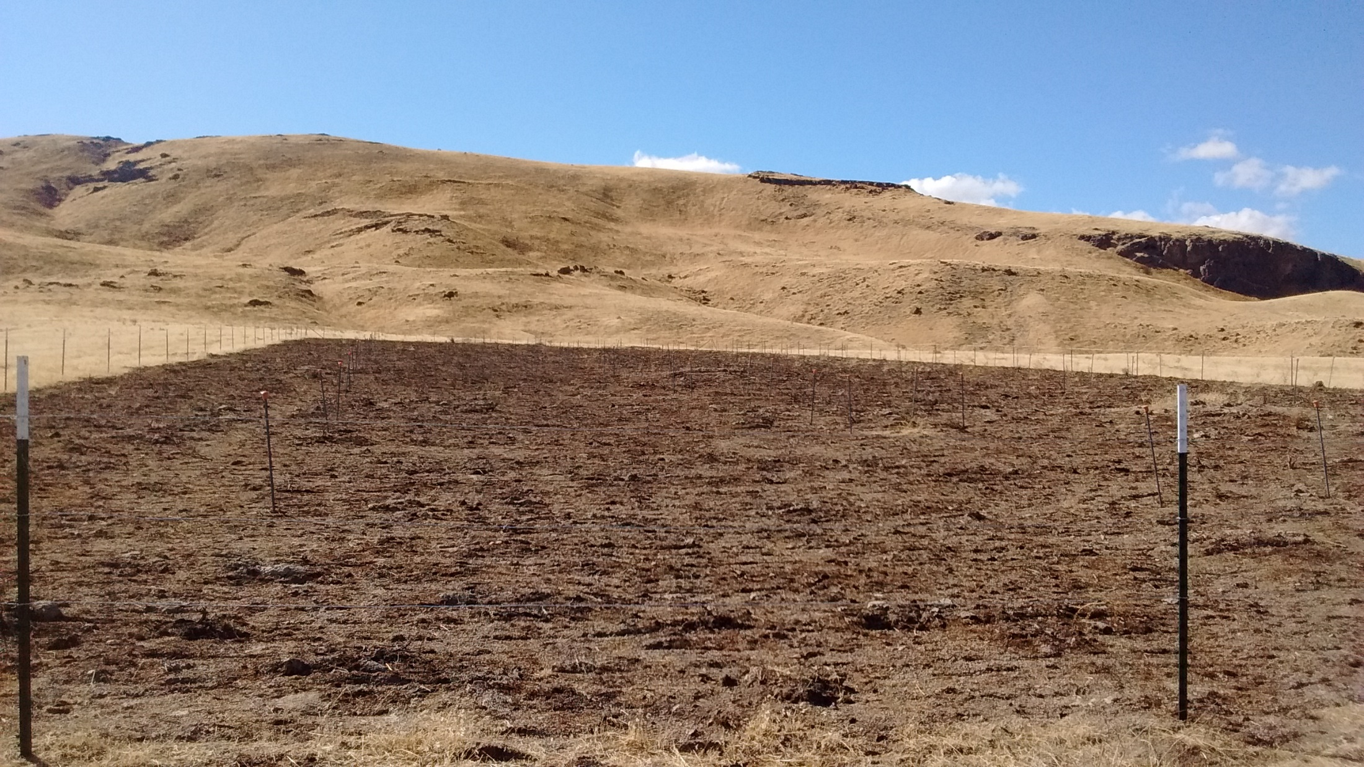
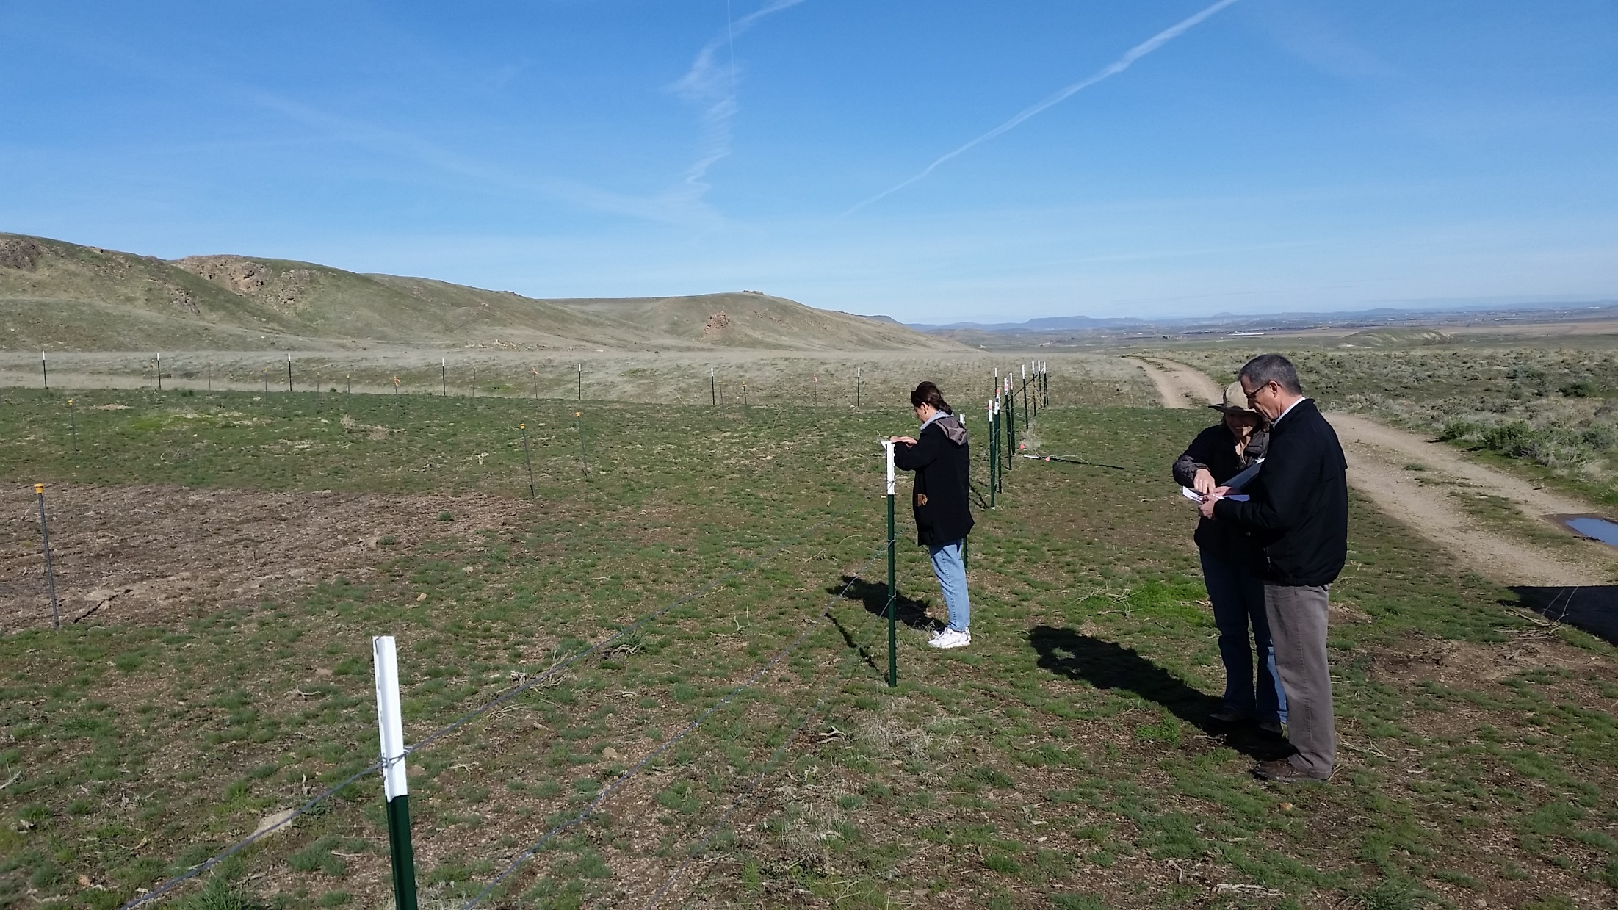

Slide 21
Conclusions
WSB have shown promise in the laboratory, greenhouse, and wheat field, but results in rangelands to date are more variable and largely unpublished
Studies and manager trials are underway that should help clarify where, when, and why WSB are or are not effective in rangeland ecosystems
Still, many “holes” will exist in our knowledge of WSB
If you are planning an application of WSB, consider using controls, replication and monitoring to make it possible to learn from your application. Connect with researchers if appropriate and possible.

Slide 22
Finally…
Have questions/ideas?
Know about a study or trial we haven’t yet tallied? Want to be connected to the community of researchers and managers working with WSB? Please get in touch!
Join us in Sparks, NV, Sunday, Jan 28th, 1-6 pm RTEC Session of SRM annual meeting
Matt Germino
mgermino@usgs.gov
(208) 426-3353
Brynne Lazarus
blazarus@usgs.gov
208 473-1338
Notes:
Finally -- please feel free to get in touch with questions and ideas and please let us know if you are aware of or involved in WSB studies or manager trials we have not yet tallied or just
Finally, we know there are more manager trials (and perhaps also a study or two) out there that we have not yet tallied, and we encourage you to get in contact with us to get connected with the community of other researchers and managers working with WSB.

