Slide 1

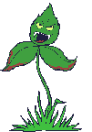

U.S. Fish and Wildlife Service Update
U.S. Fish & Wildlife Service
Western Weed Coordinating Committee
November 28-30, 2017
Las Vegas, NV
Lindy Garner,
Regional Invasive Species Program Lead
Mountain-Prairie Region, Denver CO
Give ‘em an inch, they’ll take an acre!
Mountain-Prairie NWRS
Notes:
Good afternoon I am going to talk about invasive species management on Refuges but focus on how we are communicating our message, or NOT, and how that is helping or hurting us and our efforts, and a couple of tools that we are promoting for strategic implementation of EDRR. The idea is to get us thinking again how we are communicating on these issues and hopefully stimulate thought on how can we improve to more effectively get our staff, supervisors, and our partners to understand our status, impacts and strategies so that we can get this issue prioritized for funding,
And will also throw in some of the tools out there my program is trying to use to help persuade managers to stop turning the crank on old strategies and methods, so we can move forward strategically and cost effectively

Slide 2
Crucial Conservation Conversations – Prioritize
U.S. Fish & Wildlife Service
Define and communicate primary management objective with staff and partners
Evaluate species distribution and abundance within context of invasiveness and feasibility of control
Evaluate weed impact specifically to primary management objective; biological integrity, grazing forage, migratory bird nesting habitat
Area prioritization too rather than just species prioritization
Accept that some invasive species may not have direct, or immediate harmful impacts, sacrifice areas?
Mountain-Prairie NWRS
Notes:
What we learned were
We are forced to go back to the details and look closely at species distribution within our refuges relative to invasiveness of that species and whether or not we have a chance at control depending upon how much of a tie that species has to impact specific land management objectives

Slide 3
Review conservation targets and goals
Compile list of non-native plants (established and nearby [early detection])
PLANNING
Prioritize species: which non-native plants should be a focus of our limited resources?
Prioritize areas: which areas are at greatest risk from invasive plants?
Assess the distribution and abundance of priority invasive plants in in priority areas
Understand the ecology of priority invasive plants
ASSESSMENT
Identify and document optimal strategies for managing priority invasive plant threats
Develop SMART objectives: what are the expected results of our strategies? (short and long term?)
Implement strategies
IMPLEMENTATION
Track implementation: what actions were taken and where
Monitor: are we achieving the results we expected? (see SMART objectives)

Slide 4
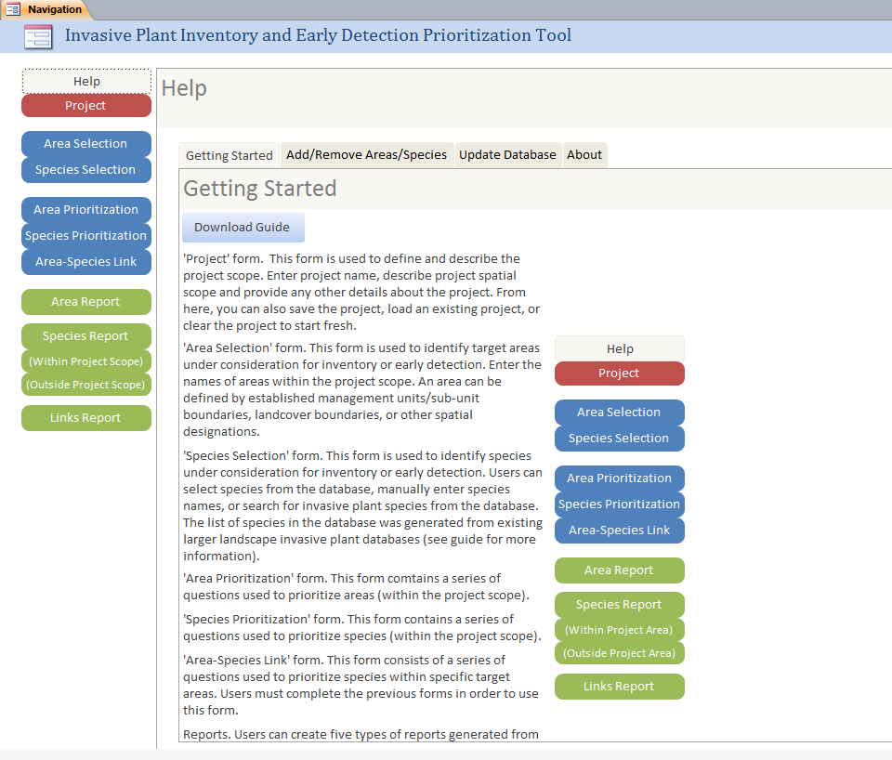
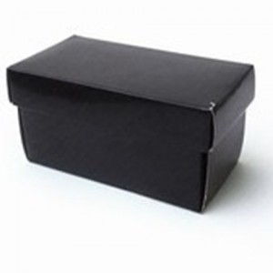

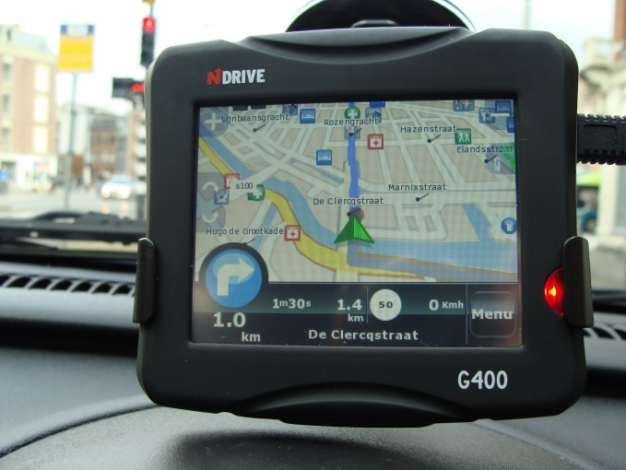
x
x

Slide 5

Review conservation targets and goals
Review by Refuge
Compile list of non-native plants
(established and nearby)
Pulled together prior to meeting
Prioritize species
Tuesday - Wednesday
Prioritize areas
Wednesday - Thursday
Notes:
Introductory meeting last summer – some initial discussion we have included to build from – all up for discussion/revision

Slide 6
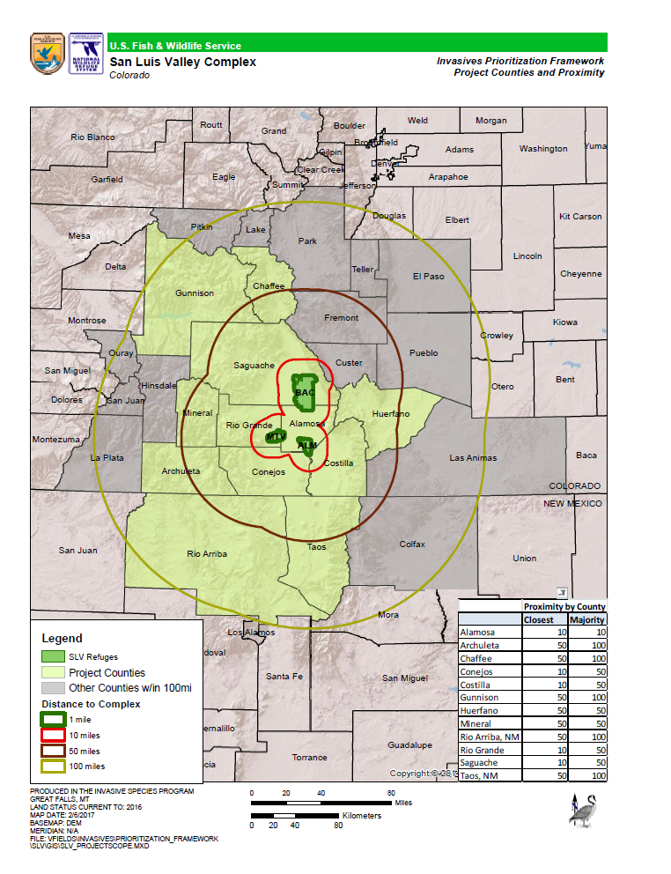

Slide 7
U.S. Fish & Wildlife Service
INVASIVE SPECIES MANAGEMENT
San Luis Valley NWR Complex, Colorado
Mountain-Prairie NWRS
Notes:
So This morning I am going to talk about invasive species management on Refuges but focus on how we are communicating our message, or NOT, and how that is helping or hurting us and our efforts. The idea is to get us thinking again how we are communicating on these issues and hopefully stimulate thought on how can we improve to more effectively get our staff, supervisors, and our partners to understand our status, impacts and strategies so that we can get this issue prioritized for funding,
And will also throw in some of the tools out there my program is trying to use to help persuade managers to stop turning the crank on old strategies and methods, so we can move forward strategically and cost effectively

Slide 8
INVASIVE SPECIES MANAGEMENT
San Luis Valley NWR Complex, Colorado
AREA PRIORITIZATION
SLV COMPLEX
BACA
ALAMOSA
MONTE
VISTA
Upland
Rabbit-brush
Wet
Meadow
Uplands
Wetlands/
Wet Meadow
Uplands
Wetlands/
Wet Meadow
Upland Grease-wood
Playa
Retired Ag
Riparian
Retired Ag
Retired Ag
Riparian
Vanessa Fields

Slide 9
U.S. Fish & Wildlife Service
INVASIVE SPECIES MANAGEMENT
San Luis Valley NWR Complex, Colorado
Mountain-Prairie NWRS
Notes:
So This morning I am going to talk about invasive species management on Refuges but focus on how we are communicating our message, or NOT, and how that is helping or hurting us and our efforts. The idea is to get us thinking again how we are communicating on these issues and hopefully stimulate thought on how can we improve to more effectively get our staff, supervisors, and our partners to understand our status, impacts and strategies so that we can get this issue prioritized for funding,
And will also throw in some of the tools out there my program is trying to use to help persuade managers to stop turning the crank on old strategies and methods, so we can move forward strategically and cost effectively

Slide 10
U.S. Fish & Wildlife Service
INVASIVE SPECIES MANAGEMENT
San Luis Valley NWR Complex, Colorado
Mountain-Prairie NWRS
Notes:
So This morning I am going to talk about invasive species management on Refuges but focus on how we are communicating our message, or NOT, and how that is helping or hurting us and our efforts. The idea is to get us thinking again how we are communicating on these issues and hopefully stimulate thought on how can we improve to more effectively get our staff, supervisors, and our partners to understand our status, impacts and strategies so that we can get this issue prioritized for funding,
And will also throw in some of the tools out there my program is trying to use to help persuade managers to stop turning the crank on old strategies and methods, so we can move forward strategically and cost effectively

Slide 11
Several Other Initiatives
U.S. Fish & Wildlife Service
Large Eradication Project Fund $1 million
Inventory and Early Detection Guide
Prevention Policy and BMPs
Spatial Data Management Team
Sagebrush Operations with Partners
Inventory and Monitoring Protocols
Mountain-Prairie NWRS
Notes:
Good, Fair, Poor ratings. Continue to refine these criteria and align them with the language in the RFP as we learn more about the types of projects out there. For example, number of proposals this time requesting funds for work on private lands. Or when monitoring plan has not yet been developed. When NEPA is not necessary as in Humboldt Bay example.
Verbesina encelioides (golden crown beard) is an aggressive, non-native plant that grows in thick, monocultural stands. This pest species prefers sandy soils and is established at three locations in the remote Northwestern Hawaiian Islands: Midway Atoll, Kure Atoll, and Pearl and Hermes Reef. Midway Atoll National Wildlife Refuge supports the world’s largest breeding colonies of Laysan and Black-footed albatrosses, both of which have undergone massive population declines and have been designated as species of “highest concern” by bird conservation organizations in North America.
Seeds brought in accidentally with importation of topsoil from Guam and the main Hawaiian Islands by a cable company and the Navy for lawns and gardens. Or, the plants were brought in as an ornamental in pots and escaped. Now covers 28% of the refuge and 39% of Sand Island.
When Verbesina dies back it leaves these woody stalks making it difficult for the albatross to find their nests. The result is reduced breeding grounds for the albatross.
11

