Slide 1
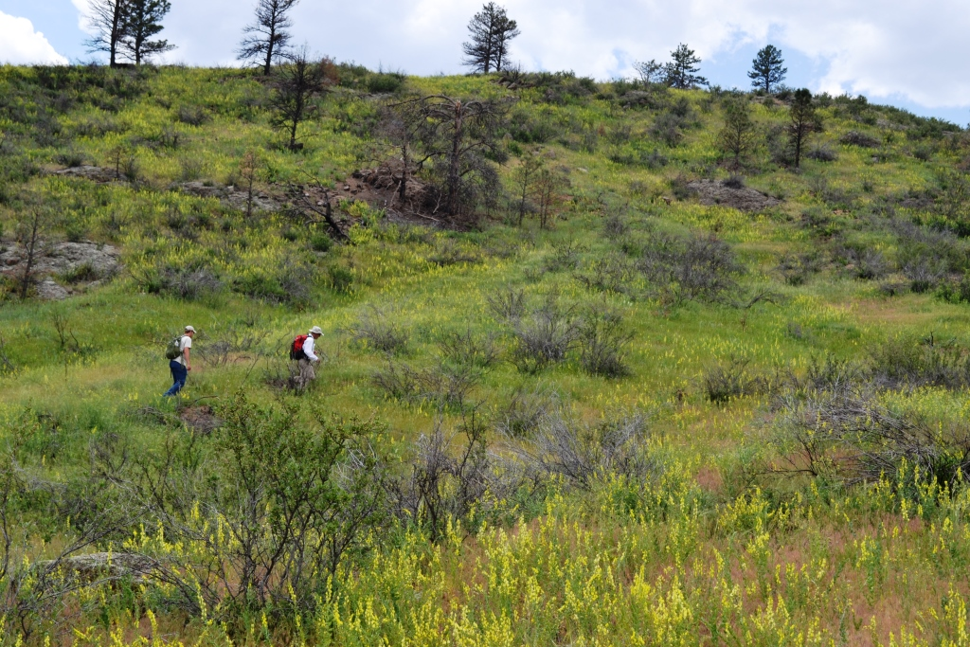

WWCC 2017 Annual Meeting Colorado Update
Dalmatian toadflax

Slide 2
CDA Noxious Weed Program Update - 2017
Noxious weed mapping – move to EDDMapS
Listing decision process
EDRR framework

Slide 3
CDA Noxious Weed Program Update - 2017
Regional cooperation
Phragmites study with CSU
Updating strategic plan

Slide 4
CDA Noxious Weed Program Update - 2017
Weeds we’re watching:
Old world bluestems
Palmer amaranth
Ventenata grass
Medusahead rye

Slide 5
CDA Noxious Weed Program Update - 2017
Weeds we’re watching:
Ornamental grasses
Purple pampas grass
Ravenna grass
Russian sage
Tree of heaven
Siberian elm

Slide 6
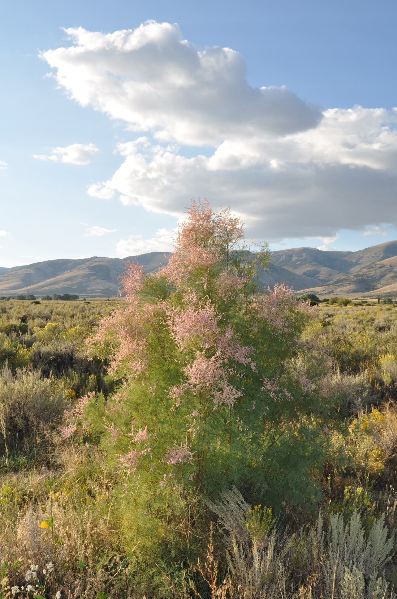
Thank you!
Steve Ryder
State Weed Coordinator
Colorado Department of Agriculture
(303) 869-9034 o
(303) 828-8329 c
steve.ryder@state.co.us

