Slide 1
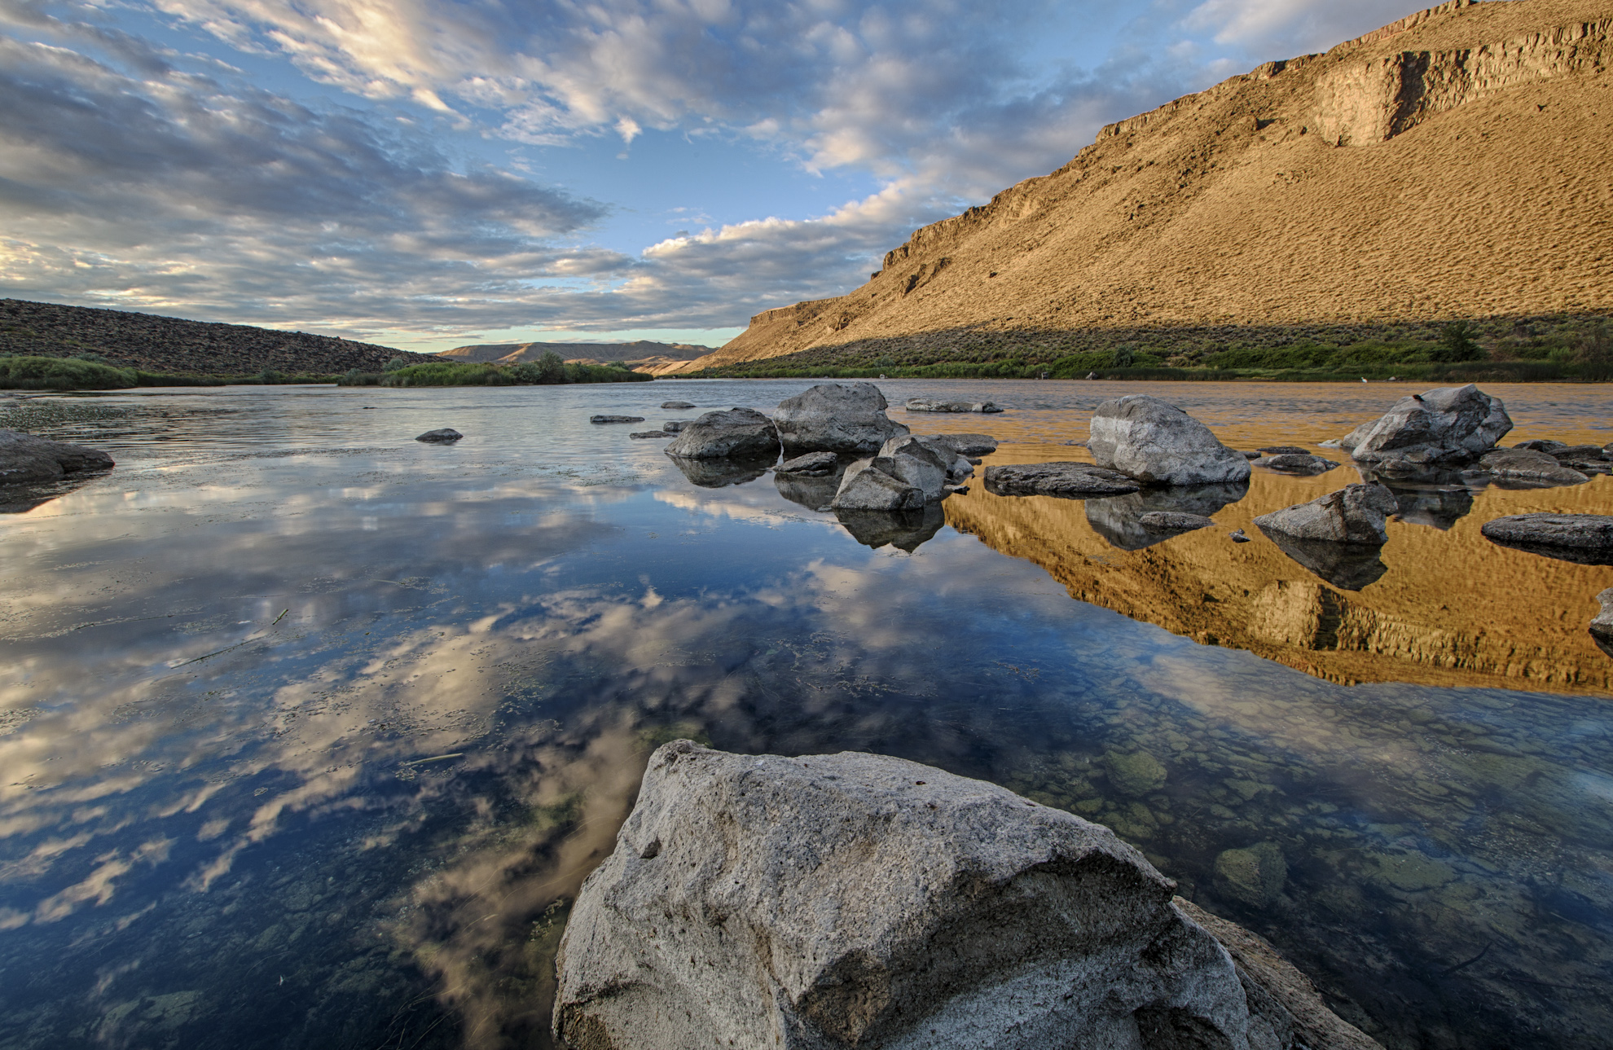

Distribution of the Tamarisk Beetle Across the Western United States
Ben Bloodworth
Program Coordinator
Las Vegas, NV
November 29, 2017

Slide 2
Beetle/Tamarisk Interaction: Green to Brown 2009 - 2011

Slide 3
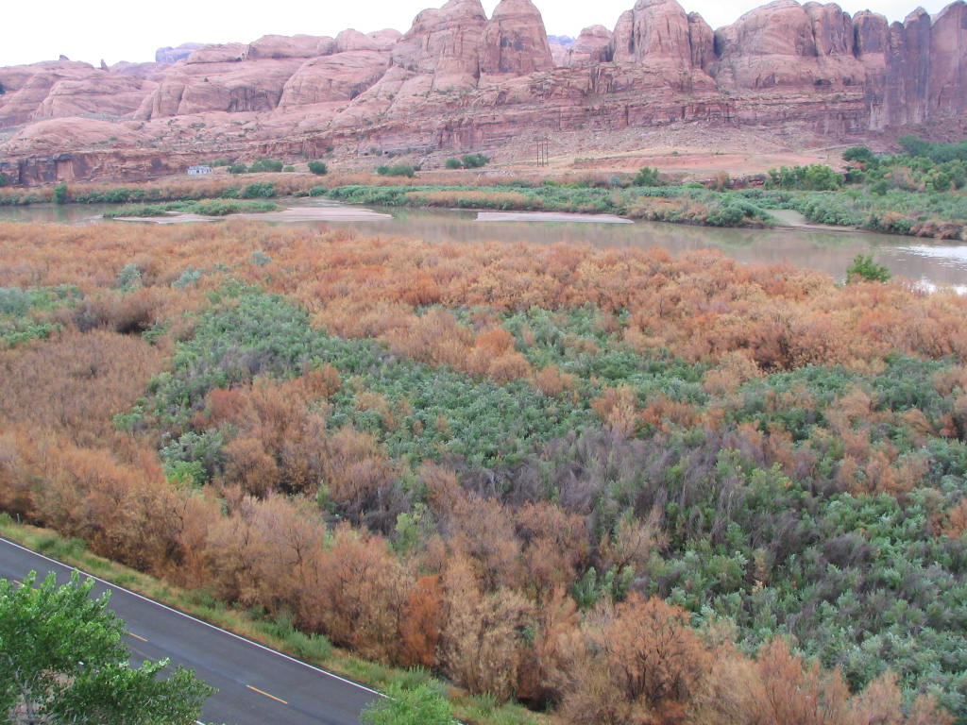
Beetle Browning 2008 at WB Site
Wright Robinson

Slide 4
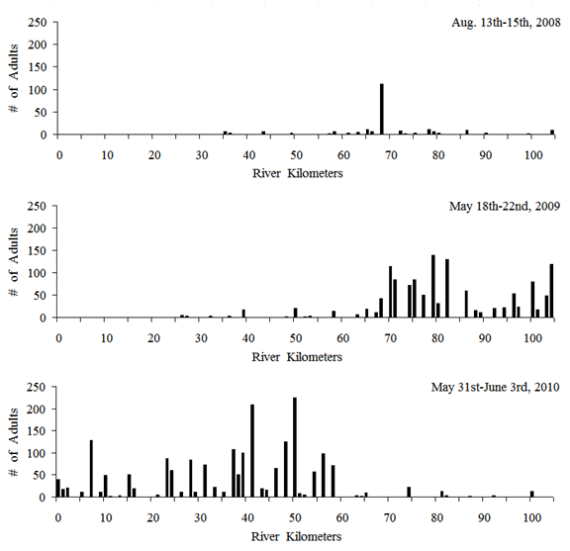
Beetles will defoliate Tamarix and the timing and frequency will be variable.
Beetles will move over large distances, periodically defoliating tamarisk stands, as illustrated by their movements on the Dolores River.
Jamison et al 2015

Slide 5
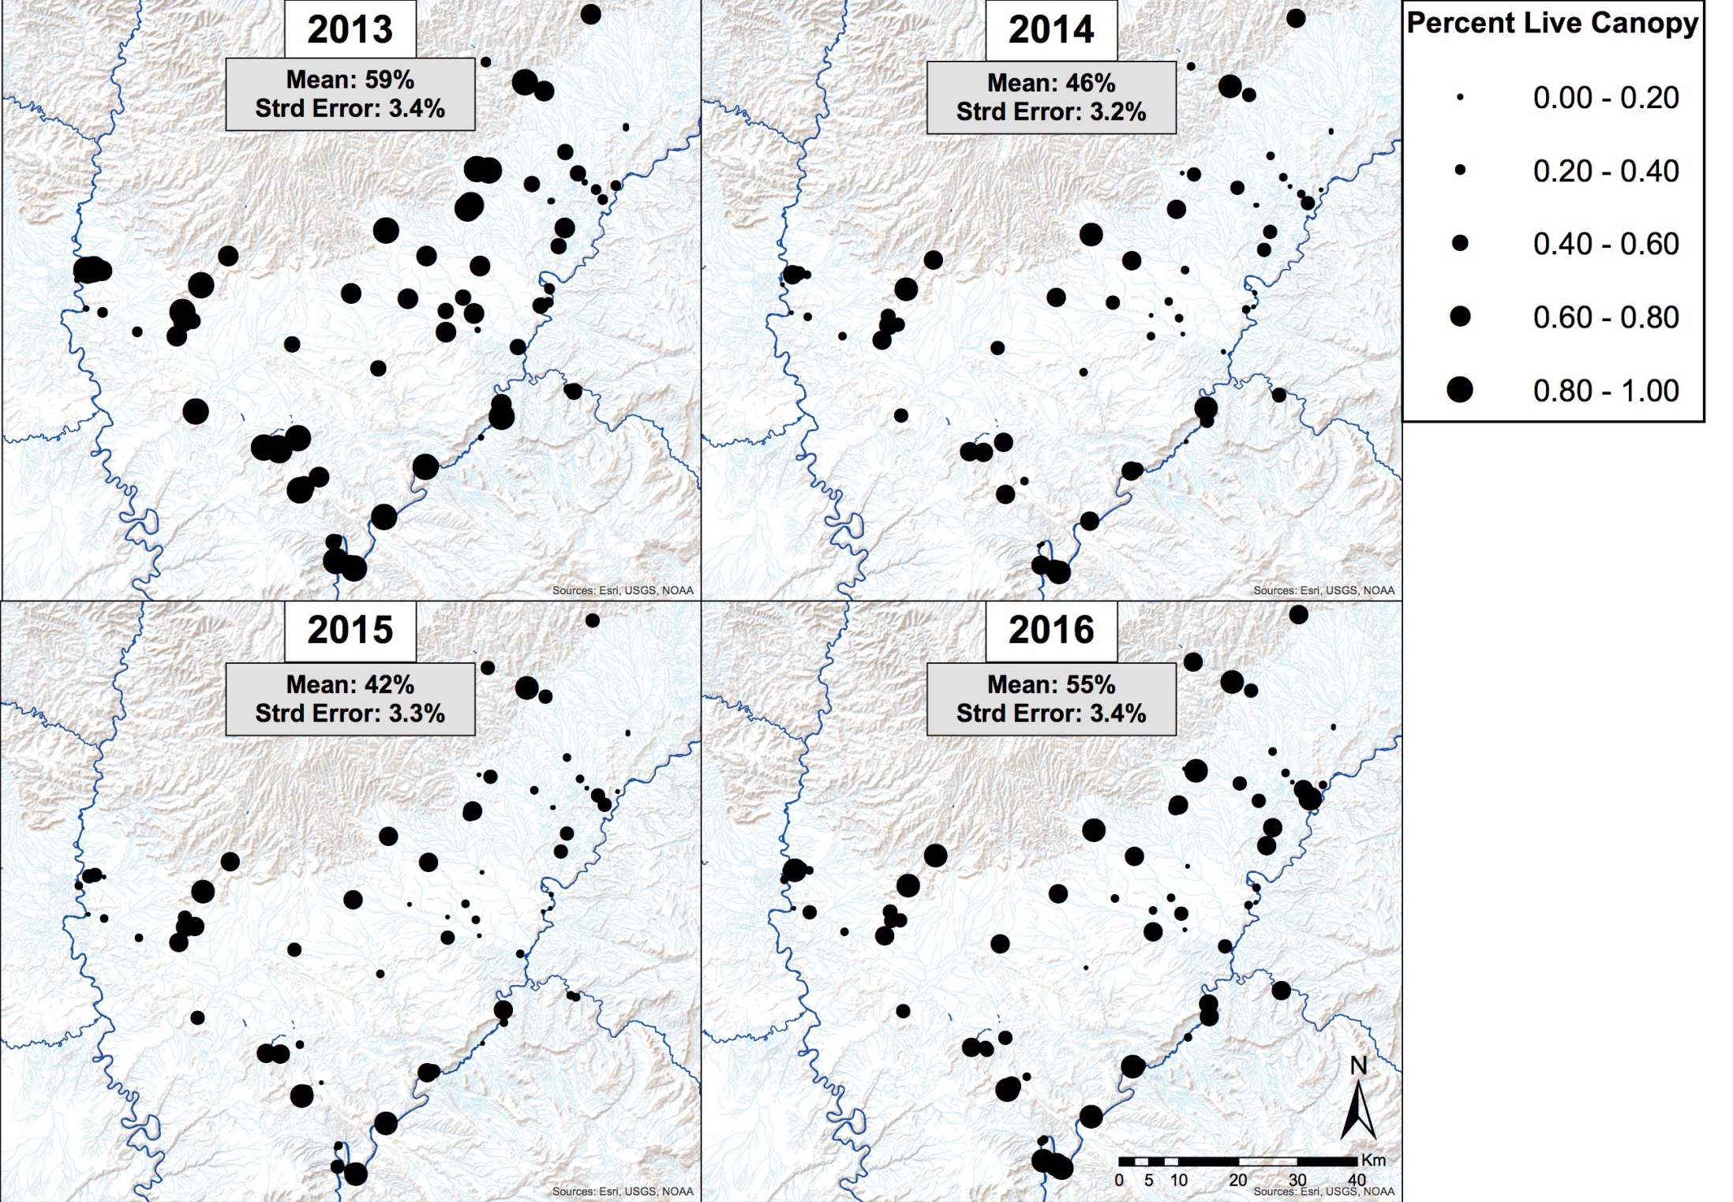

Slide 6
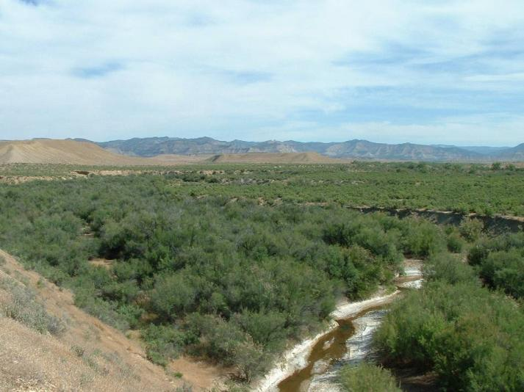
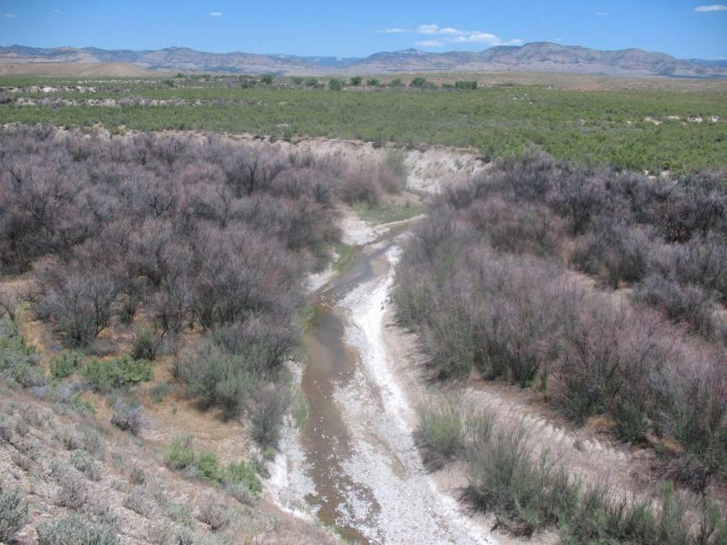
2007 pre-beetle
Stan Young ranch along East Salt Creek in Mesa County before and after beetles released.
2010 post-beetle
Notes:
Showing the before and after effects of the beetle.

Slide 8
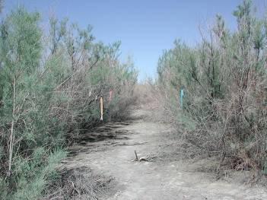
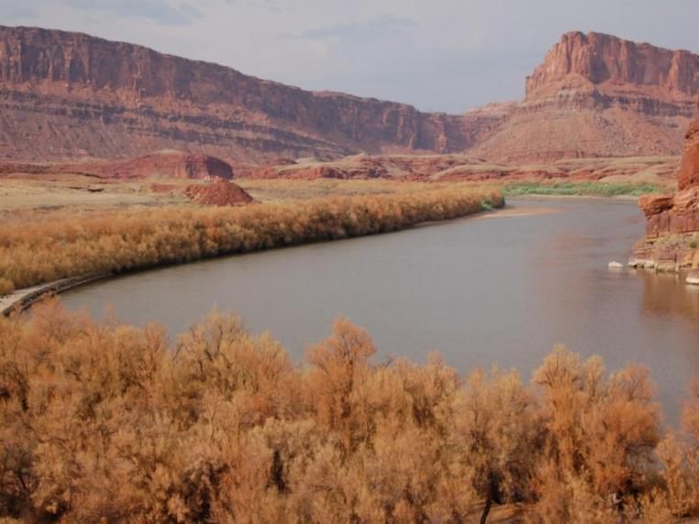
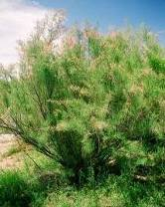
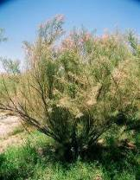
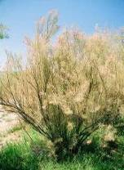
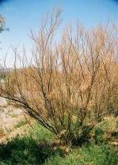
Impact Rapid & Dramatic
2003 Humboldt R, NV
But: Re-growth fast,
Dieback gradual &
Mortality slow
2007 Colorado River, UT
First Defoliation
June 11
June 22
June 26
July 9
Survival
Notes:
Initial impact dramatic, but only gradual dieback over several years

Slide 10
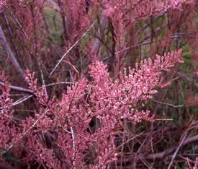
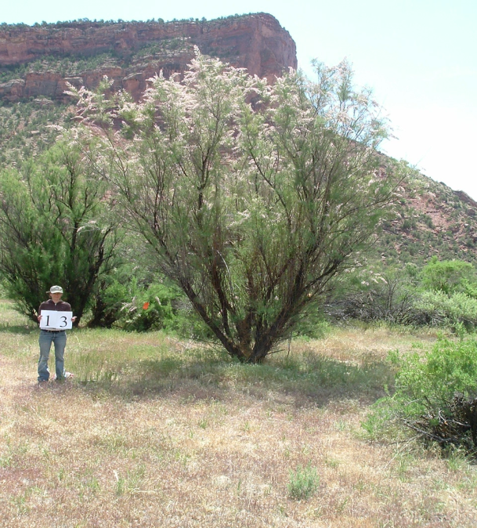
Decline in flowering/seed production
A marked tree representing the 40-60% flowering class

Slide 11
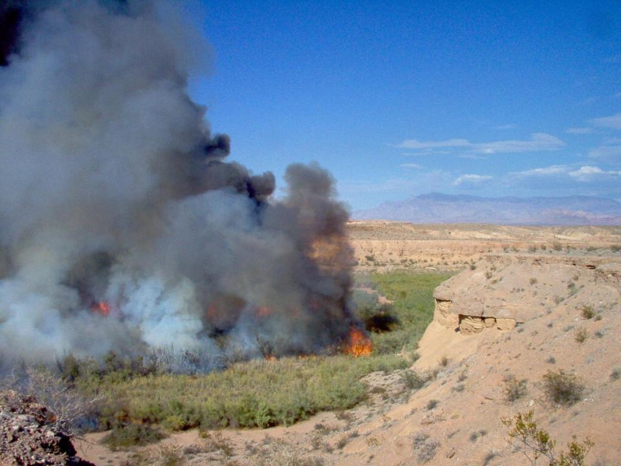
Valley of fire wash, S. Nevada Sept 2008
Avg flame Length 35m (114.8ft)
Avg ROS 11.7m/min (38.4ft)
Avg Tam removal 55%

Slide 12
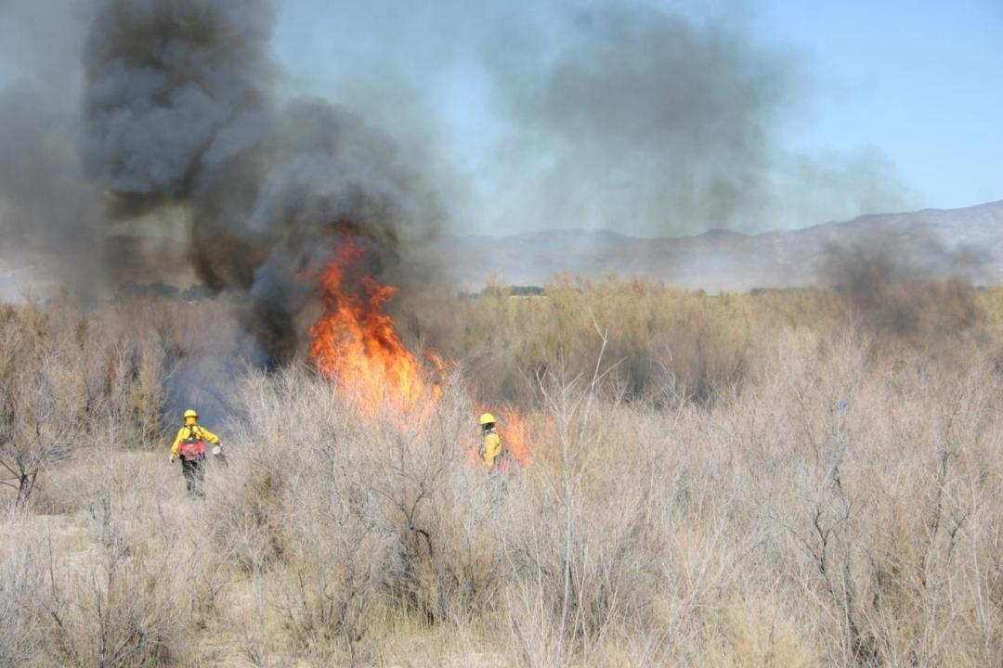
Humboldt Sink, N. Nevada Aug 2006
Avg flame Length 6.5m (21.3ft)
Avg ROS 10.4m/min (34.1ft)
Avg Tam removal 40%

Slide 13
In general:
Beetle impacts may slightly increase
possibility of ignition on the short-term
Beetle impacts greatly decrease fire
intensity and spread
Beetle impacts can combine with fire
effects to lead to higher mortality rates

Slide 14
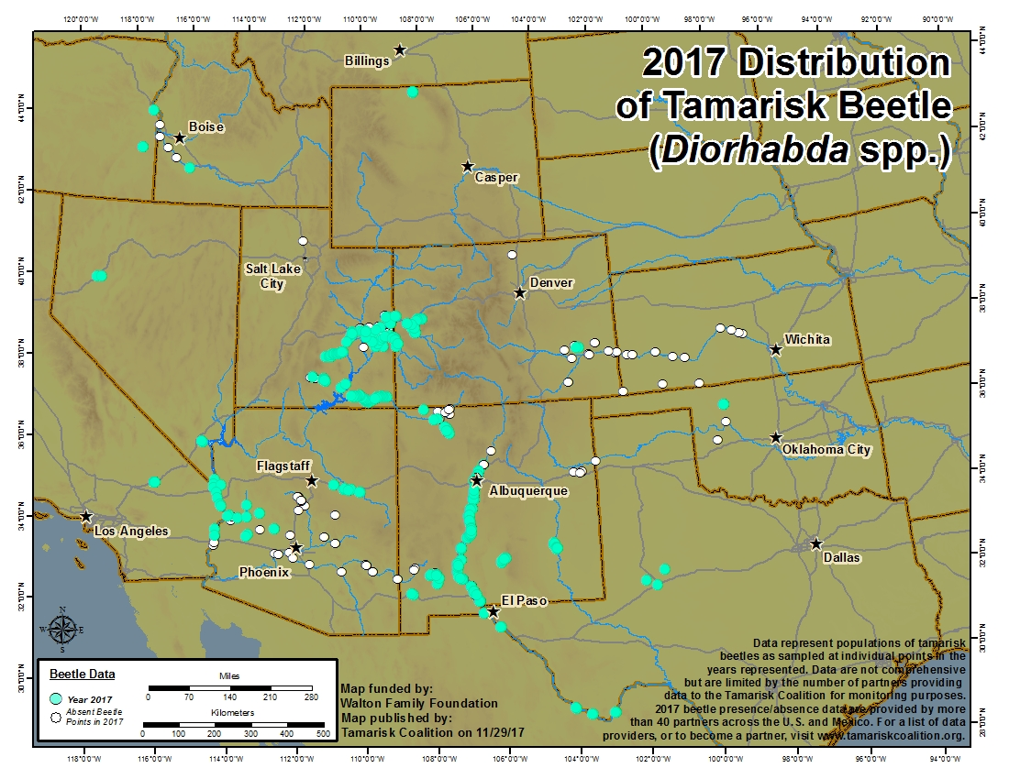

Slide 15
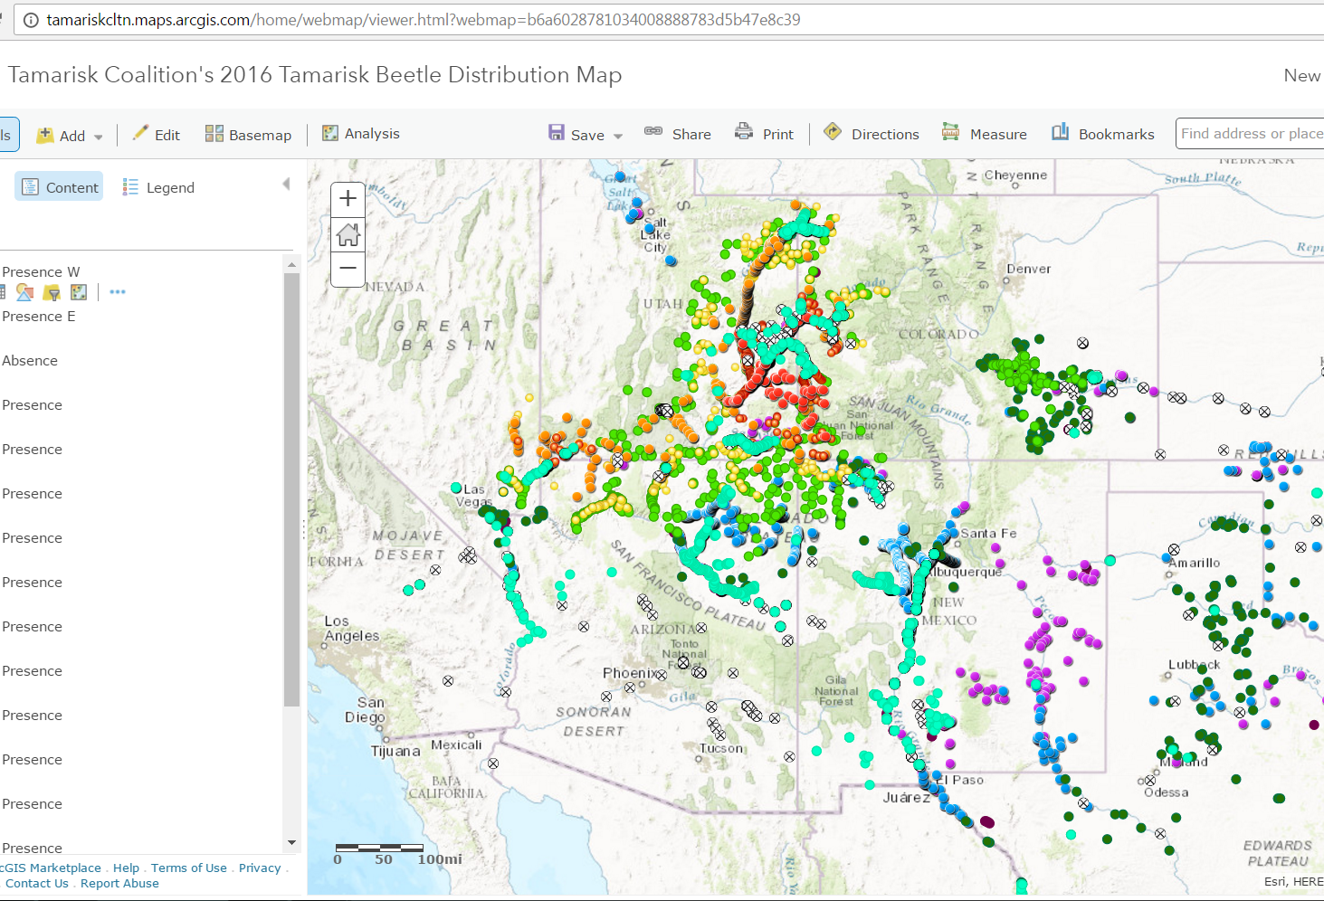
TC ArcGIS Online Map

Slide 16
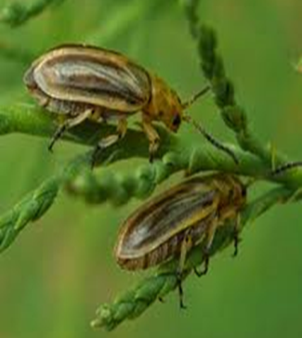
USDA Tamarisk Beetle Lawsuit
2001 USDA permitted release of the beetle, with expectation of movement seen in trials.
2010 APHIS sued by Center for Biological Diversity and Maricopa County Audubon for failure to protect SWFL as required by the ESA.
2016 Judge ruled APHIS failed to take adequate action to mitigate adverse effects of the beetle program termination – ESA 7(a)(1).
2017 Judge has not specified what is required of APHIS, but they are moving forward with multiple federal programs to implement restoration in SWFL areas.

Slide 17


Slide 18
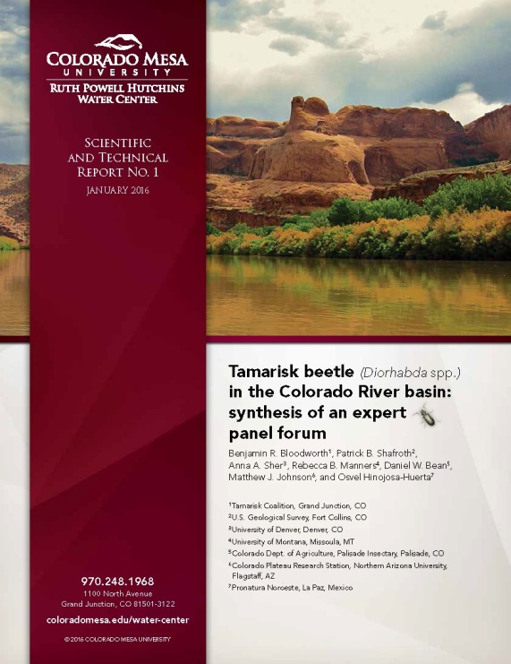
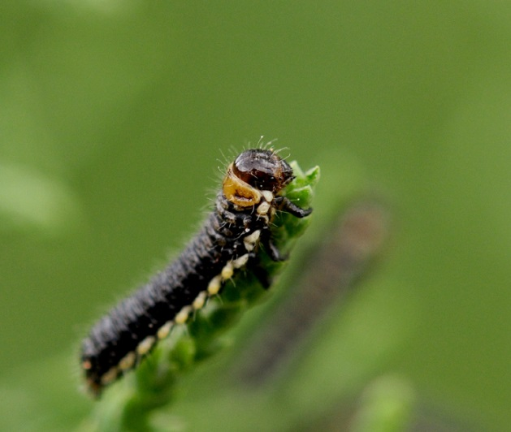
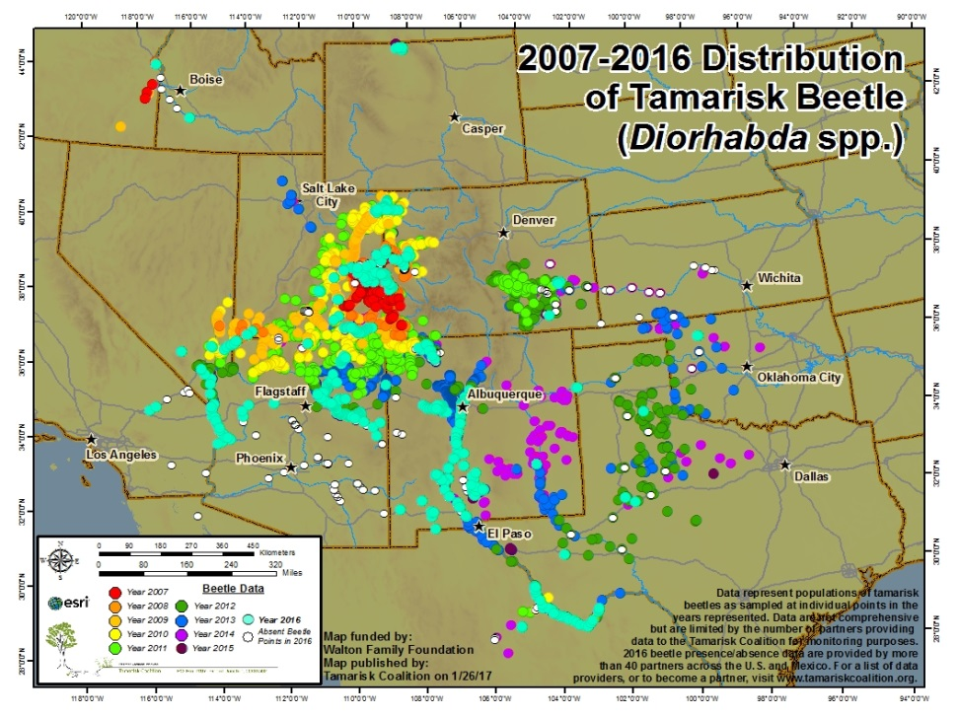
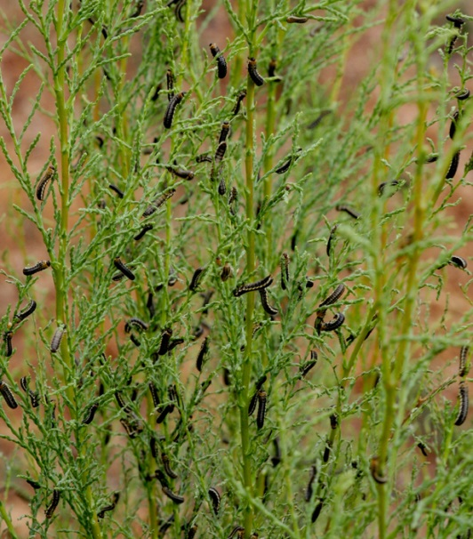
Contact Information
Ben Bloodworth
bbloodworth@tamariskcoalition.org
970.256.7400
www.tamariskcoalition.org

