Slide 1
2018 noxious weed list changes
Additions:
  Impatiens parviflora, small-flowered jewelweed - Class A
  Tussilago farfara, European coltsfoot - Class B
  Centaurea melitensis, Malta starthistle - Class B
  Myriophyllum spicatum x Myriophyllum sibiricum hybrid - Class C
  Impatiens capensis, spotted jewelweed - Class C
Reclassification
  Reclassify Thymelaea passerina, spurge flax, from a Class A to a Class B
Class B designation changes

Slide 2
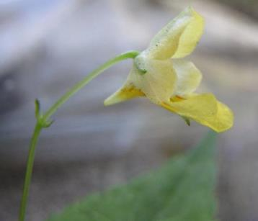
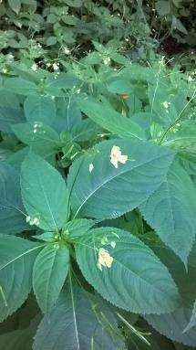
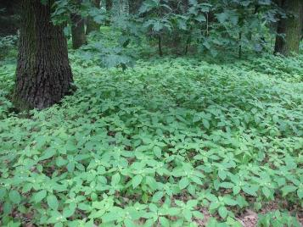
Impatiens parviflora, small-flowered jewelweed
Class A noxious weed
Native to Asia
Annual, hairless, up to about 1 meter
Leaves alternate, sharply serrated margins
Flowers one to several in upper leaf axils, pale yellow
  Also self-fertilizing flowers
Capsules, up to 1 inch, elastically dehiscent, 1 to 5 seeds
Spreads by seed, 220 seeds to 1,000-2,000 seeds per plant
Image by Alexander J. Wright
Image by Alexander J. Wright
Image by Tim Miller

Slide 3
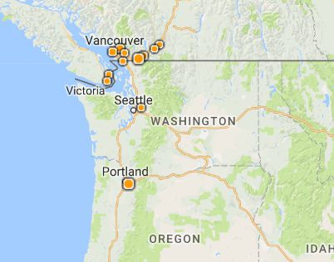
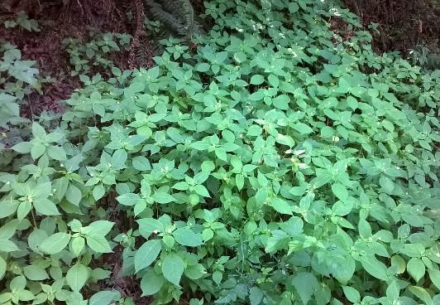
Small-flowered jewelweed
U.S.: Washington, Oregon, Wisconsin
  only two locations in King County
Grows in shade to part-shade, dry to moist soils: wooded areas, forest edges, paths, riverbanks
Invasive in Europe, widespread
Dominating herbaceous layer
Control
Hand pulling
Herbicide
Image by Alexander J. Wright

Slide 4
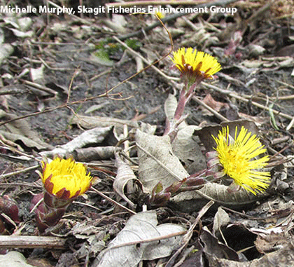
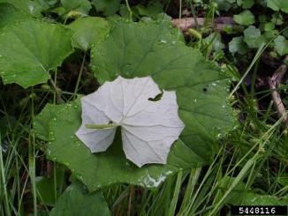
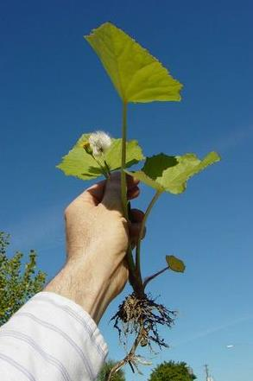
Tussilago farfara,
European coltsfoot
Leslie J. Mehrhoff, University of Connecticut, Bugwood.org
Class B noxious weed
Native to Europe, Asia, North Africa
Rhizomatous perennial 2 to 20 inches
Flowering stems grow first in spring
  Small leaves
  Tip of stem, yellow flowerhead, disk and ray flowers
Leaves sprout during to after flowering
  Basal leave grow from rhizomes, up to 11.8 inches long
    white-woolly below
Seed production varies depending on conditions
Image by Richard Old

Slide 5
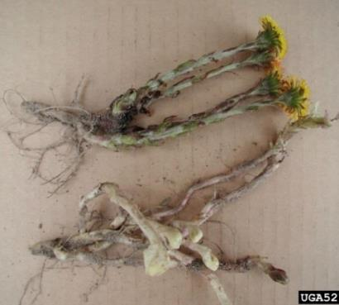
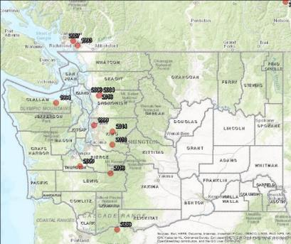
European coltsfoot
Open to shaded, disturbed environments
Spreads by windblown seeds or by rhizomes
Dispersed in agricultural fields by tillage equipment, in water along rivers.
  Rhizome fragment with one node can produce plant
Can invade and impact natural areas
  established in areas after knotweed treatment
Class B noxious weed; designated in WA except for Grant, Lincoln, Adams, Benton and Franklin counties
Control:
Small amounts: maybe dig out
Establish competition, reduce disturbance
Herbicide to fully emerged leaves, glyphosate
Leslie J. Mehrhoff, University of Connecticut, Bugwood.org
King County Noxious Weed Program

Slide 6
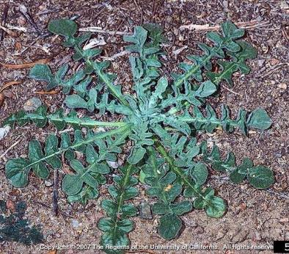
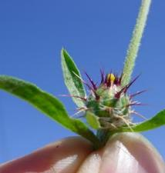
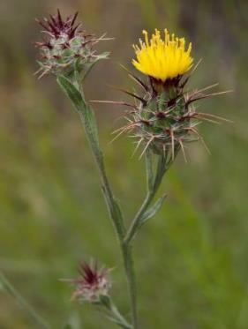
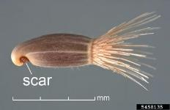
Centaurea melitensis,
Malta starthistle
Class B noxious weed
Native to Europe and Northern Africa
Annual, to 36 inches tall, loosely gray-tomentose, the stem with narrow wings
Leaves
  Basal and lower stem leaves: margins entire to dentate lobed, to 6 inches
  Middle and upper leaves smaller, linear-oblong and entire
Flowerheads solitary or in groups of 2-3; often with covered with cobwebby hairs; round-oval in shape
Principle bracts: tipped by spine 0.2 to 0.5 inches, purplish, spiny-fringed at base
All disk flowers; pappus 1.5-3 mm. long
Joseph M. DiTomaso, University of California - Davis, Bugwood.org
Image by: Rich Old
D. Walters and C. Southwick, USDA APHIS ITP, Bugwood.org
image by: Franco Folini

Slide 7
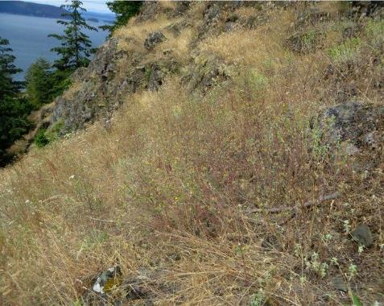
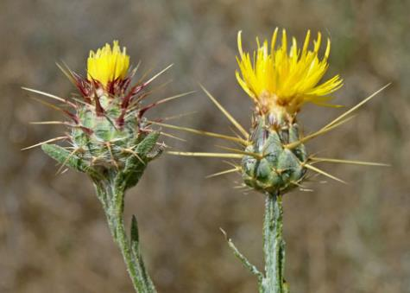
Malta starthistle
Washington:
  Most records prior to 1939
  Skagit County, Cypress Island (2016)
Survey: no other known at this time, but may be mistaken for yellow starthistle
Prefers disturbed and open areas, including grasslands, open woodlands, agricultural fields and roadsides
Less aggressive than yellow starthistle, it still spreads quickly by producing great quantities of seed if given the proper conditions
Class B noxious weed listing; designations same as yellow starthistle, Centaurea solstitialis:
  All of Washington except in Klickitat, Whitman, Benton, Franklin, Walla Walla, Columbia, Garfield, and Asotin counties, and a portion of Stevens County
Control methods similar to yellow starthistle
image by: Bud Hardwick
Image by Ron Vanderhoff
Notes:
Naturalized in Africa (other parts), Australia, New Zealand, United States, parts of South America (Argentina, Chile, Uruguay, Ecuador, Peru)

Slide 8
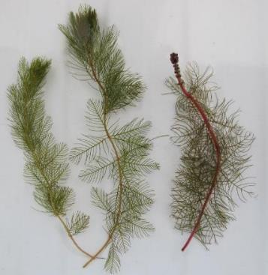
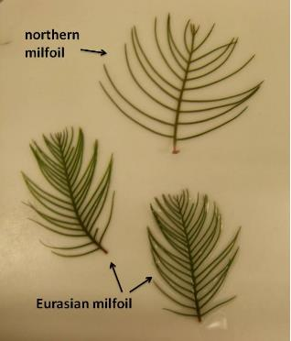
Eurasian watermilfoil hybrid
Class C noxious weed
M. spicatum: Class B noxious weed (native to Europe, Asia, North Africa) hybridizing with M. sibiricum, northern watermilfoil.
Many hybrid strains
Two hybrid watermilfoil stems on the left and one northern watermilfoil stem on the right, plants from Loon Lake, Stevens County
Images by Jenifer Parsons, DOE

Slide 9
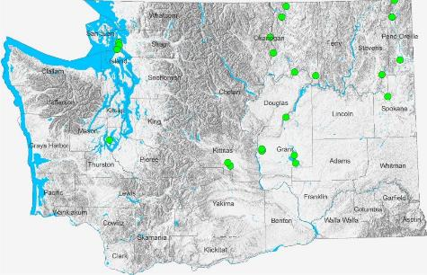
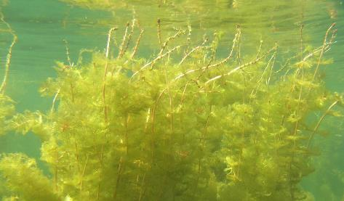
Eurasian watermilfoil hybrid
Genetic and morphological analysis is needed for confident ID
Commercial lab conducting analysis
Hybrids documented in Washington: pretty widespread, more in eastern WA
  Douglas/Okanogan County: Rufus Woods Lake
  Okanogan: Buffalo Lake, Leader Lake, Osoyoos Lake, Spectacle Lake, Conconully (Salmon) Lake
  Grant County: Blue Lake, Burke Lake, Corral Lake, Evergreen Lake, Stan Coffin Lake, Moses Lake
  Kittitas County: Fiorito Ponds, Mattoon Lake
  Pend Oreille County: Boundary Reservoir, Davis Lake, Pend Oreille River
  Pierce County: Bay Lake
  Skagit County: Campbell Lake, Heart Lake (35N-01E-36)
  Spokane County: Nine Mile Reservoir
  Stevens County: Loon Lake
  Island County: Cranberry Lake
Jenifer Parsons, Dept. of Ecology
Image by Dave Lamb

Slide 10
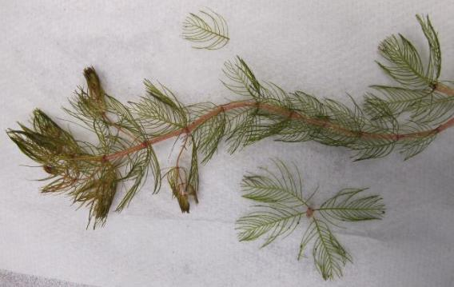
Eurasian watermilfoil hybrid
Many negative impacts of Eurasian watermilfoil, aggressive strains of hybrid watermilfoil.
Not all strains of hybrid are bad actors; pretty widespread
Department of Ecology—testing information
Grant funded projects that can include multiple test
Image by Jenifer Parsons, DOE
Notes:
Funding for testing, check with Jen

Slide 11
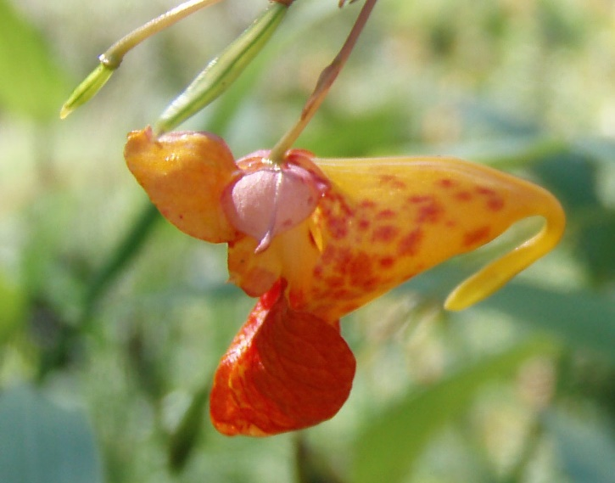
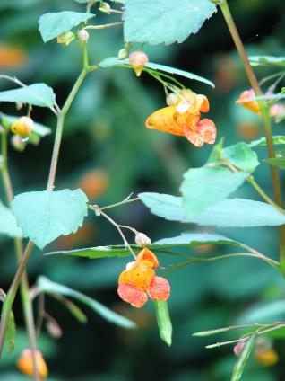
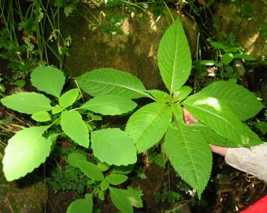
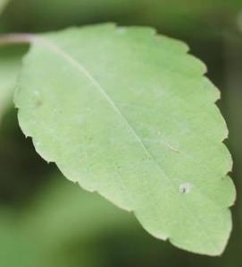
Impatiens capensis, spotted jewelweed
Image by King County NWCB
Class C noxious weed
Native to eastern U. S. and Canada
Glabrous annual, up to about 4.9 feet
Alternate leaves, margins scalloped with sharp points
Two kinds of flowers
Flowers have recurved spurs, are typically spotted
Capsules, about 1 inch long, explosively open and propel seeds a short distance
King County NWCB
Rob Routledge, Sault College, Bugwood.org
Image by Whatcom County NWCB
Notes:
Added to the Monitor List in 2011

Slide 12
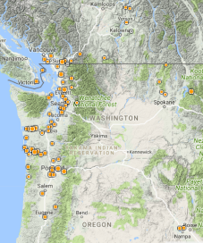
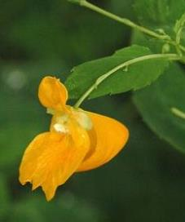
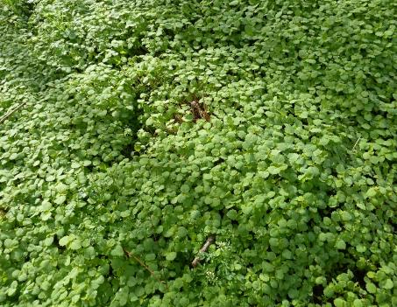
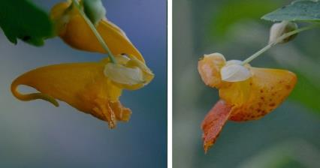
Spotted jewelweed
Image by Ben Legler
Moist soils in forests, lake and pond edges, riverbanks, sloughs, disturbed wetlands and sunny roadside ditches or canals
Primarily western Washington
Impatiens capensis and Impatiens ecornuta, spurless jewelweed, hybridize to produce Impatiens x pacifica
Can survive in tough, variable conditions
Populations noted as increasing in Washington
  Being found in areas of knotweed control
Control
Hand pull
Herbicide
Image by Warren Gold
©2016 Ryan Batten

Slide 13
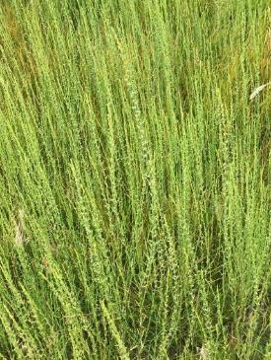
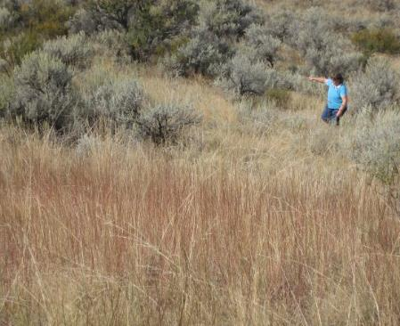
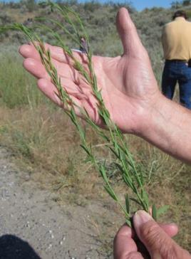
Reclassification:
Thymelaea passerina, spurge flax: Class A to Class B noxious weed
Class B noxious weed designated for control in eastern Washington except Okanogan County
Listed as a Class A noxious weed in 1999; WSDA Quarantine list
Images by Larry Hudson

Slide 14
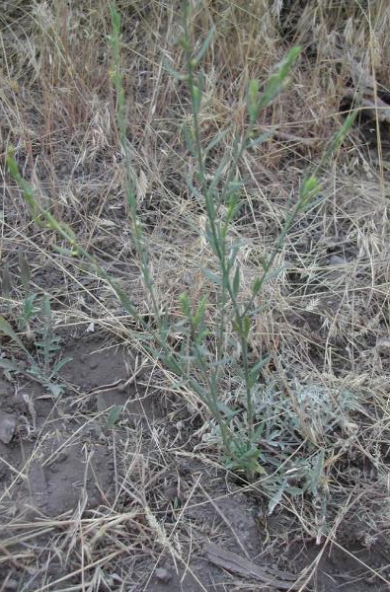
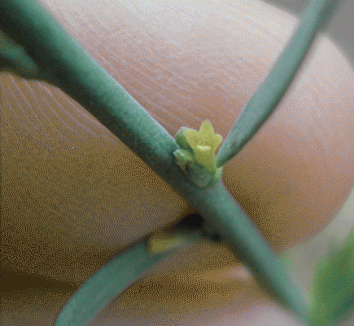

Spurge flax,
Thymelaea passerina
Native to parts of northern Africa, Asia and Europe
Annual, up to 24 inches tall
Yellowish-green stems, turn red in fall
Leaves alternate, narrow
Small greenish-yellow flowers
Capsules, spreads by seed
Grows in rangeland areas, disturbed sites and dry pastures
Weed in grain crops; animals do not graze
Spreads quickly

Slide 15
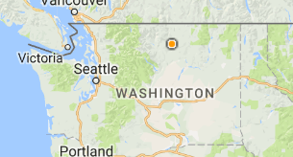
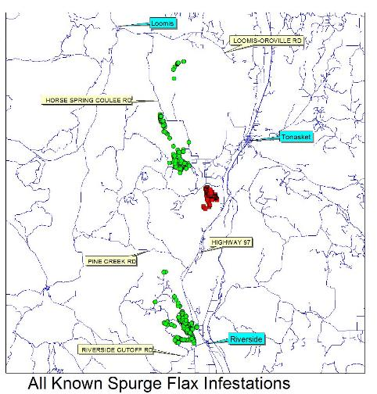
Spurge flax reclassification
Hard to find
Difficult to control
New populations keep being found (2010, 2011, 2016)
  Wildfire (2013, 2015)
  As of 2016, ~10,560 acres infested (in 2004, 130 acres)
New! 2017 new infestation ~800 acres infested (~30-50 acres of treatment)
Many vectors of spread in infested areas (ATV/ORV, wildlife, hunters, fire suppression vehicles)
Class B noxious weed, designated in eastern Washington except Okanogan County
*Red squares are new locations of spurge flax found in 2017

Slide 16
Economic Impacts of Select Invasive Species

Slide 17
Top Five At Risk Counties

Slide 18
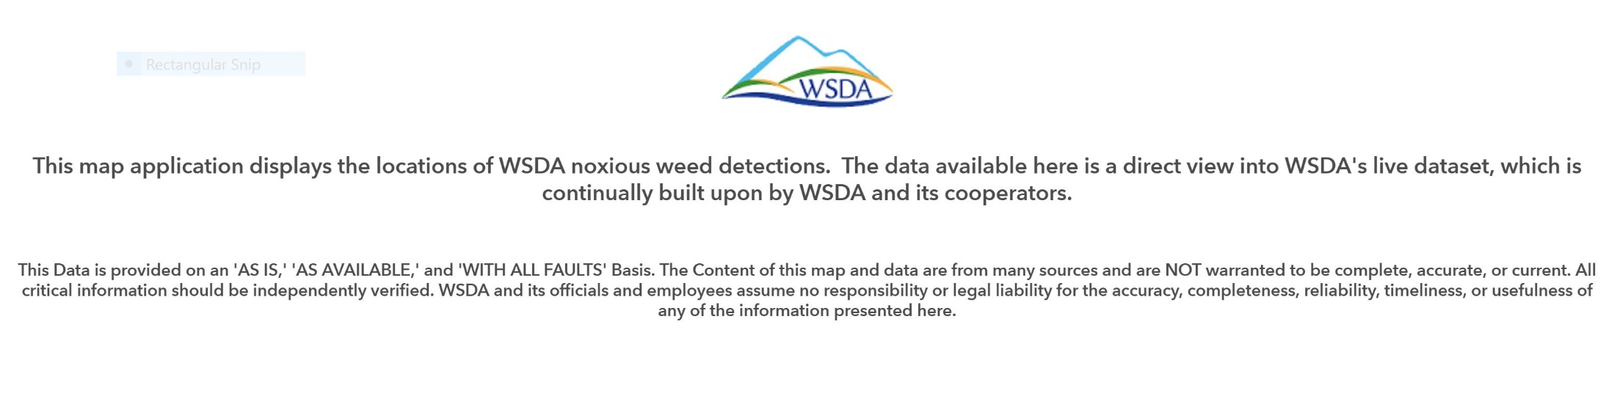
Online Public Weed Data Viewer

Slide 19
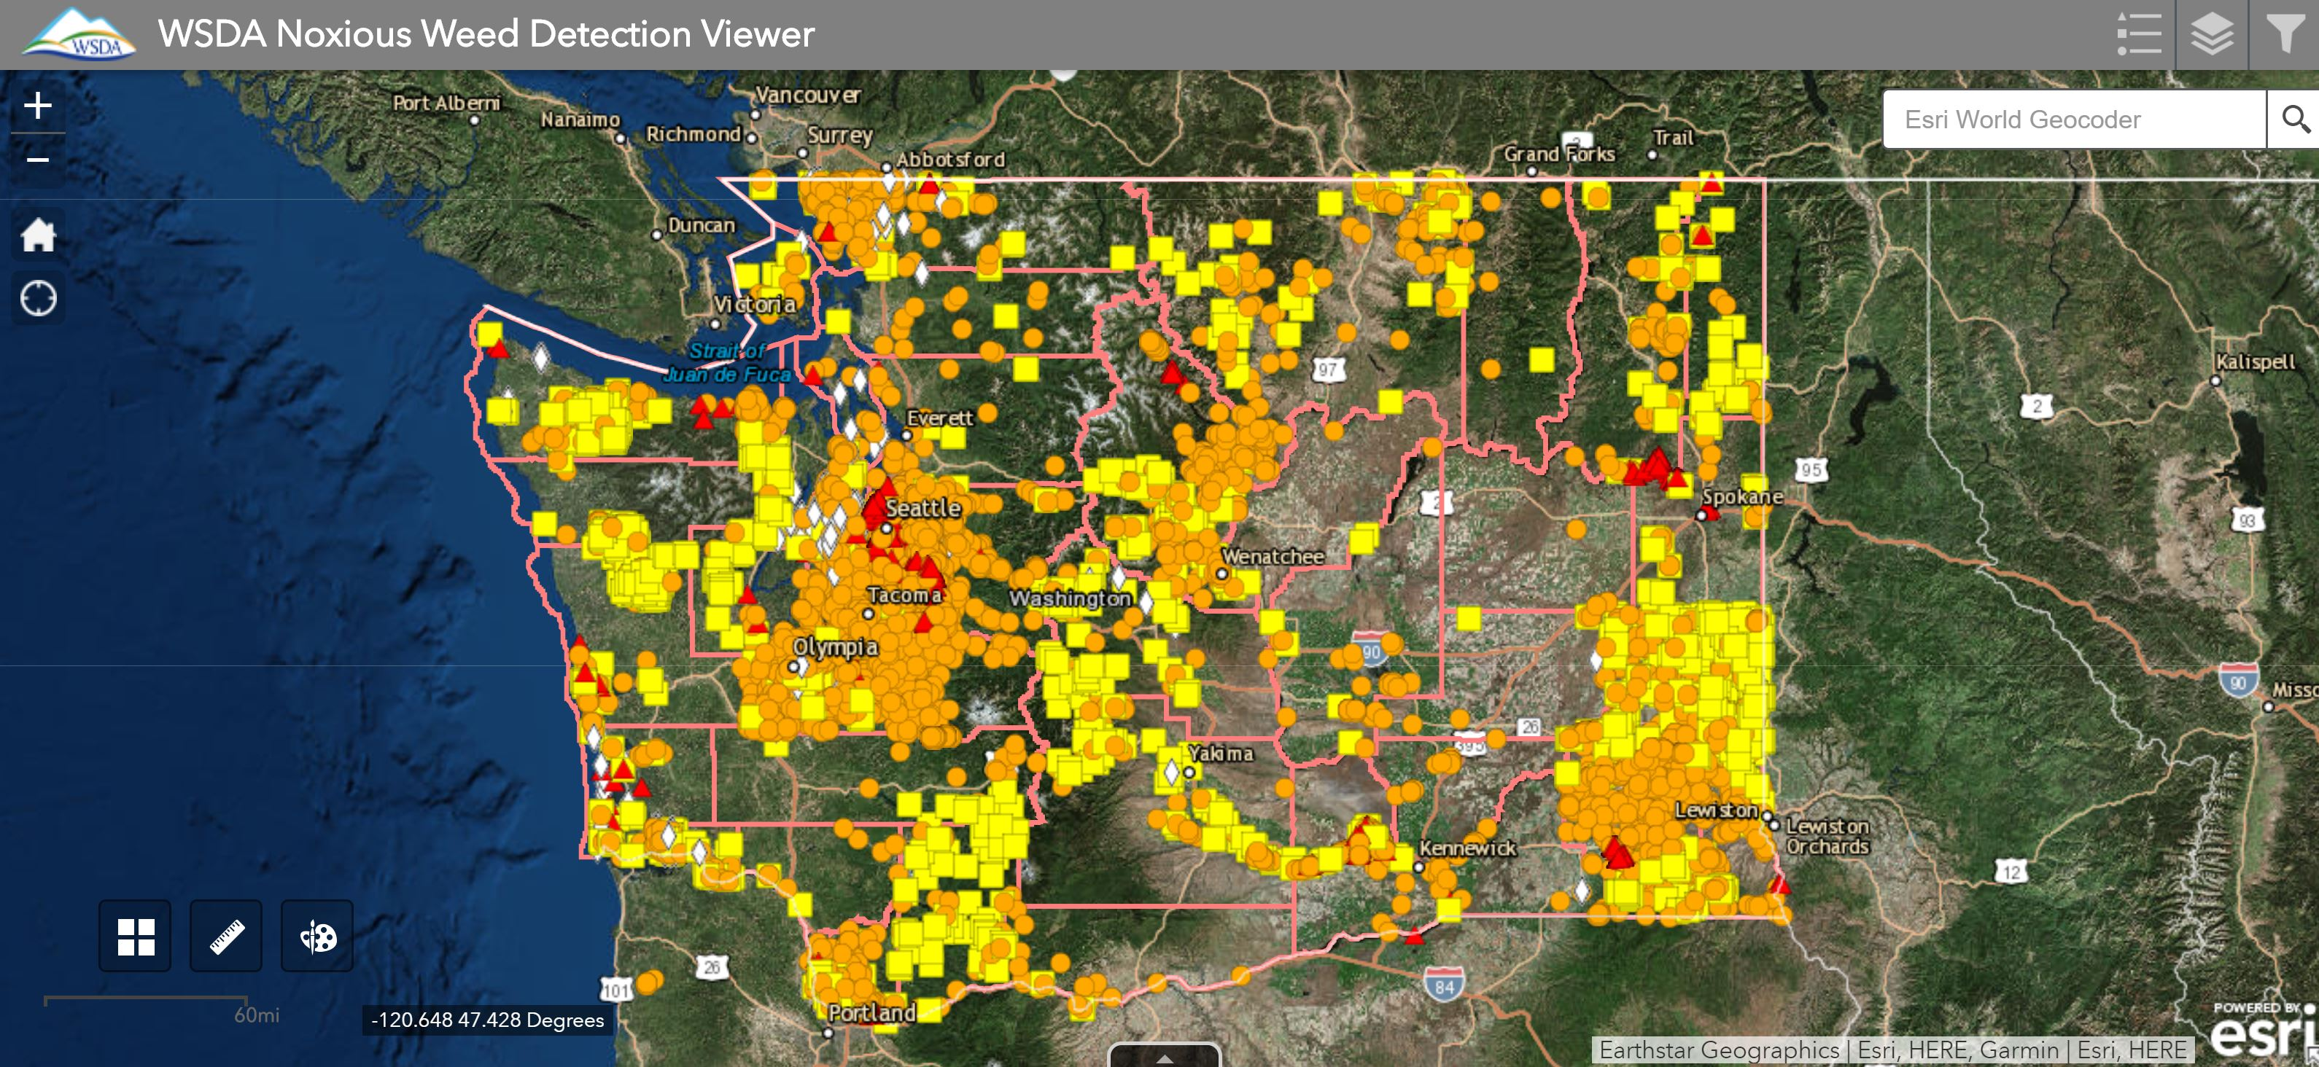

Slide 20
